Slide 1



Where’s My Paper ?!
Global Paper Supply Shortage & How Marketers Are Responding
March 3rd 2022

Slide 2
Today’s Agenda:
  Who we are: CNG’s Interest in Global Paper + Pulp Markets
  How did the Paper Market get here?
  External Market Factors
  Trends Moving Forward
  How Marketers Are Successfully Navigating Current Conditions
  Q & A

Slide 3

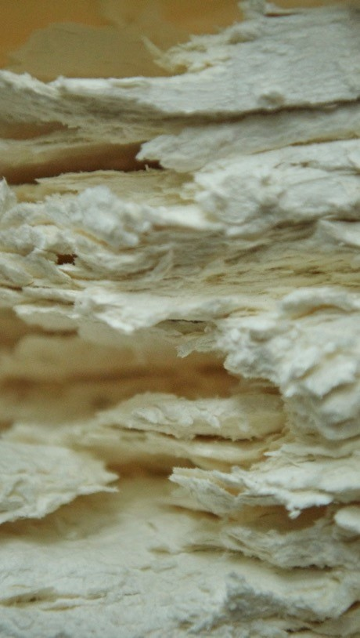


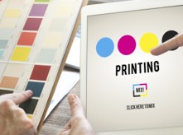


3,000
CONSULTING DIVISION
PRIVATELY OWNED
CONSULTING DIVISION focused on solutions that help achieve our clients’ business objectives.
and operated since 1886 by the founding family.
Professionals around the
world to serve a range of
clients and industries.
Show performance by tactic with comparisons to plan / prior time period(s)
DIRECT TO CONSUMER
$7 BILLION
PRINT SOLUTIONS
Deep expertise in helping retailers, catalogers, direct to consumer brands and others look their best in print.
Global sales of $7.0 billion and nearly 8 million tons of products annually - paper, packaging, pulp, tissue and metals.
PRINT & DIGITAL MARKETING
Direct mail, inserts/ onserts, search, social, affiliate, programmatic, data & analytics.

Slide 4
Our Core
Brands and Businesses
Strategic Mill -> End User Paper Procurement serving Retailers, Catalogers, B2B and DTC brands.
Digital + Offline Direct Marketing Agency
Print and Postal Consulting, Print Production Solutions
North American Paper & Packaging Distribution Solutions
Global Paper, Packaging and Print Solutions
Corporate Print Management

Slide 5
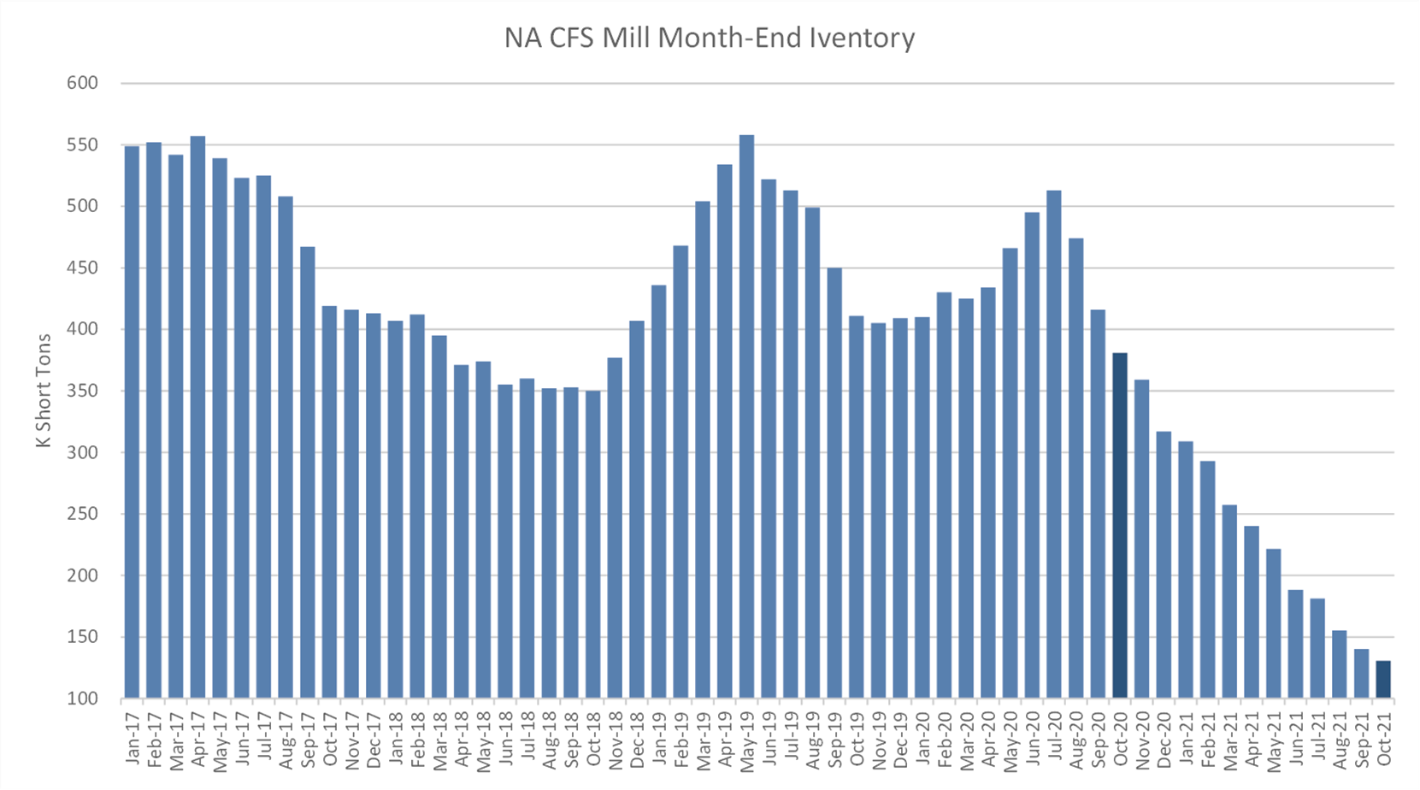
Paper Market Conditions – Big Picture
Overview
All graphic paper markets are Oversold.
Supply Decline Accelerated with Machine conversions in 2020-2021
  Evergreen, Sappi, ND, Verso, UPM, Stora Enso & SCA have all reduced supply
Paper manufacturers are operating on an Allocation System and Inventory at Historic Lows
Most mills are Significantly Behind & Shorting Orders
Surcharges are the norm for 2022
Mill Cost Inflation:
  Pulp prices are up 40%
  The Global Freight Rate index is up 341% year over year (container shortage is a challenge)
  Crude Oil is up 82%
  Recovered paper availability in Europe at All Time Low
  Natural Gas prices in Europe have Doubled since Summer
  Labor Shortages impacting both manufacturing and logistics

Slide 6
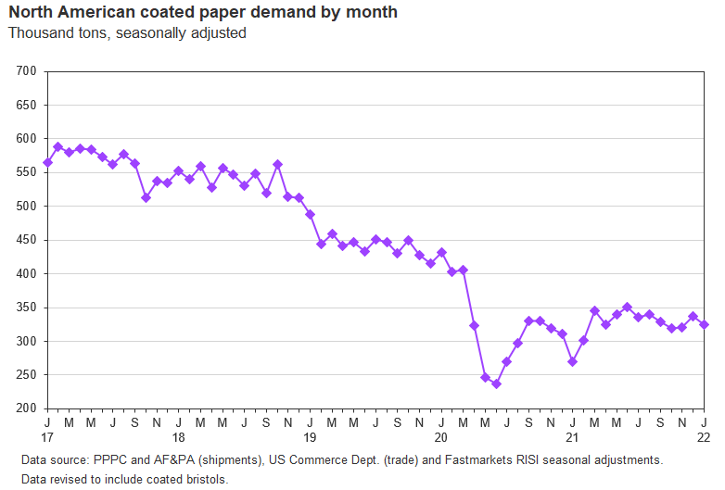
Paper Market Update – 5-year Demand Trend
DEMAND has recovered most of its pandemic losses. After a brief pause at the end of 2021 RISI expects a more complete demand recovery to be unlocked as vaccinations progress and the economy begins to normalize in 2022.

Slide 7
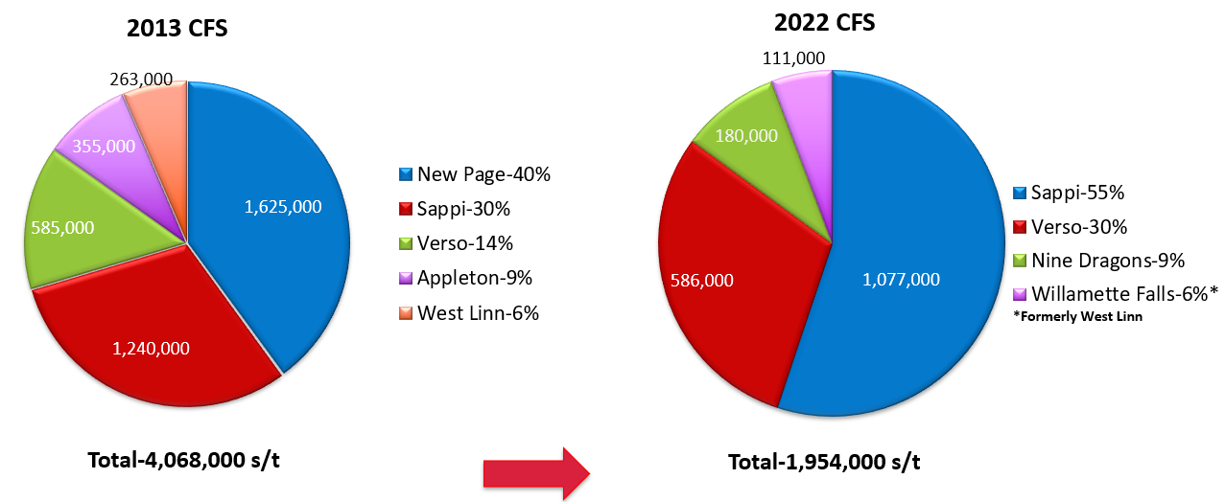
Paper Market Update – Supply Reductions
SUPPLY: North American Freesheet capacity reduced by over 52% since 2013

Slide 8
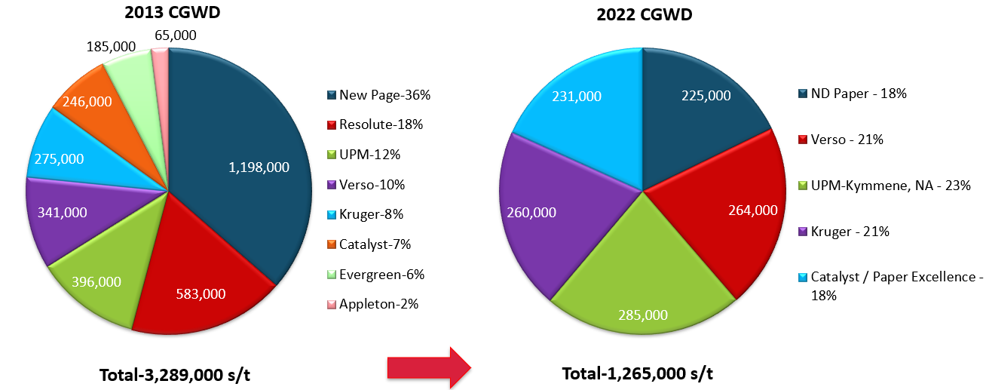
Paper Market Update – Supply Reductions
SUPPLY: North American Coated Groundwood capacity reduced by over 61% since 2013

Slide 9
Paper Market Update – NA Paper Assets
NA CFS Capacity: -75% since 1999
NA CGW Capacity: -77% since 1999
Source: RISI

Slide 10
Paper Market Update – Global Supply

Slide 11
Current Paper Market Conditions – Pricing
Price increases from the mills have continued for all grades of paper.
Paper prices across the board increased between 20-30% in 2021.
Heavy input cost inflation is the main driver of mill price increases: market pulp, transportation, energy and labor.
Suppy / Demand imbalance favoring producers are expected to drive further price increases.
Source: RISI

Slide 12
UPM and the Finnish Paper Workers Strike
The Finnish Paperworkers’ Union is on strike at UPM mills in Finland, inclusive of the Kymi, Kaukus, Jämsänkoski, and Rauma mills.
There have been multiple extensions announced so far with the most recent extending it by two more weeks until 2 April 2022, unless a new agreement is reached earlier.
Impact on Supply
According to RISI, UPM produces 980,000 MT/year of Coated Mechanical in Finland, which equals about 53% of UPM’s European CM production and 18% of total European CM capacity.
UPM also produces 350,000 MT/year each of SC and WFC in Finland, which equals roughly 28% and 29% respectively of UPM’s European SC and WFC production, and 8% and 7% respectively of total European SC and WFC capacity.
The supply disruption caused by the strike, even if short-lived, will create even greater tightness in the global graphic paper market.
What end users need to know
Any orders that were entered with UPM to be produced at a Finnish mill with requested delivery dates of mid-February through 3/31/22 could be impacted.
There is a chance that orders with earlier delivery dates will also be affected, but this has not yet been confirmed.

Slide 13
UPM Strike - Impact
Based on the December 2021 RISI Paper Import Statistics:
  Finland represents 33% of coated mechanical imported volume (#4/#5) to the U.S.
  Finland represents 6% of the uncoated freesheet imported volume to the U.S.
  Finland represents 10% of the uncoated mechanical imported volume to the U.S. (SCA+/SCA++)
  Finland represents 21% of the coated freesheet imported volume to the U.S. (#2/#3)

Slide 14
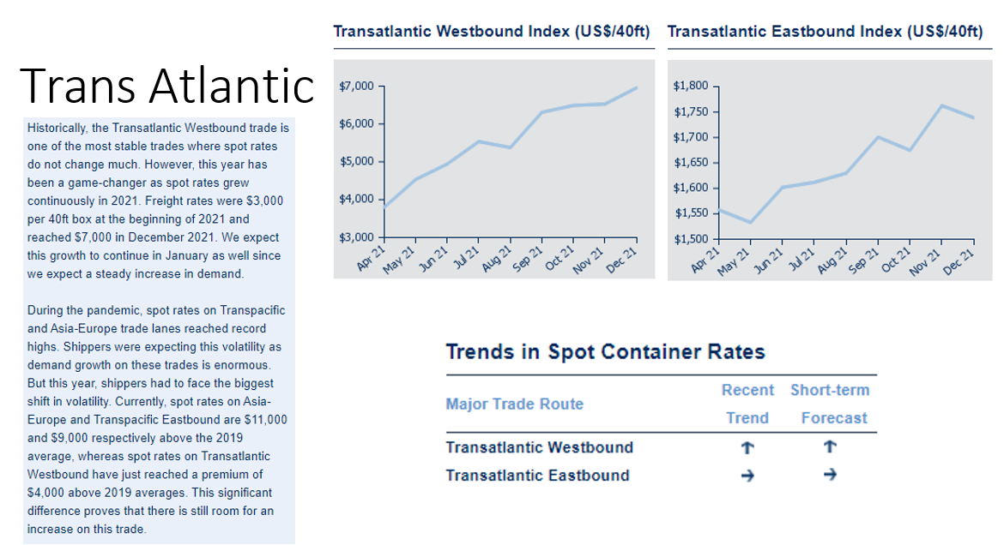
External Market Forces – Import & Export

Slide 15
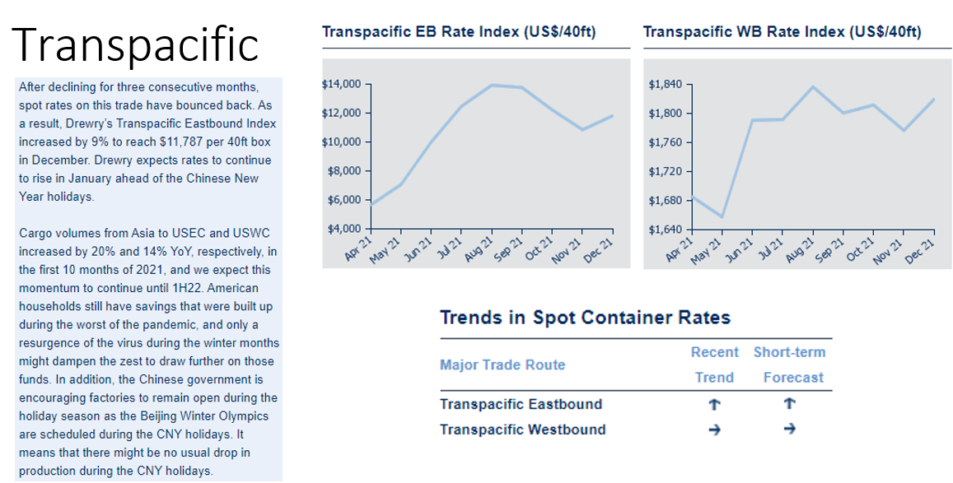
External Market Forces – Import & Export

Slide 16
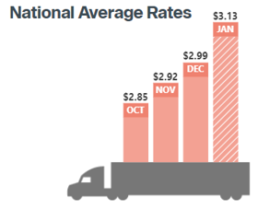
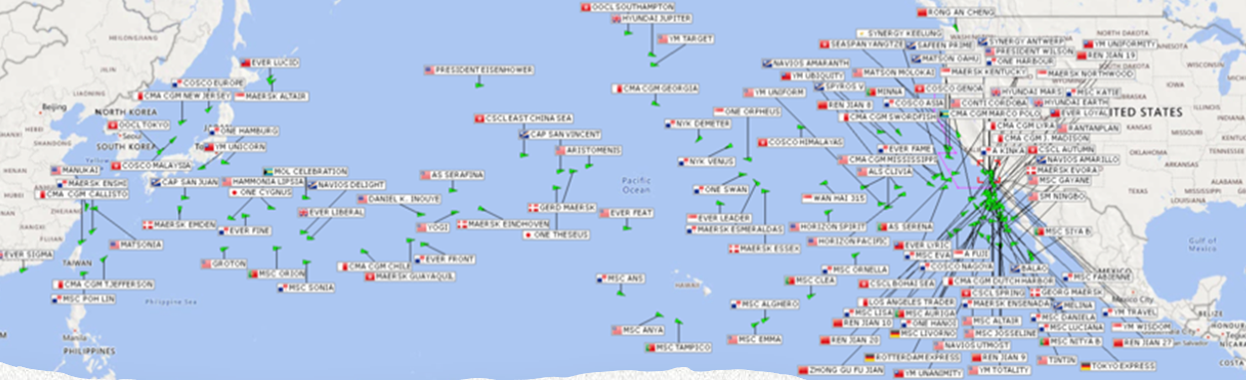
External Market Factors – Other
COVID-related labor shortages:
  Printers
  Truck Drivers
  Dockworkers
US West Coast longshoremen renegotiation - Q1/2 of 2022
Global Energy Supply
Geopolitical Climate
Direct to Consumer Corrugated Demand
Single use Plastic Regulation

Slide 17
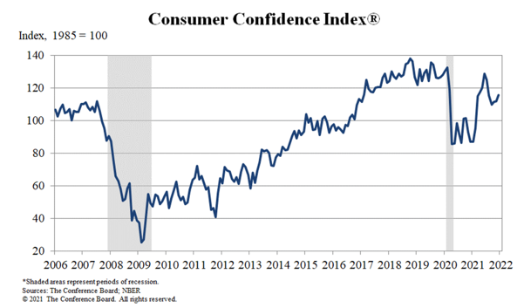
Trends to Watch Moving Forward…
Consumer Confidence & Expectations remain high
Global Economic Impact of Russia-Ukraine
Digital Marketing efforts become more statistically reliable but significantly more expensive
USPS Regulation & Postage Increases
Stabilization of Supply-Demand of Paper Market Q4 2022 -> 2023
ROAS Print Media Relative to Digital

Slide 18
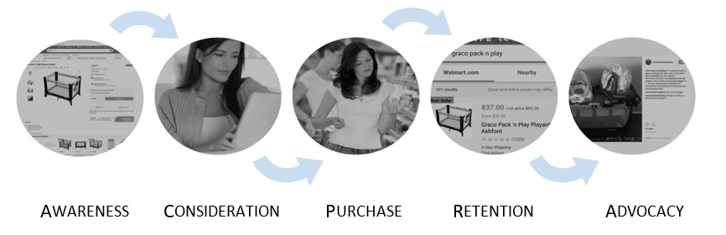
Marketers Navigating the Headwinds...
From Full-range Catalogs to Targeted Direct Mail
Clever Interplay between Offline and Online Efforts
Understand your key retention metrics: RR%, Attrition%, CPA, Lifetime orders (solo) vs. Lifetime orders (multis)
Programmatic Direct Mail:
  New to File Retention Programs - Win the 2nd Purchase
  Abandon Browse/Cart Retargeting - Speed to Market
  Premium Loyalty - Paying Customers are Loyal Customers
The Rise of Direct to Consumer - Digital Natives turning to Print
Improved Focus & Accuracy on the Customer Journey:

Slide 19
THANK YOU
Michael Streit
mstreit@lindenmeyrcentral.com
+1 646 573 2469
Advocacy:
American Forest & Paper Association
https://www.afandpa.org/

