Slide 1
Analyzing Market Segments with Google Analytics – How do I help students make sense of web data
Daniel Shen, PhD
Professor of Marketing
SUNY New Paltz School of Business

Slide 2
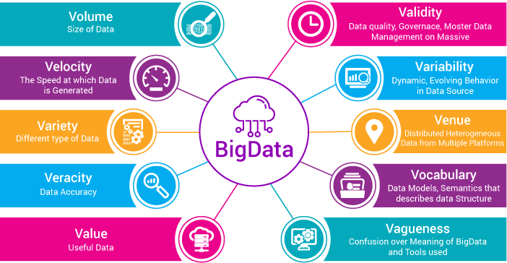
From Customer Data to Customer Insights
Customer data
Customer insights
Notes:
Data: megabyte – gigabyte – terabyte – petabyte
Data storage: data file – database – data warehouse – data swamp

Slide 3
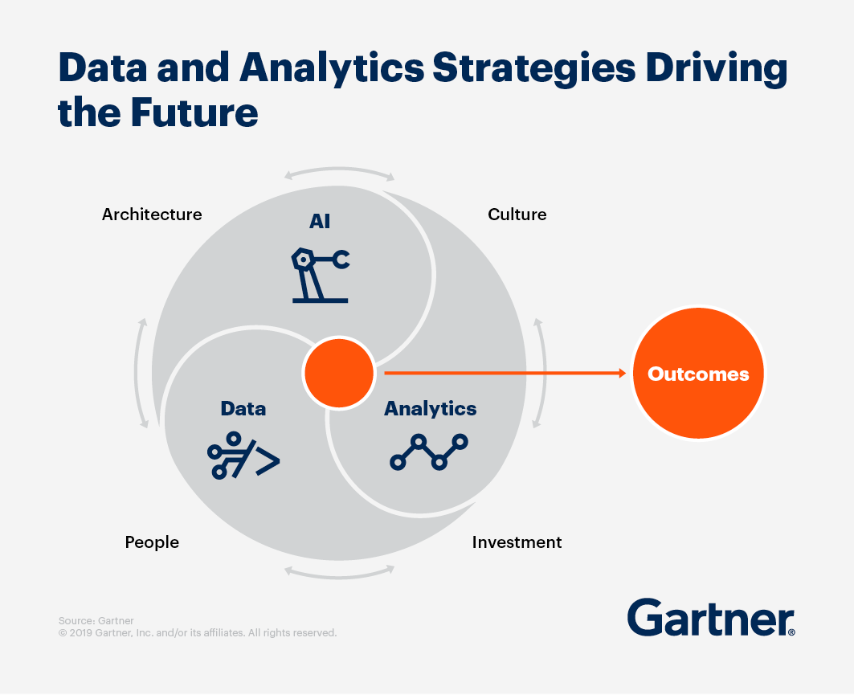
From Customer Data to Customer Insights
Customer data
Customer insights
“If we wanted to figure out that a customer is pregnant, even if she didn’t want us to know, can you do that?” (NYT 2012)
Andrew Pole’s pregnancy-prediction model helped sales of mom and baby products at Target
What people do we need? How to educate business students for future careers?

Slide 4
Data Analytics in Business Education
In 2018, AACSB International estimated 400 analytics degree programs and increasing rapidly
Mostly within established disciplines (statistics and operations management)
Also involving faculty from marketing, finance, accounting, management and organizational behavior
Core skills
Quantitative (stats foundation)
Data management (dirty secret)
Business knowledge and design (business foundation)
Relationship and communication (Analysts who can “tell a story with data”)
Source: The State of Analytics Degrees in Universities (Davenport 2018)

Slide 5
SUNY New Paltz School of Business
State school with most students coming from Hudson Valley, NYC, and the Tri-state areas
Students with diverse backgrounds
Ranked 49th out of 1,449 U.S. colleges and universities in the 2020 Social Mobility Index, which evaluates schools’ ability to provide economically disadvantaged students with opportunities to succeed.

Slide 6
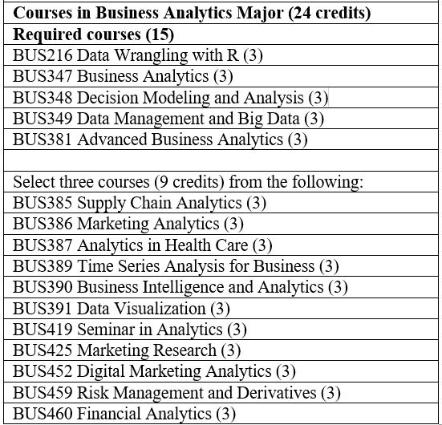
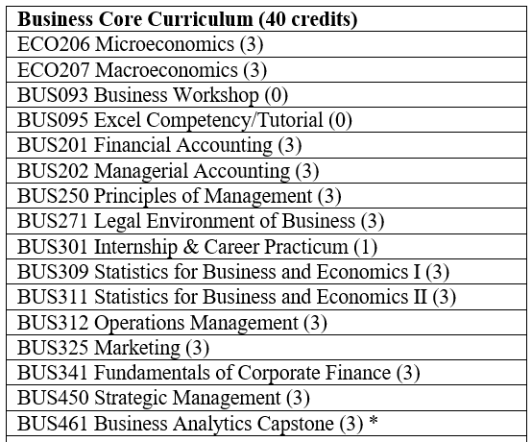
SUNY New Paltz - Business Analytics Degree Program

Slide 7
Digital Marketing Analytics: Which Tools?
Which students?
Marketing majors and Business Analytics majors
Why web analytics?
Data analysis of web traffic and on-site clickstream behavior – highly relevant to managing a company’s website, app, and social media assets
Computationally less demanding with analytical tools: Adobe Analytics, IBM Digital Analytics, Google Analytics 360, Webtrends

Slide 8
Why Google Analytics?
Google Analytics 360 (standard, premium) listed in Gartner’s (2022) reviews of digital marketing analytics tools
Google Analytics (free version) is fully functional for small businesses.
Its analytical skills seamlessly transferable to Google Analytics 360
Truly free: learning material, Google Merchandise Demo, and certification exam.

Slide 9
Google Analytics – A Quick Look
Google Merchandise Store
Google Analytics within the Demo account
Realtime
Audience
Acquisition
Behavior
Conversion
Provides a real business context to learn data analysis for digital marketing decisions
Some data have been modified

Slide 10
Segments in Google Analytics
Is to analyze subsets of data - basically, filter your data without permanently deleting any of the data you have collected.
Data available in Google Analytics (free)
Geographic: nations, regions, states, counties, cities, or even neighborhoods.
Demographic (limited): age, life-cycle stage, gender, income, occupation, education, religion, ethnicity, and generation.
Psychographic (limited): social class, lifestyle, or personality characteristics.
Behavioral (elaborate measures of online behavior): e.g., in Audience (new vs returning, recency, frequency, and engagement), Acquisition (Traffic source, Ads), Behavior (content interaction), and Conversions (Goals, Shopping)

Slide 11
Segments in Google Analytics
Segmentation analysis greatly facilitated
Segmentation analysis without using “Segments” - can be found in different reports
In Segments - System segments
In Segments - Custom segments
Students are expected to learn
What types of data are available in GA? Where to find them in GA? How to use them for analysis? Practice, and more practice!

Slide 12
Segmentation Analysis
System Segments
Bounced sessions
Converters
Custom Segments
Conversion by number of visits
Whales (users having spent $300 or more)
US Technophiles by generation cohort

Slide 13
Projects Mentored by HVDMA Membership Businesses
Spring 2020
Data Intelligence and Insight (Heather Winnicki, Vice President of Product Management at Infogroup)
B2C Coffee Continuity Club (Chris Pelczar, Vice President Strategic Sales, Rickard² )
Donor Acquisition for Non-Profit Organizations (Bruce Hammer, VP Nonprofit Services, Path2Response)

Slide 14
Projects Mentored by HVDMA Membership Businesses
Spring 2021
The Kool Kat Re-launch (Becky Santaniello, Vice President of Sales at Mailinglists.com)
National Women’s Soccer League (Jeremy Johnson, Senior Vice President, Customer Acquisition at Specialists Marketing Services, Inc.)
Google Analytics Marketing Project (Ed Larkin, VP, New Business Development for Alliant, The Audience Company)

Slide 15
Projects Mentored by HVDMA Membership Businesses
Spring 2022
The Shoofly (Lisa Moore, Account Director, Licensing at Data Axle)
National Women’s Soccer League (Jeremy Johnson, Senior Vice President, Customer Acquisition at Specialists Marketing Services, Inc.)

Slide 16
Projects Mentored by HVDMA Membership Businesses
Spring 2020
Data Intelligence and Insight (Heather Winnicki, Vice President of Product Management at Infogroup)
B2C Coffee Continuity Club (Chris Pelczar, Vice President Strategic Sales, Rickard² )
Donor Acquisition for Non-Profit Organizations (Bruce Hammer, VP Nonprofit Services, Path2Response)
Spring 2021
The Kool Kat Re-launch (Becky Santaniello, Vice President of Sales at Mailinglists.com)
National Women’s Soccer League (Jeremy Johnson, Senior Vice President, Customer Acquisition at Specialists Marketing Services, Inc.)
Google Analytics Marketing Project (Ed Larkin, VP, New Business Development for Alliant, The Audience Company)
Spring 2022
The Shoofly (Lisa Moore, Account Director, Licensing at Data Axle)
National Women’s Soccer League (Jeremy Johnson, Senior Vice President, Customer Acquisition at Specialists Marketing Services, Inc.)

Slide 17
HVDMA + SUNY New Paltz
“It was so rewarding to me to mentor Professor Shen’s marketing students! I enjoyed collaborating with the other mentors, and I’m sure I learned as much, if not more, from the students as they did from me. Prof. Shen course prepares them well for careers beyond graduation.”
Becky Santaniello, Vice President Sales
Mailinglists.com/Infinite Media
“The SUNY New Paltz students exceeded my expectations. They excelled at researching and understanding concepts that were new to them and utilized critical thinking skills to master their approach. I was proud to be involved as a mentor and learned from the students as well!”
Chris Pelczar, Vice President
Strategic Sales, Rickard²
Mentorship Program initiated in 2019 (Sheryl Benjamin, Vice President at Data-Axle)
HVDMA membership organizations volunteer to help
Student engagement with events such as Christmas and Laura Smith Scholarships

Slide 18
HVDMA + SUNY New Paltz
“Professor Shen’s Google Analytics class is designed to prepare students for real-life scenarios. As mentors, we have the opportunity to guide students as they develop a marketing plan and realistic solution. As a two-time mentor, I’ve been amazed with the talent, knowledge, professionalism, and drive showcased by the SUNY New Paltz students. It’s extremely fulfilling when your team flawlessly executes the marketing presentation!”
Jeremy Johnson, Senior Vice President
Customer Acquisition at Specialists Marketing Services, Inc.
“Every time I get asked how I got to where I am now, the first thing that comes to mind is my involvement with HVDMA, and Professor Shen, who not only mentored me, but introduced me to such a rewarding organization. I’ve never met a group of people more willing to teach and share resources that bridges the gap between a student’s realm of education and experiences and the opportunities that are out there for them. Through the connections I made from attending a single HVDMA networking event, I’ve been able to harbor close relationships with professionals in the industry that I can go to for advice and insight. I’ve also been able to land my first opportunity in the direct marketing industry through a connection I’ve kept since then.”
Rommyani Basu
Customer Support Specialist Path2Response
Mentorship Program initiated in 2019 (Sheryl Benjamin, Vice President at Data-Axle)
HVDMA membership organizations volunteer to help
Student engagement with events such as Christmas and Laura Smith Scholarships

Slide 19
Forward-looking Thoughts
The Mentorship Program
Call for mentors - my next class in Spring 2023
More creative next steps
HVDMA projects to involve more faculty and students?
Joint training program for new business professionals?
An internship program, interview preparation by HVDMA? …
Don’t hesitate to reach out – I am here!
LinkedIn
Email: shena@newpaltz.edu
Your continued support

Slide 20
Thank you. Any questions?

