Slide 1




What's the Future of the Postal Service and Where Do I Fit In?
A Pulse On Washington and Assessment of Postal Service Reform Legislation
STRICTLY PRIVILEGED AND CONFIDENTIAL

Slide 2

2021: Baseline Data Points - Macro Political & Economic Assessment
We are in day 189 of the Biden Presidency (as of July 29).
The elections are 450 days away.
As of this week, 163M Americans, or 49% of the population is fully vaccinated.
Since the low on March 23, 2020, the S&P has surged more than 90%; the DJIA just under 88%; and the Nasdaq near 112%.
In April 2020, the unemployment rate reached 14.8%—the highest rate observed since data collection began in 1948. In July 2021, the national unemployment rate stood at 5.9%.
Following the enactment of the American Rescue Plan, the Federal Government has spent approximately $5.3 trillion in order to mitigate the economic fallout caused by the pandemic. .
The budget deficit passed the $2 trillion mark in May. The Federal government’s debt currently stands at $28 trillion.
For comparison, stimulus approved by President George W. Bush at the start of the financial crisis totaled just $152 billion. TARP, allocated $700 billion for buying up banks' toxic assets. The American Recovery and Reinvestment Act, signed in 2009 included $831 billion in aid.
It has been 205 days since the January 6 attack on the U.S. Capitol.
2

Slide 3
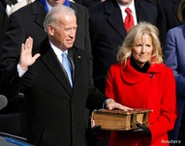




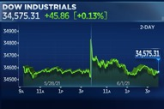
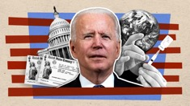
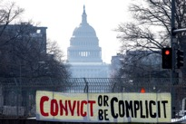
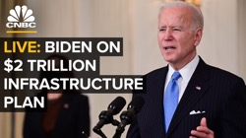
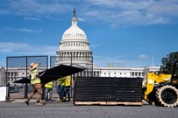

2021: Baseline Data Points - Macro Political & Economic Assessment
In the first six months of his presidency, Biden has signed 26 bills into law. By comparison, President Trump had signed 42 bills into law in the first six months.
Biden signed 52 Executive Orders in the first six months, compared to 42 signed by Trump and 22 signed by Obama.
In the first 100 days, Biden tweeted approximately 770 times, compared to 1,000 by Trump.
Biden has done 4 solo news conferences, already matching George W. Bush’s first year and 3 ahead of Donald Trump in 2017

Slide 4
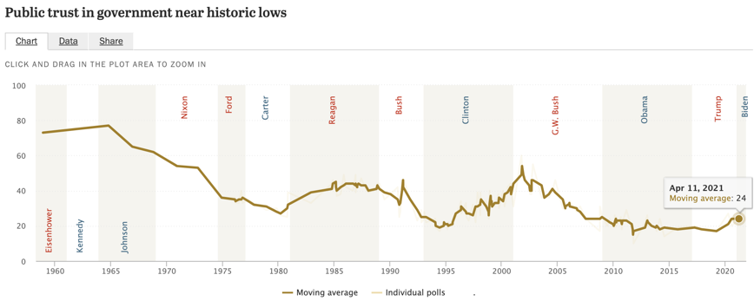
Public Trust in Government Remains Low (Surprise)
When the National Election Study began asking about trust in government in 1958, about three-quarters of Americans trusted the federal government to do the right thing almost always or most of the time.
Since the 1970s, trust in government has been consistently higher among members of the party that controls the White House than among the opposition party.
Beyond other public policy issues, this lack of general trust is now hurting Covid-19 vaccination efforts – a critical mechanism required to facilitate a return to normalcy.

Slide 5
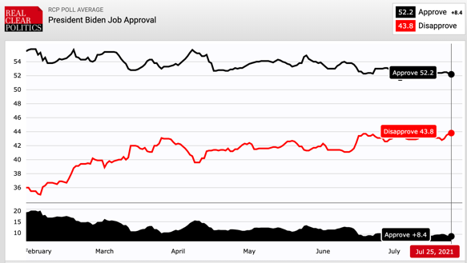
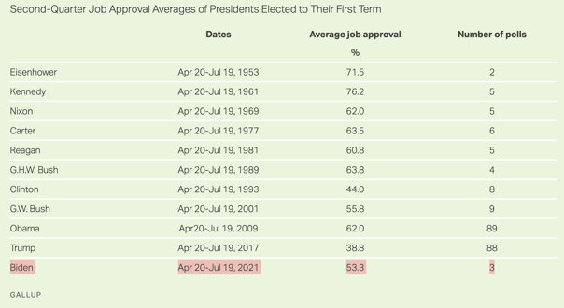
President Biden’s Approval Rating
Biden's first-quarter job approval rating averaged 56%, while his second-quarter average was 53.3%.
A recent Gallup poll found Biden’s approval rating had dipped by 6 percentage points to 50%, his lowest mark since taking office in January.
Prior to July, Biden’s approval rating had remained steady, but a slowing vaccination rate, combined with the Delta variant and key policy priorities facing gridlock in Congress – Biden’s approval was guaranteed to dip.

Slide 6
Biden’s Approval On Policy
Beyond high initial marks for his handling of Covid, Americans have conflicting views on Biden’s performance on other policy issues.
A recent poll from Ipsos found that Biden fares less well on immigration, gun violence, and crime. On these issues, fewer than half of independents approve of the job he’s doing, but his approval among Democrats is also lower.
In the coming weeks, Biden’s approval of Covid and his handling of the economy and other policy issues will be at risk given the Delta variant.

Slide 7
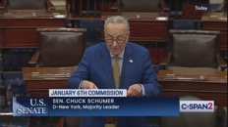
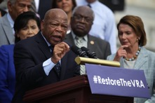
Congress – Near Term Agenda Expectations (It’s complicated)
July has marked an important period for Senate Democrats as they try and advance President Biden's domestic agenda ahead of August recess. The House adjourns on July 30 and the Senate on August 9.
Bipartisan infrastructure negotiations: Senate Majority Leader Schumer said he was "fully committed" to passing a bipartisan infrastructure bill this summer but warned that more foot-dragging could require the Senate to stay in over the weekend or cuts to some of the upcoming August recess.
      Senate Democrats are facing an increasingly narrow legislative window to advance Biden's infrastructure priorities. Schumer and Speaker Pelosi are both in a uniquely challenging and precarious situation; irrespective of any changes to August recess, advancing the bipartisan infrastructure will require considerable floor time, which explains Schumer's rationale in trying to force Democrats and Republicans to reach an agreement.
      Speaker Pelosi has said that the House will not pass the bipartisan infrastructure bill unless the Senate also sends over a budget resolution with elements of the American Jobs Plan and American Families Plan. Per Speaker Pelosi, “there ain't no infrastructure bill without the reconciliation bill.”
January 6 Select Committee: The House Select Committee investigating the Capitol riots held it’s first hearing this last Tuesday.
Government funding: When Congress reconvenes in late September, the immediate focus will include passing a stopgap bill to keep the government funded past the September 30 deadline.
Surface Transportation Reauthorization: The House passed The INVEST in America Act, a $715 billion Surface Transportation and Water Infrastructure package. The bill cleared the House with support from two Republicans alongside all 219 Democratic members. Earlier this year, the Senate EPW Committee passed its version of the legislation with bipartisan support, but the legislation still needs to be brought for a full vote on the Senate floor.

Slide 8
Congress – Near Term Agenda Expectations (It’s complicated)
China-Related Legislation: In early June, the Senate passed the US Innovation and Competition Act. The House is taking a piecemeal approach and passed the National Science Foundation for the Future Act (H.R. 2225) and the Department of Energy Science for the Future Act (H.R. 3593). Other legislation, such as the Uyghur Forced Labor Prevention act – is expected to move in late Fall.
NDAA: The Senate Armed Services Committee voted to advance the FY2022 NDAA to the Senate floor, however consideration is not expected until September. The House Armed Services Committee is currently in the process of holding subcommittee markups, but any additional movement is also unlikely until September.
Gun control: A bipartisan attempt in the Senate to advance gun control legislation fell apart in early June after Senator Murphy and Cornyn concluded that discussions had run their course. Despite Murphy calling almost half of the GOP Conference, he failed to find compromise by a self-imposed deadline of early Spring or early summer.
Police Reform: The chief negotiators for the package – Senator Scott, Booker, and Congresswoman Bass announced last month that they had “reached an agreement on framework addressing the major issues for bipartisan police reform.” One of the areas that Democrats and Republicans have yet to agree on is qualified immunity – which would protect state and local government officials, including law enforcement, from liability in civil suits unless they violate a persons clearly established constitutional rights.
Immigration Reform: Democrats are trying to include immigration priorities in the $3.5 trillion budget reconciliation package, in an attempt to circumvent Republicans. In private, Democrats have expressed the current strategy is their only chance to enact meaningful immigration changes this Congress. Details are limited but one of the policy goals is to create a pathway to citizenship for undocumented groups, such as Dreamers.
Notes:
There are many competing priorities in Congress, virtually any of which can blow up into a major storm and put passage of other lower profile legislation in doubt.

Slide 9
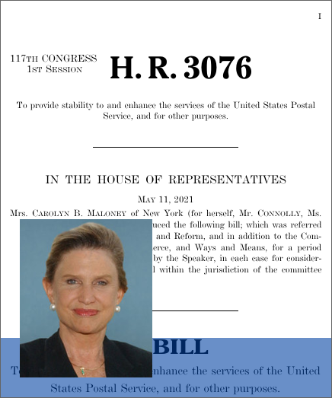
Update on Postal Reform In Congress - H.R. 3076
On May 11, Chairwoman Maloney and Ranking Member Comer introduced the Postal Service Reform Act to provide financial and operational stability to the Postal Service.
Subcommittee on Government Operations Chairman Connolly and Congresswoman Foxx are also original co-sponsors of the legislation, which among other things, would eliminate the agency’s 2006 mandate to fund retiree health benefits and would require postal employees to enroll in Medicare when they turn 65.
On May 13, The House Oversight Committee passed the legislation by a voice vote.
The bill is now being worked by the House Ways and Means Committee and House Energy and Commerce Committee, both of which have jurisdiction over Medicare, for possible amendments before it heads to the House floor for a vote expected in September.

Slide 10
Update on Postal Reform In Congress - S.1720
In the Senate, HSGAC Chairman Peters and Ranking Member Portman introduced the companion legislation on May 19. In the Senate, the legislation has 25 cosponsors – 13 Republicans and 11 Democrats.
The 50-50 split in the Senate requires any legislation to have 60 votes in order to pass. Having 10 original Republican cosponsors is a critical and notable accomplishment and raises the likelihood of the legislation being enacted.
It is unclear whether the Senate oversight committee will hold a mark up on the bill or bypass markup and go directly for a full vote in the Senate.
The Senate Appropriations Committee is reviewing the Medicare Integration language and is being urged to add a provision requiring the PRC to re-review the new rate authority granted the USPS.
Both Chambers are seeing eye to eye on the legislation. This is critical because previous iterations of postal reform have failed because the House and Senate could not agree on a unified vision.

Slide 11
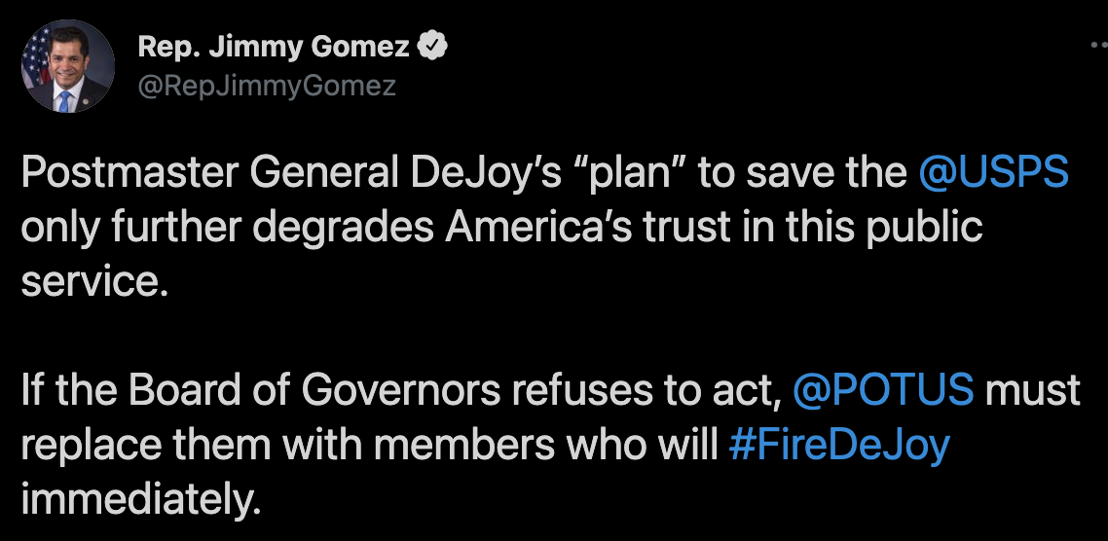
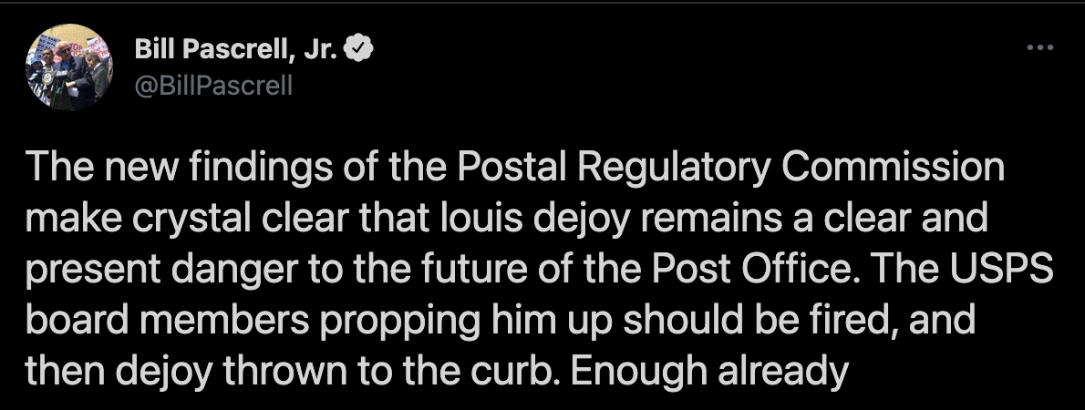
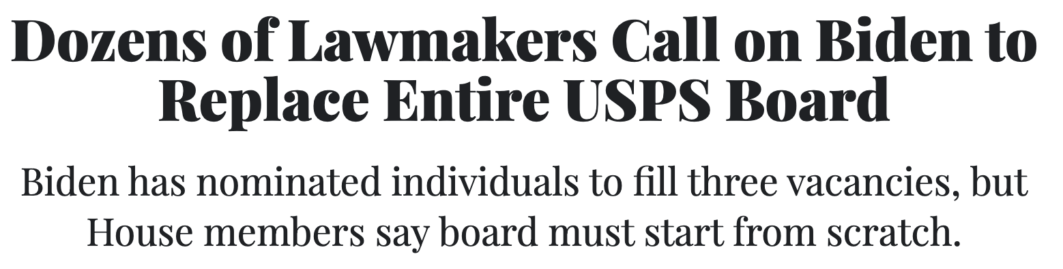
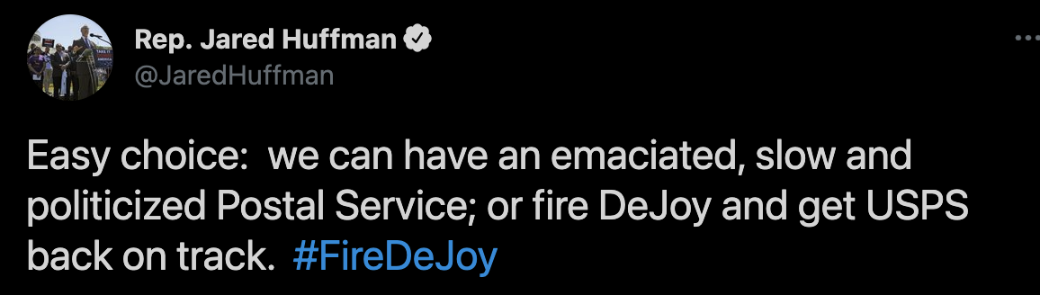
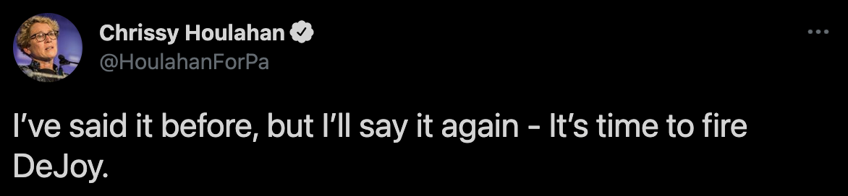

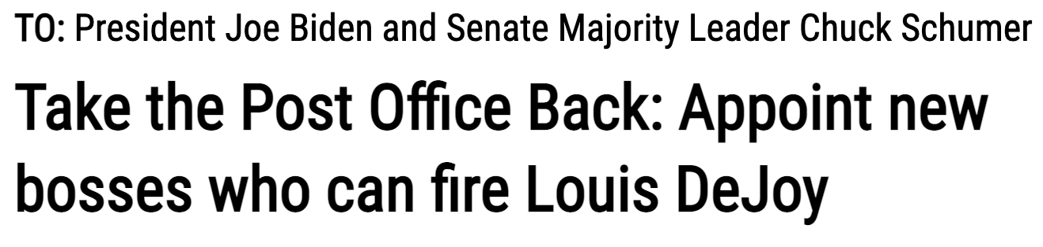
Rhetoric From Some Democrats Threatens to Derail Postal Service Legislation

Slide 12
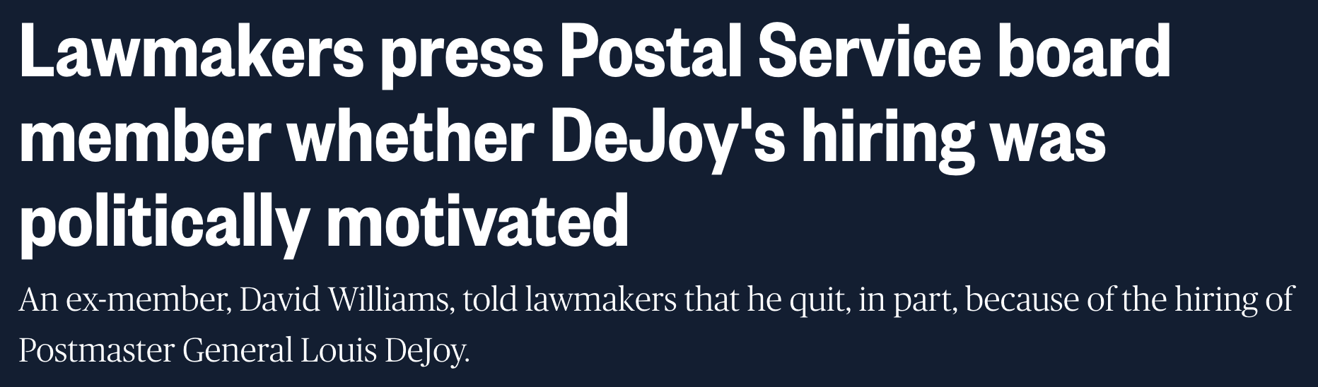
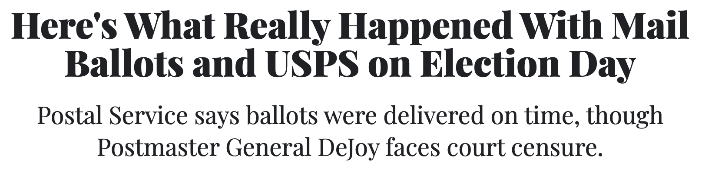
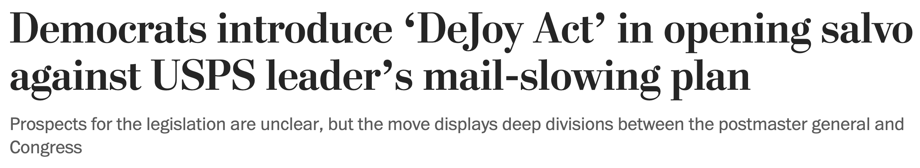
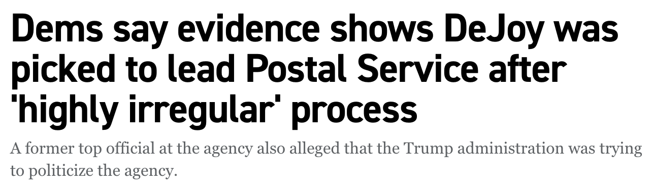
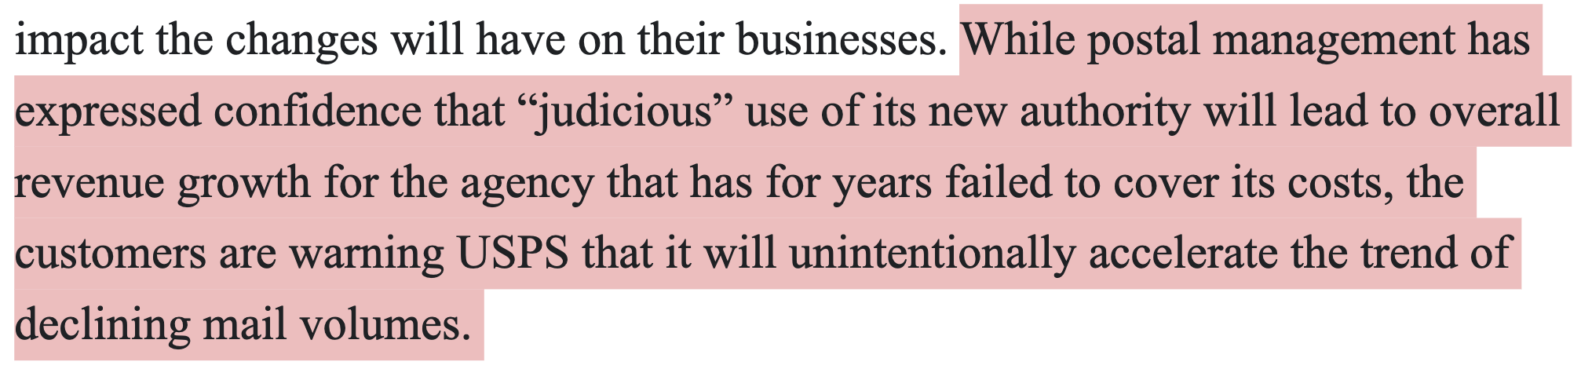
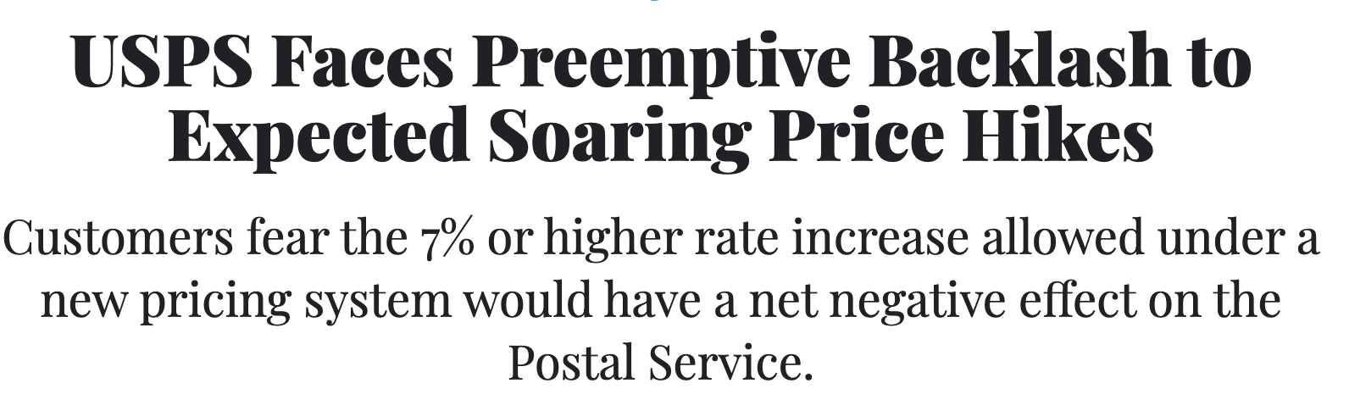
The Politics of The USPS & The PMG

Slide 13











U.S. Postal Service Board of Governors
Ron A. Bloom
Chairman, Board of Governors
Roman Martinez IV
Vice Chairman, Board of Governors
John M. Barger
Member, Board of Governors
Robert M. Duncan
Member, Board of Governors
Anton G. Hajjar
Member, Board of Governors
Amber F. McReynolds
Member, Board of Governors
Donald L. Moak
Member, Board of Governors
Ronald A. Stroman
Member, Board of Governors
William D. Zollars
Member, Board of Governors
Louis DeJoy
Postmaster General and
Chief Executive Officer
Douglas Tulino
Deputy Postmaster General and
Chief Human Resources Officer
The USPS BOG is comprised of 9 outside governors appointed by the President and confirmed by the Senate. No more than 5 can be from the same party. The BOG appoints the PMG and together the DPMG, both of whom become members of the BOG. Terms are staggered for 7 years and can be renewed one time. Only the BOG can remove the PMG or DPMG. The BOG meets regularly, typically monthly. The Postmaster General serves at the pleasure of the governors for an indefinite term and the Deputy Postmaster General serves at the pleasure of the governors and the Postmaster General. Each governor receives $300 per day for not more than 42 days of meetings each year and travel expenses, in addition to an annual salary of $30,000. The Board directs the exercise of the powers of the Postal Service, directs and controls its expenditures, reviews its practices, conducts long-range planning, approves officer compensation and sets policies on all postal matters. The Board takes up matters such as service standards and capital investments.

Slide 15
PRC Order No. 5763
In November 2020, The Postal Regulatory Commission issued Order No. 5763 adopting rules to modify the system for regulating rates and classes for Market Dominant products.
PAEA required the Commission to review the existing Market Dominant rate and classification system 10 years after the enactment of the PAEA to determine if the system achieved the PAEA’s nine objectives, considering the 14 factors established by Congress.
According to the notice from the PRC - To address the Postal Service’s financial health and target primary drivers of net losses, the Commission implements two mechanisms designed to permit the Postal Service to generate additional revenue to cover costs outside of its control.
  The first mechanism, designed to address consequences of mail density declines, modifies the price cap to provide additional rate adjustment authority equal to the uncontrollable density-driven portion of increases in average cost-per-piece, as calculated under the Commission’s formula.
  The second mechanism, designed to address the Postal Service’s retirement amortization payments that are outside of its control, modifies the price cap to provide additional Market Dominant rate adjustment authority equal to the percentage by which total revenue would need to increase (necessarily assuming an equal increase levied on Competitive products) to provide sufficient revenue for the Postal Service to meet its required retirement obligation payments, as calculated under the Commission’s formula.
  Non-compensatory (i.e. “underwater”) products and classes also receive an additional 2% over the Class-wide average increases.

Slide 16
Order No. 5763 – practical implications
The PRC has granted additional authority to the USPS for 5 years, renewable for another 5 years should the PRC determine appropriate.
The CPI-limited rate cap is modified as follows:
CPI-U (inflation) + Density adder + Retirement adder + 2% for underwater = total maximum rate authority available
No future guidance on magnitude or timing of rate increases is available.
The Density adder will not be known until March of each year when the PRC issues its Annual Compliance Determination.
90 days notice of new rate increases shall be given.

Slide 17
USPS 10-Year Plan – “Delivering for America”
In March, PMG DeJoy released his strategic vision for the USPS.
The goals of the plan include:
  Strengthened public service mission including 6 and 7 days of mail and package delivery.
  Service standards that foster service excellence – 95 percent on time reliability.
  A bold approach to growth, innovation and continued relevance – $24 billion of new revenue.
  With congressional support, electric delivery fleet by no later than 2035.
  Best-in-class mail and package processing and delivery operations.
  A modern, transformed network of Post Offices designed as go-to destinations.
  A fully optimized surface and air transportation network.
  A stable and empowered workforce including reducing non-career workforce turnover by 50%.
  An organization structured to support effectiveness.
  A supportive legislative and administrative framework.
  A more rational pricing approach including the judicious implementation of new and existing pricing authority.

Slide 18









USPS Delivering for America Plan
THE PROBLEMS WE’RE ADDRESSING THROUGH THE IMPLEMENTATION OF THIS PLAN
Hastened shift in demand away from mail to packages
Misaligned mail and package processing operations
Underperforming air and surface transportation network
Unattainable First-Class Mail service standards
Prolonged underinvestment in retail and delivery network
Misaligned and redundant organizational design
High turnover rate within our non- career employee workforce
Long-overdue pricing regulation changes from the PRC
Onerous legislative and administrative mandates

Slide 19
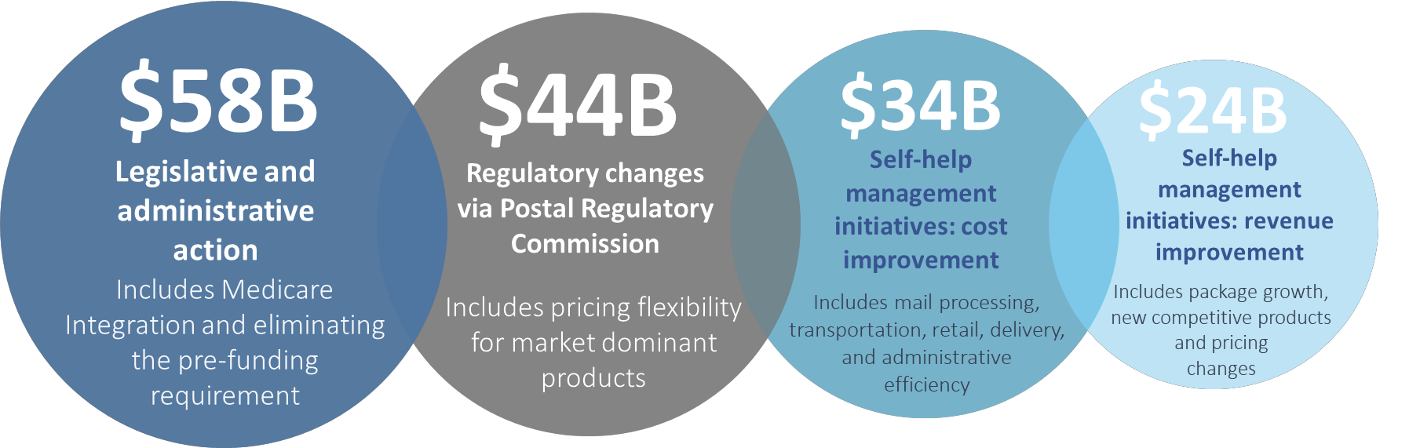
Solving for a projected $160 billion 10-Year Forecasted Loss:
Our balanced approach to revitalizing the Postal Service
USPS Delivering for America Plan

Slide 20

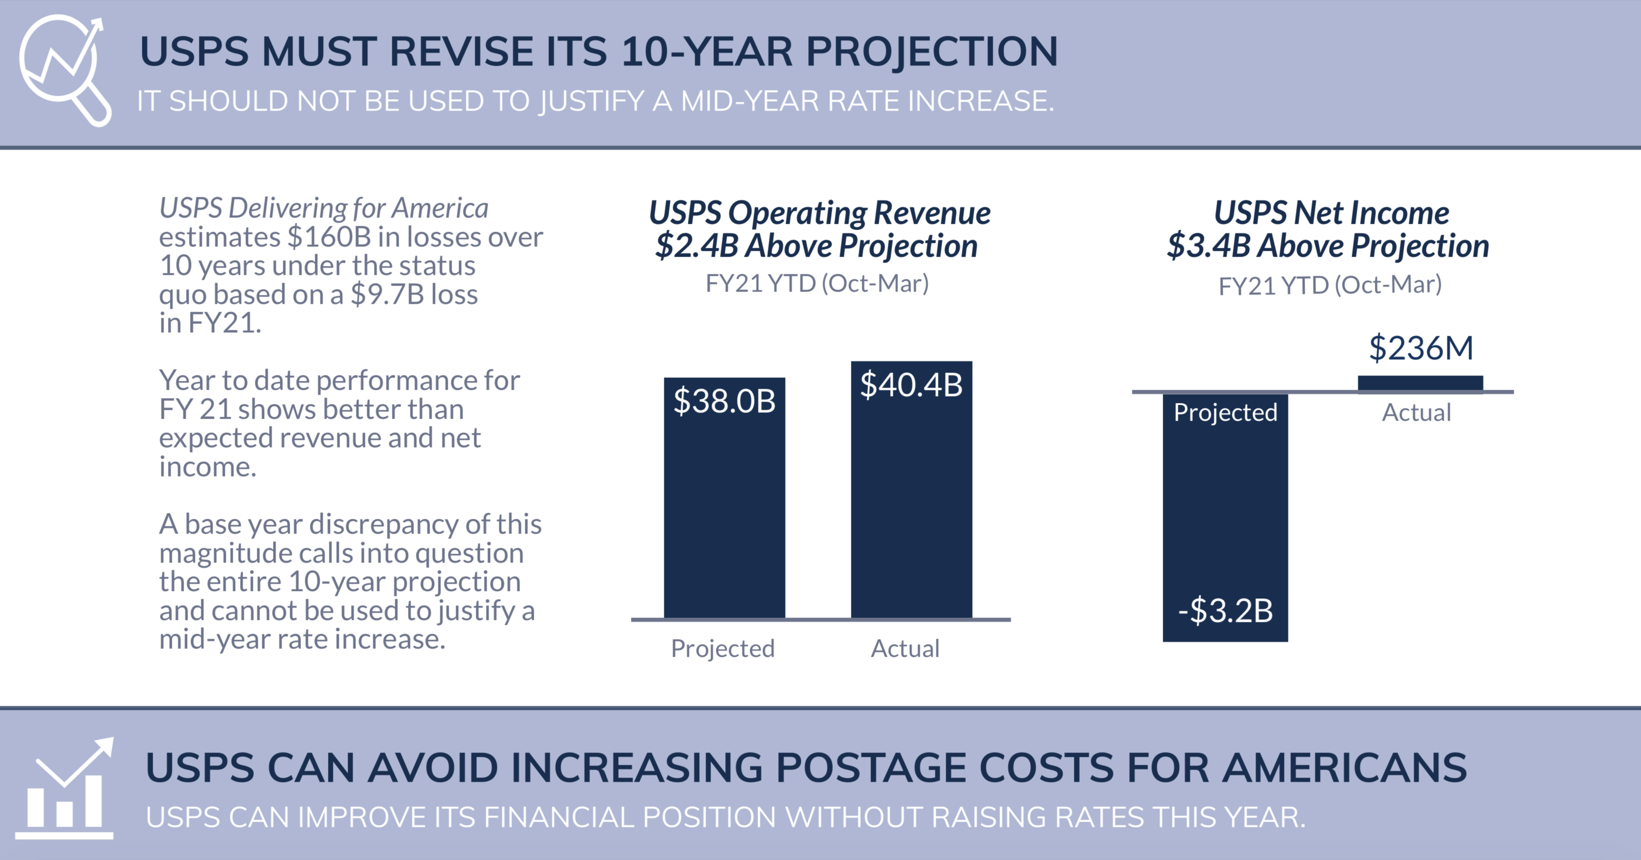
Executive Summary & Full Report are available here:
https://www.greetingcard.org/wp-content/uploads/2021/07/Exec-Summary-Review-of-USPS-10-Year-Plan-Final-July-2021.pdf
https://www.greetingcard.org/wp-content/uploads/2021/07/Report-Review-of-USPS-10-Year-Plan-Final-July-2021.pdf

Slide 21
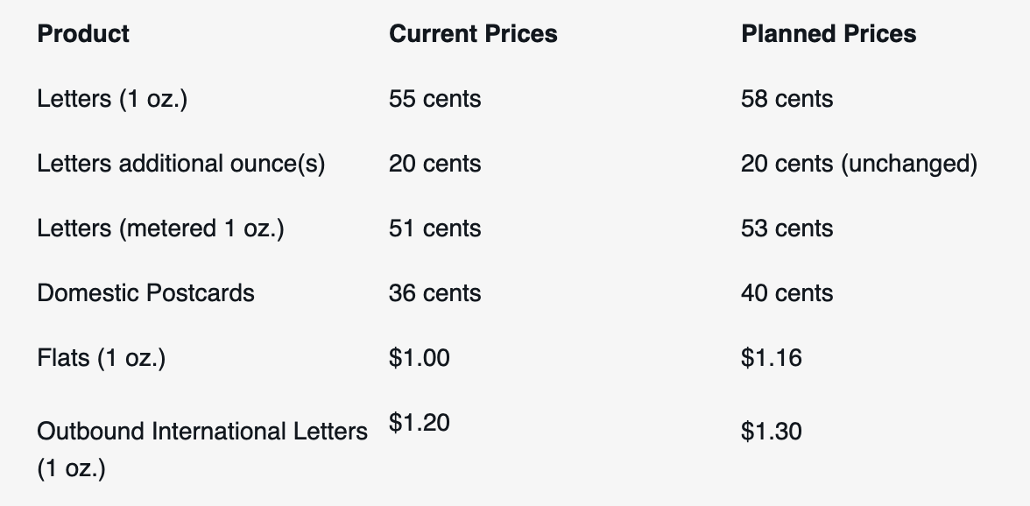
USPS Proceeds with Request For Postal Rate Change
In May, the USPS filed notice today with the Postal Regulatory Commission (PRC) requesting price changes to take effect on August 29, that are in accordance with approvals provided by the PRC last year.
The proposed price changes would raise overall Market Dominant product and service prices by approximately 6.9 percent. First-Class Mail prices would increase by 6.8 percent to offset declining revenue due to First-Class Mail volume declines. In the past 10 years, mail volume has declined by 46 billion pieces, or 28 percent, and is continuing to decline. Over the same period, First-Class Mail volume has dropped 32 percent, and single piece First-Class Mail volume — including letters bearing postage stamps — has declined 47 percent.
Proposed Price Changes Include:

Slide 22

Bellwether Citizen Response survey highlights
Key findings from newly-released national survey conducted by Bellwether Citizen Response:
Overwhelming majority of the American public would oppose USPS actions to deprioritize mail service
The majority of Americans (77%) have little-to-no awareness of the upcoming postage increases due to take effect August 29
More service delays and postage increases would push most Americans to consider alternatives to using the mail
The majority of the American public (76%) strongly agrees that the USPS should place equal importance on the delivery of regular mail and packages—a stark contrast with USPS’ move to prioritize package delivery over mail delivery by raising mail postage and slowing mail services
If rates increase, two-thirds (65%) of respondents will consider shifting their communications from USPS mail to online
If delivery times slow, nearly three-quarters of respondents (73%) will consider shifting their business communications from USPS mail to online
Public satisfaction with USPS could be waning: 68% of Americans report strong overall satisfaction with USPS service, but that’s a huge decline from a Postal Service Inspector General survey conducted in October 2020 and released in April 2021 which found that 91% of respondents held a positive opinion of USPS.
This was a nationally representative, statistically valid sample of over 2,000 consumers by the former president of Ipsos and a Dartmouth professor
Full report available: http://www.bellwethercr.com/c21_report_usps_rate_hike

Slide 23
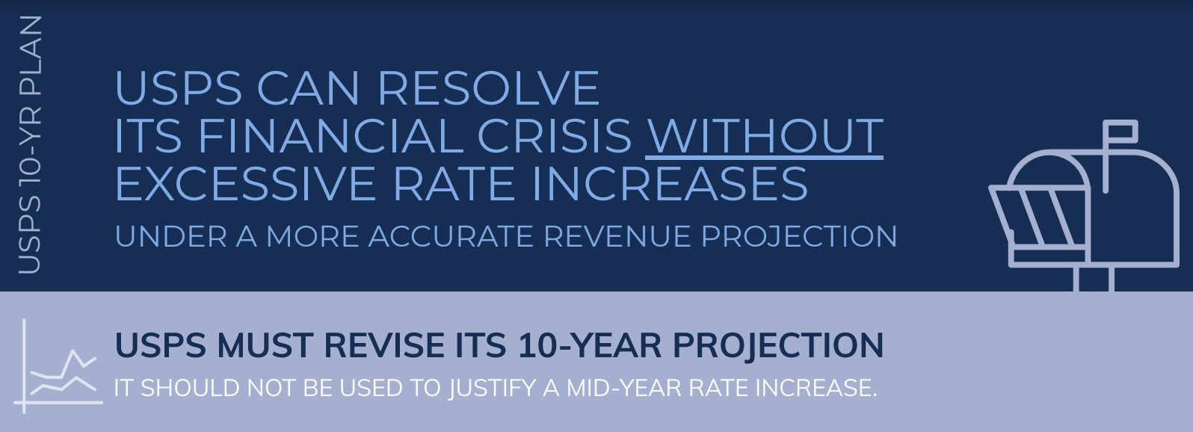
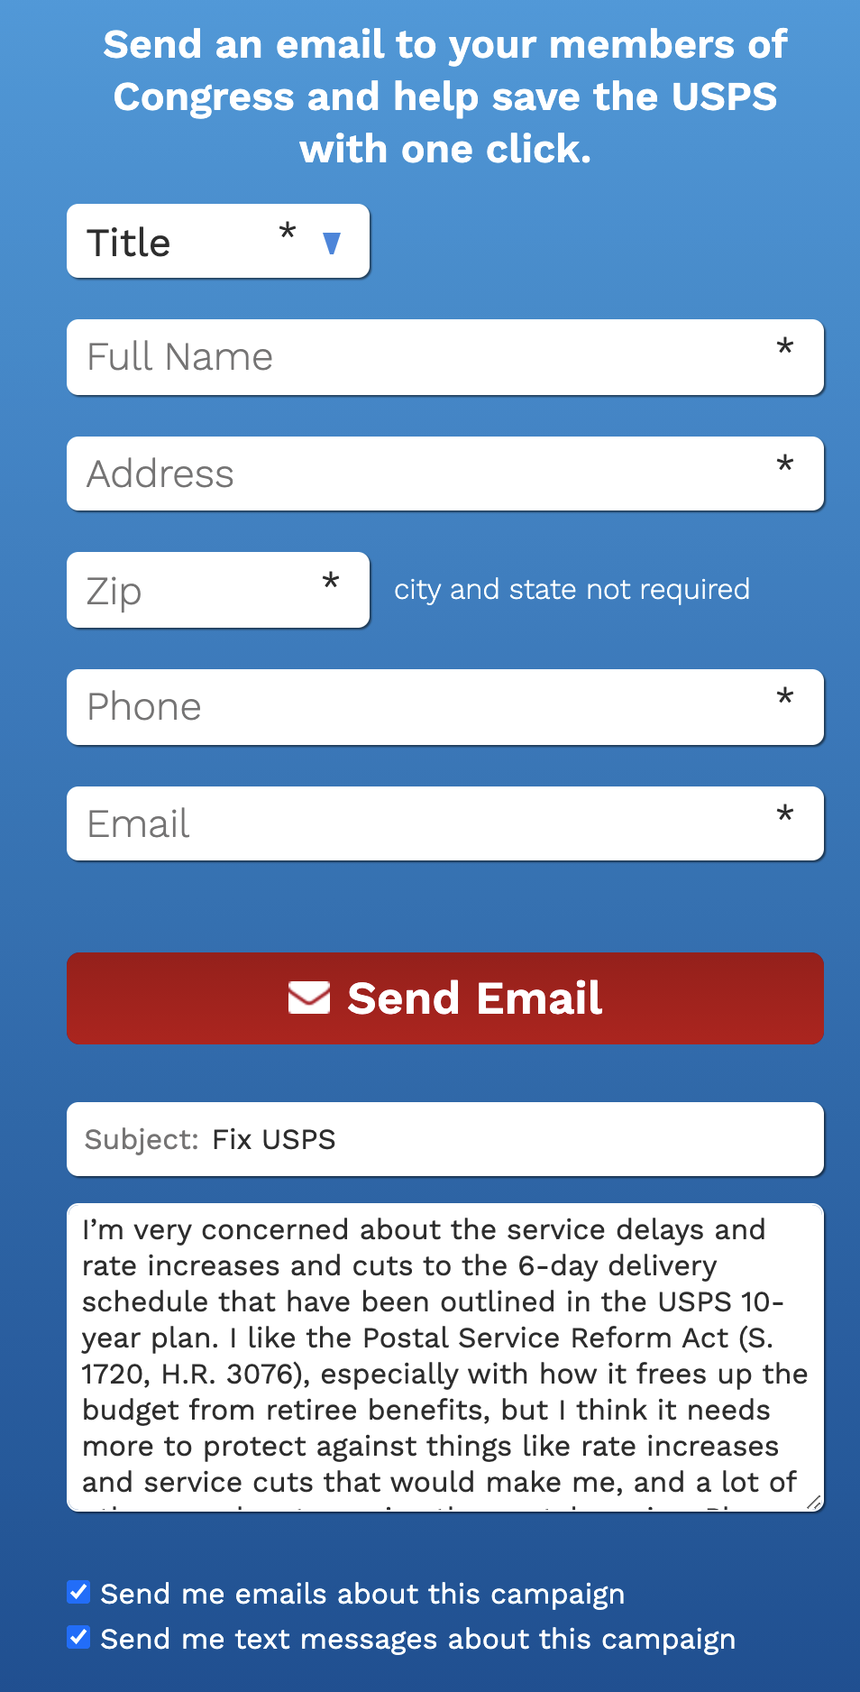

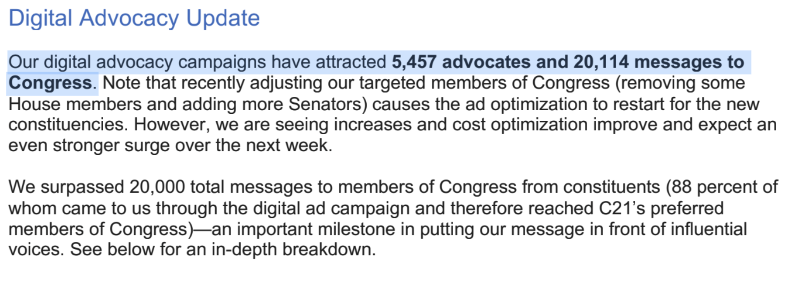
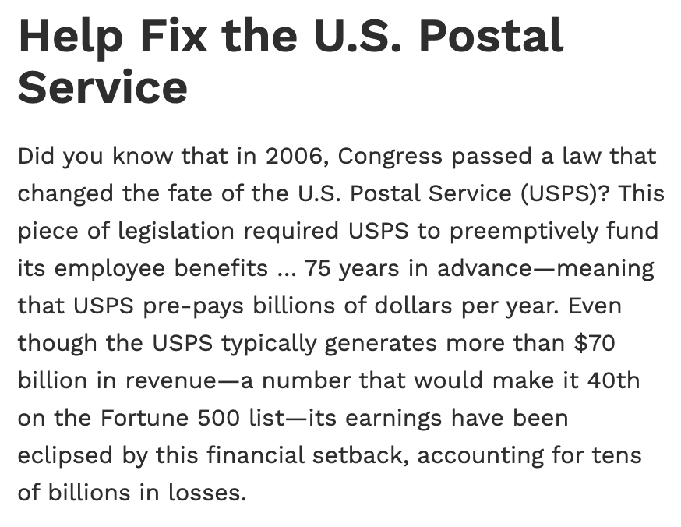

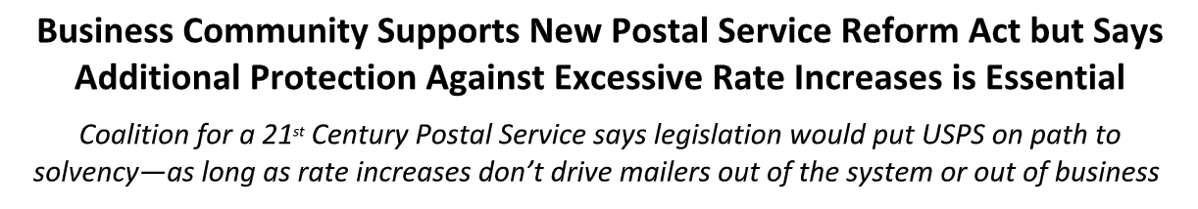
Robust & Strong Industry Response
Litigation
Public Relations
Hill Outreach

Slide 24
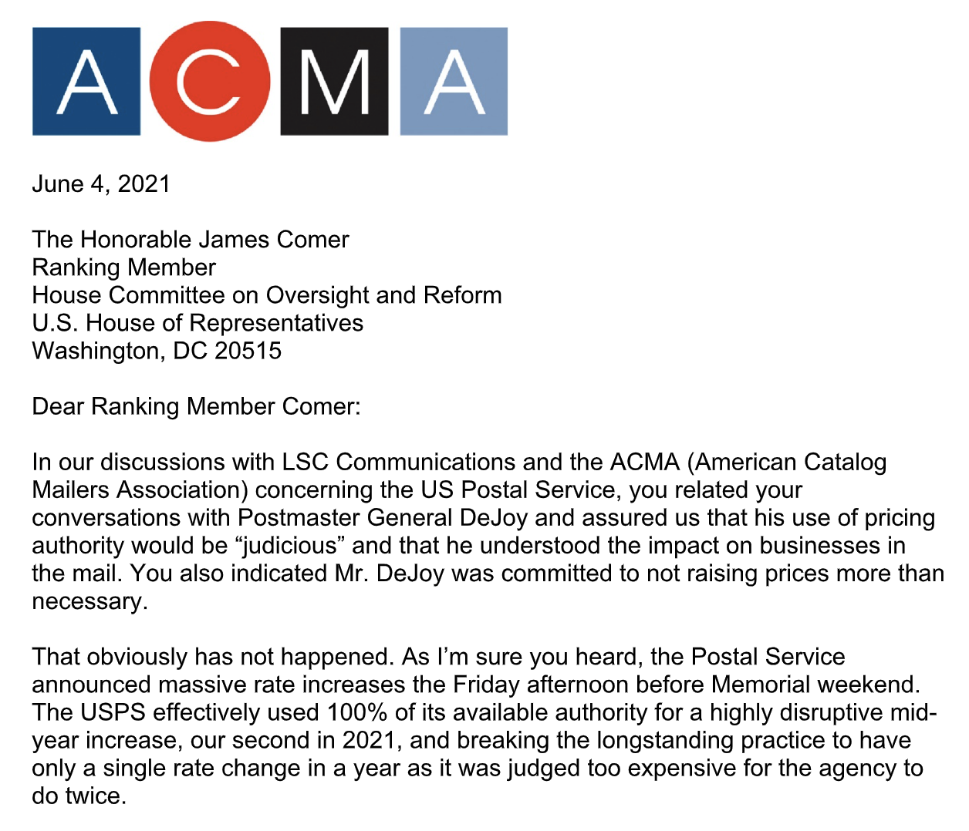
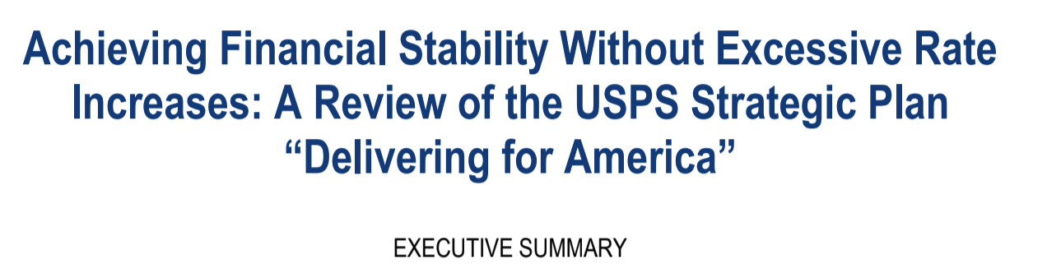
Robust & Strong Industry Response
Continued dialogue with Members of Congress

Slide 25
Robust & Strong Industry Response
Industry must make some “noise” if Postal Reform legislation is to pass
Educate employees about how this affects them and request they communicate to their Congressional delegation in no uncertain terms:
    Postal Reform is critical to our jobs and future
    The Postal Regulatory Commission must be told to re-review the authorization given to the USPS for additional rates under Order 5763
Here are the links to both our internal and external social media campaigns. We would encourage you to pass along the Stakeholder link to members, employees and more. While we are doing quite well on the numbers of email contacts with Congress as those of you on the call this morning heard, we need to keep it up.
Stakeholder (employee) Campaign (blank email for organic messages to Congress): https://p2a.co/bzX4wuZ | OR, text “mail” to 52886 and tap the response message.
Consumer (citizen) Campaign (Editable emails with suggested messaging):
https://p2a.co/J3eCLxC | OR, text “FIXUSPS” to 52886 and tap the response message.

Slide 26
Build a relationship with Congress
As an owner or key executive of a business, you simply are not doing your job without building and maintaining a strong relationship with your elected officials, the ultimate arbiters of your company’s future.
A relationship must be built in advance of need.
ACMA will help any HVDMA member build a relationship without obligation or cost to you. Contact ACMA at info@catalogmailers.org for our free “Guide to Building a Relationship with Congress.”
It is that important.

Slide 27



Thank you
Contact Us
Contact Us
Hamilton Davison | President
Email: hdavison@catalogmailers.org
Direct Cell: (401) 529-8183
Lynn Noble | VP, Industry Affairs
Email: lnoble@catalogmailers.org
Direct Cell: (513) 608-4749
Alex Vogel | CEO
Email: alex@vogelgroupdc.com
Direct Cell: (202) 669-2173
Direct Office: (202) 813-3491
Brian M. Johnson | Principal
Email: brian@vogelgroupdc.com
Direct Cell: (202) 378-8644
Direct Office: (202) 506-5649
Paul Miller | VP and Deputy Director
Email: pmiller@catalogmailers.org
Direct: (914) 669-8391
Samir N. Kapadia | COO, Principal
Email: samir@vogelgroupdc.com
Direct Cell: (202) 740-5903
Direct Office: (202) 813-3481
PO Box 41211 | Providence, R.I. 02940
Visit us at www.catalogmailers.org
2300 N Street Northwest | Suite 643 | Washington, D.C. 20037
Visit us at www.vogelgroupdc.com

