Slide 2
Today’s Speaker: Jay Schwedelson
JAY SCHWEDELSON - who????
President & CEO – Worldata
Founder of SubjectLine.com
Served 8 Years: Board of Directors – DMA
Founded DMA’s Original Email Council in 1998 – Over 1000 Members
Crain’s Top 100 Industry Professionals (10 Years in a row)
Worldata executes over 40,000 Email, Online and Direct Marketing Campaigns on Behalf of Clients Each Year.
Demand Gen Experts. Email and Direct Mail.
We are among the largest buyers of permission email media in North America.
Our research division, Worldata Research, provides free industry metrics based on these programs. Our email research is based on over 6 billion transmitted messages annually.

Slide 3
Before We Get To The Fun Stuff –
Let’s Get Nauseous

Slide 4
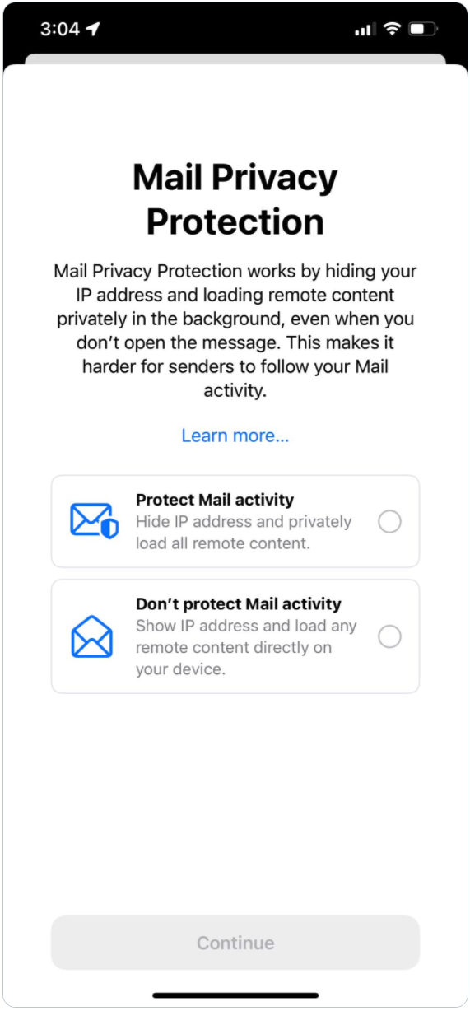
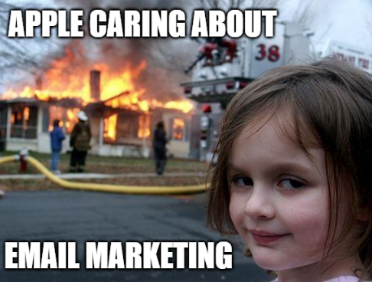

Slide 5
This is how APPLE describes it –
“In the Mail app, Mail Privacy Protection stops senders from using invisible pixels to collect information about the user. The new feature helps users prevent senders from knowing when they open an email, and masks their IP address so it can’t be linked to other online activity or used to determine their location” The change will happen in SEPTEMBER when your iPhone updates to IOS 15. You will see a screen that will invite you to opt-in.

Slide 6
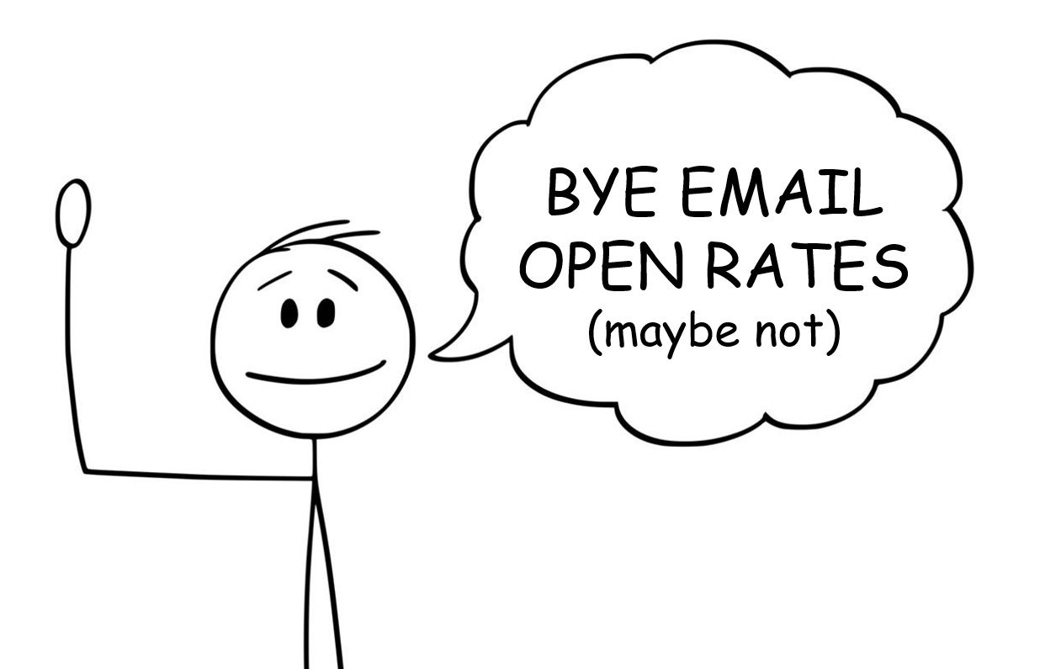

Slide 7
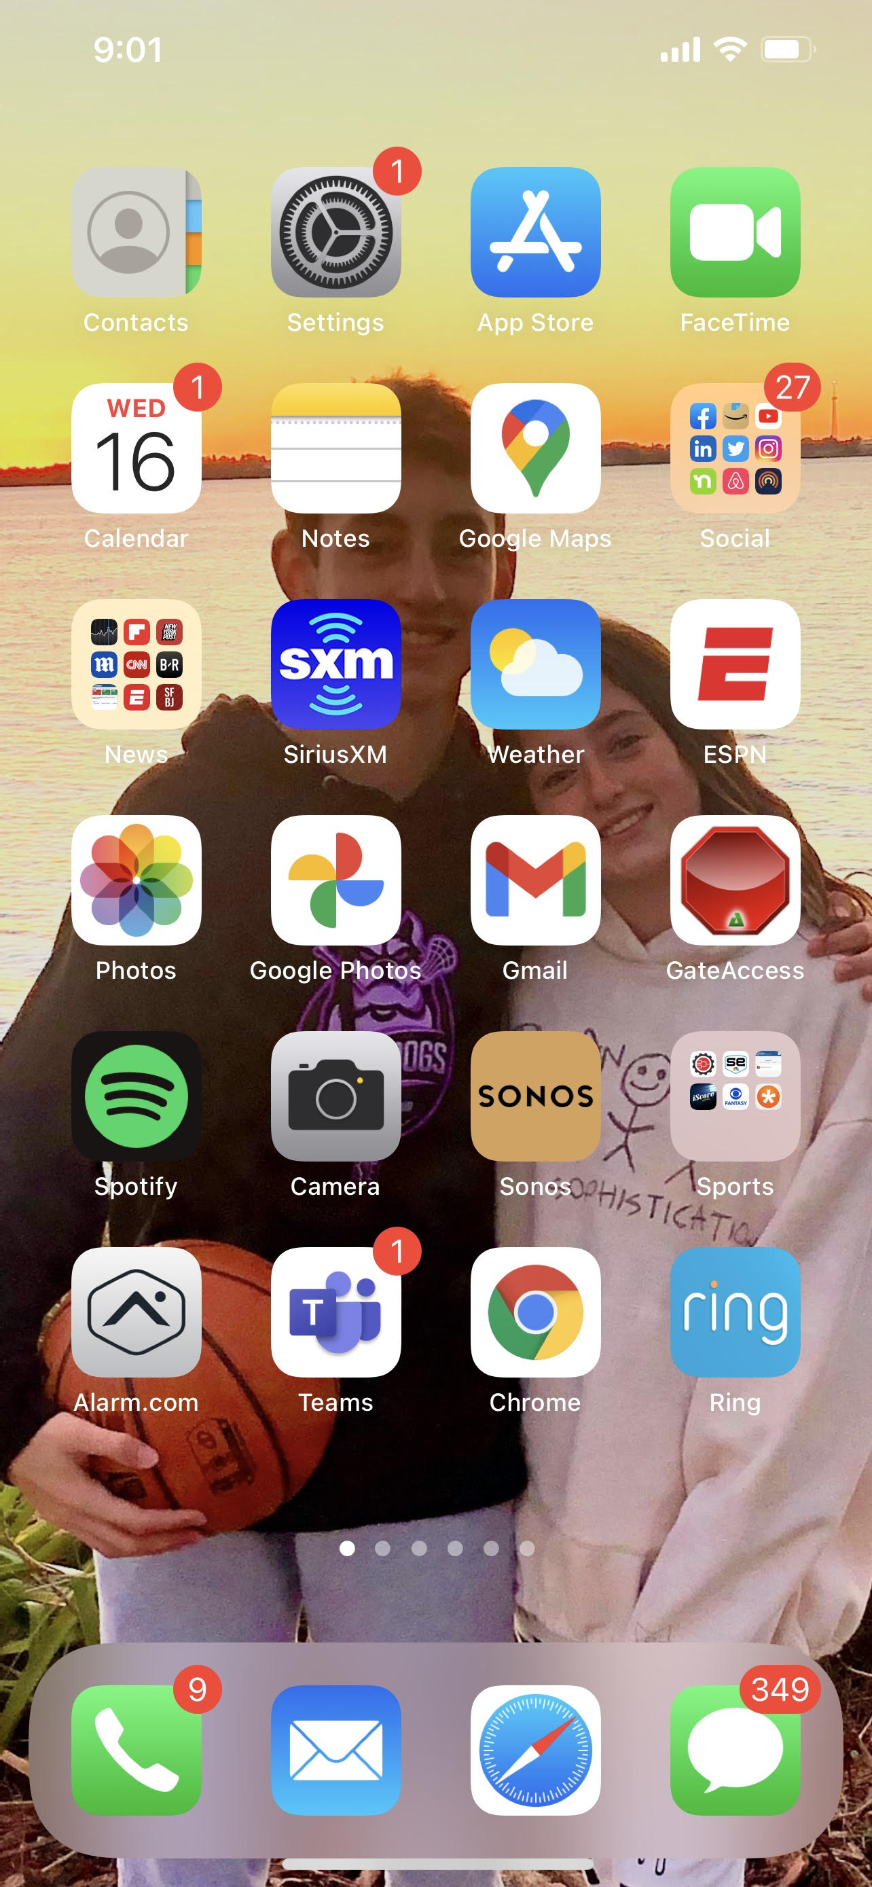
Impact: Potentially 46% of All Email Recipients
(BtoB and BtoC)
Source: Litmus
Whatever Email Goes Into Apple Mail App is Impacted

Slide 8
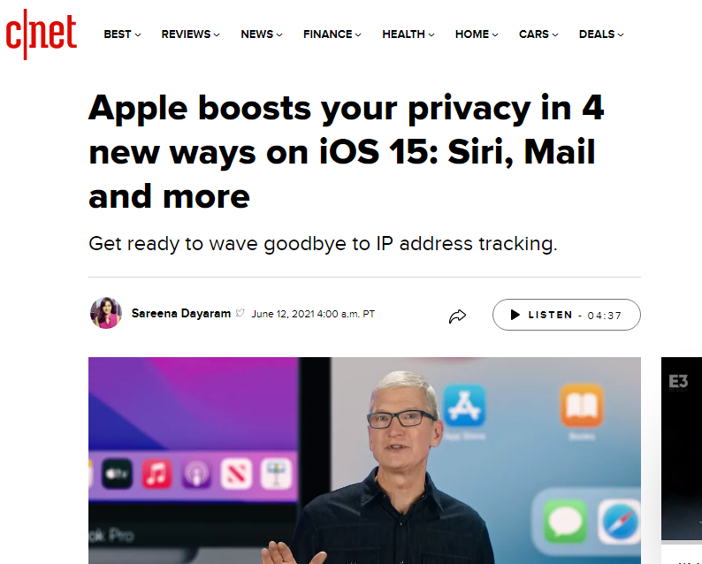
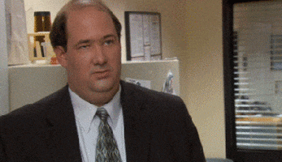
UGGHHHHHHHH!!!!!
Ok, How Bad Is It?

Slide 9
Total Disaster…
Email Open Rate Tracking
Marketing Automation Triggers
Real-Time Personalization
Address Validation and Deliverability
Publishers Touting Newsletter ‘Read Rates’
And lots of other fun stuff…

Slide 10
Prediction: Summer 2022
GOOD:
‘Open Rate’ Tracking will go from ‘Absolute’ to ‘Estimated’
Only 30% impacted inboxes. 70% of emails sent will still be able to track email opens and balance will be extrapolated.
A/B testing of Subject Lines, Timing, etc will all be fine.
BAD:
Marketing Automation triggers based on actual emails opened will be severely impacted.
Email address validation and deliverability that relies on address level email open data will be severely impacted.

Slide 11
Prediction: Summer 2022
GOOD:
‘Open Rate’ Tracking will go from ‘Absolute’ to ‘Estimated’
Only 30% impacted inboxes. 70% of emails will still be trackable and balance will be extrapolated.
A/B testing of Subject Lines, Timing, etc will all be fine.
BAD:
Marketing Automation triggers based on actual emails opened will be severely impacted.
Email address validation and deliverability that relies on address level email open data will be severely impacted
What Should You Be Doing Right Now?
First – talk with your ESP/Marketing Automation Vendor. They should be sharing the plan they have (hopefully).
Second – It will take a few months for the major email platforms to really settle on how they will ‘project’ open rates. So from September till November your metrics will be a mess….
So here is what you do –
Run a ton of A/B tests NOW. Identify known ‘winners’. Use these winners during the ‘bumpy period’. Once dust settles go back to running A/B tests.

Slide 12
Prediction: Summer 2022
GOOD:
‘Open Rate’ Tracking will go from ‘Absolute’ to ‘Estimated’
Only 30% impacted inboxes. 70% of emails will still be trackable and balance will be extrapolated.
A/B testing of Subject Lines, Timing, etc will all be fine.
BAD:
Marketing Automation triggers based on actual emails opened will be severely impacted.
Email address validation and deliverability that relies on address level email open data will be severely impacted
What Should You Be Doing Right Now?
First – talk with your ESP/Marketing Automation Vendor. They should be sharing the plan they have (hopefully).
Second – It will take a few months for the major email platforms to really settle on how they will ‘project’ open rates. So from September till November your metrics will be a mess….
So here is what you do –
Run a ton of A/B tests NOW. Identify known ‘winners’. Use these winners during the ‘bumpy period’. Once dust settles go back to running A/B tests.
If you ignore all this and your ESP is clueless here is what will happen…
Your email open rates will skyrocket in September because all email sent to Apple viewed addresses will show as an automatic open.
That is not good.

Slide 13
Enough!
Where are all the cool test ideas?

Slide 14
So How Do We Keep ‘Open Rates’ High?

Slide 15
YOU WILL GO TO THE SPAM FOLDER IF YOU:
CAPITALIZE in Subject Line
Use Exclamation Point in Subject Line
Use Emoji’s In Subject Line
Put Numbers In Your Subject Line
Use ‘Free’ in the Subject Line

Slide 16
YOU WILL GO TO THE SPAM FOLDER IF YOU:
CAPITALIZE in Subject Line
Use Exclamation Point in Subject Line
Use Emoji’s In Subject Line
Put Numbers In Your Subject Line
Use ‘Free’ in the Subject Line

Slide 17
ACTUALLY!
Your ‘Open Rates’ Go Up When You:
CAPITALIZE in Subject Line: BtoB UP 18% BtoC UP 14%
Use Exclamation Point in Subject Line: BtoB UP 12% BtoC UP 11%
Use Emoji’s In Subject Line: BtoB UP 18% BtoC UP 24%
Put Numbers In Your Subject Line: BtoB UP 19% BtoC UP 21%
Use ‘Free’ in the Subject Line: BtoB UP 31% BtoC UP 37%

Slide 18
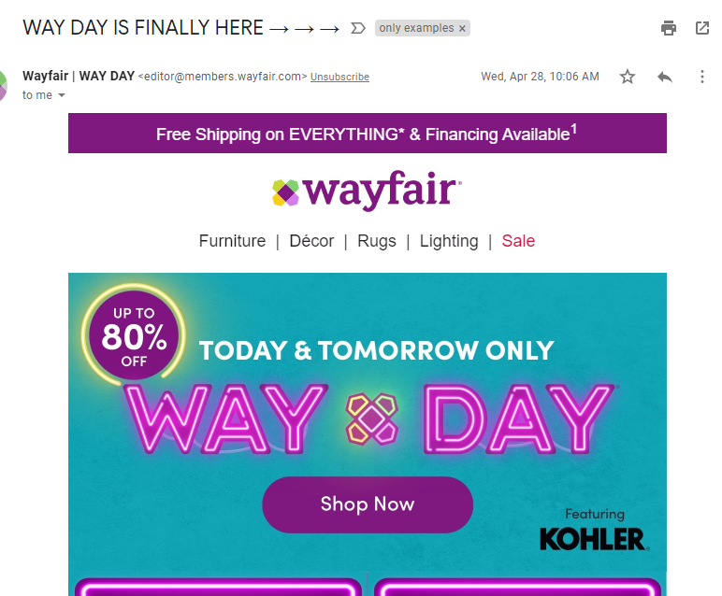
CAPITALIZATION

Slide 19
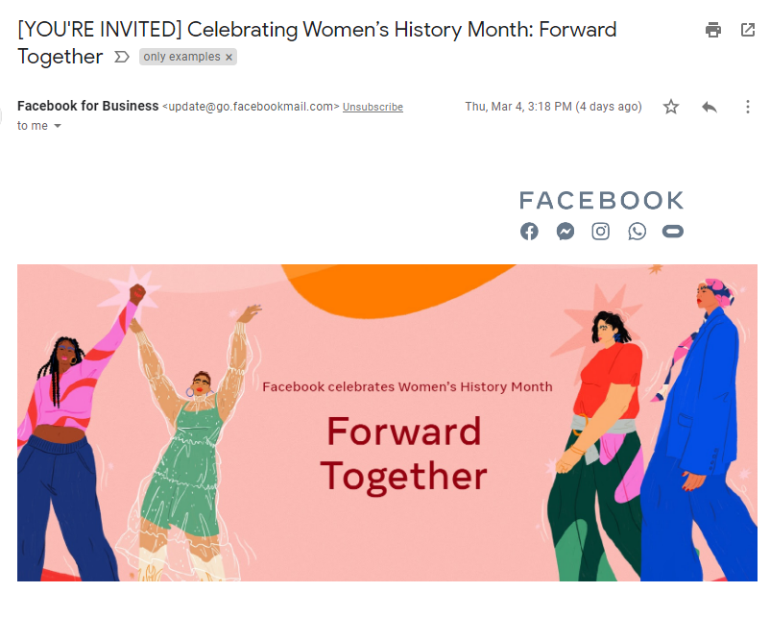

Slide 20
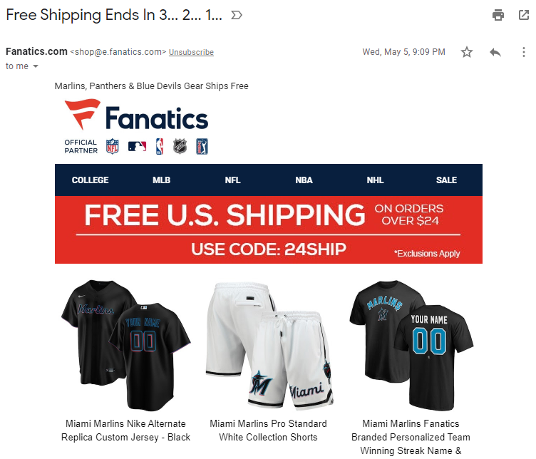
Numbers

Slide 21
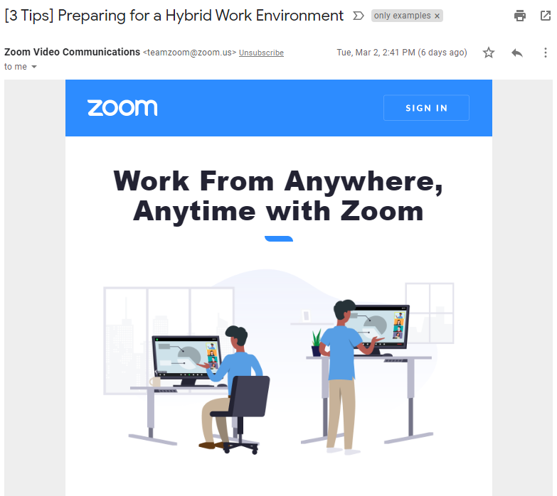

Slide 22
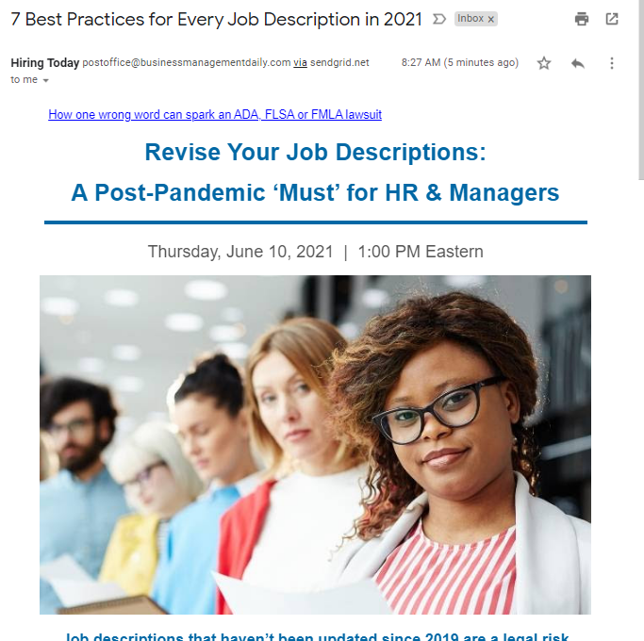
Numbers

Slide 23
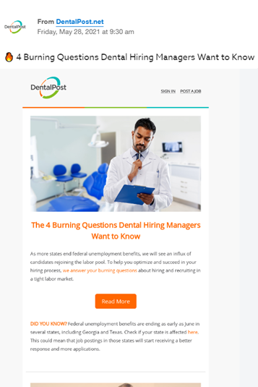
Emoji…

Slide 24
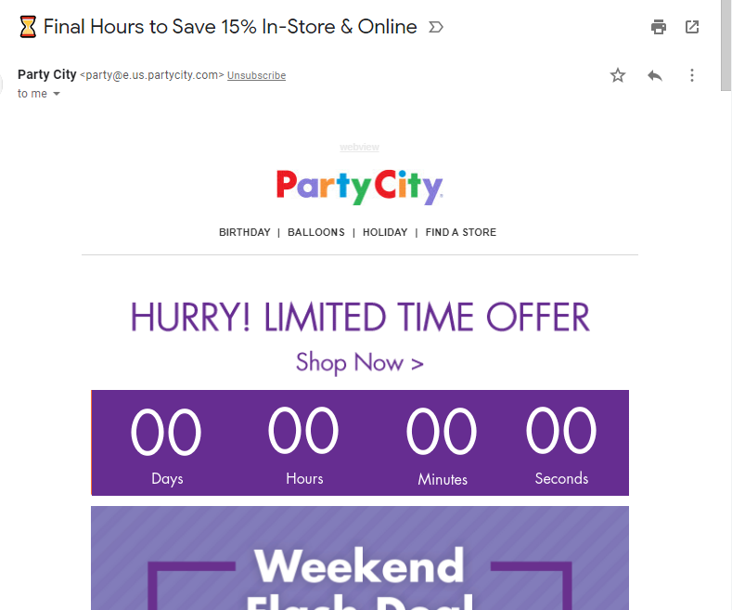
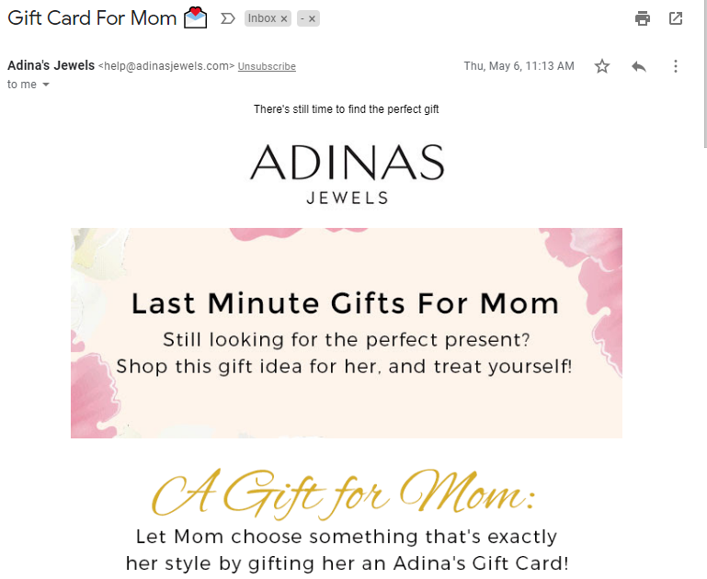
Emoji…
Let’s discuss Emoji’s…

Slide 26
TOP 5 Emoji’s For Subject Lines:
Last 30 Days:
BtoC
BtoB
⏰
⏰
Open Rate: UP 27%
Open Rate: UP 22%
⏳
⏳
Open Rate: UP 25%
Open Rate: UP 18%
❤️
✔️
Open Rate: UP 19%
Open Rate: UP 17%
⚡️
📈
Open Rate: UP 15%
Open Rate: UP 14%
👉
📅
Open Rate: UP 14%
Open Rate: UP 11%

Slide 27
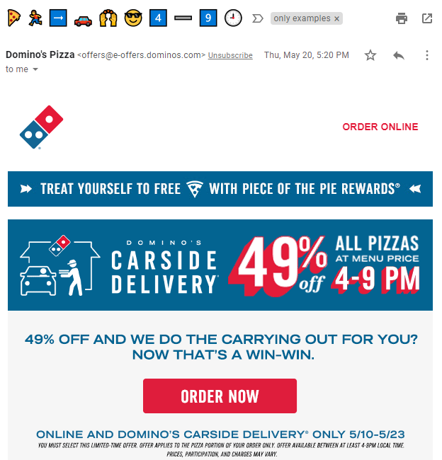

Slide 28
92% of All Emails Received (BtoB and BtoC) Can View Emoji’s/Symbols
Don’t Tune This Out Because It Sounds Silly.

Slide 29
All Emoji Info You Need…
https://unicode-table.com/en/
https://unicode.org/emoji/charts/full-emoji-list.html
https://emojitranslate.com/
https://emojipedia.org/

Slide 30
Your Email Creative is More Important Than Your Subject Line

Slide 31
Your Email Creative is More Important Than Your Subject Line

Slide 32
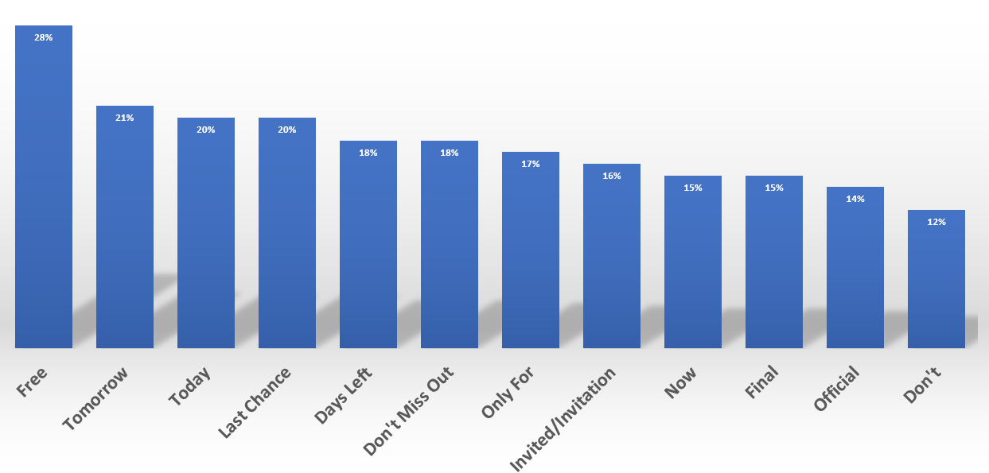
Subject Line Words That Increase Open Rates

Slide 33
Subject Line Words That Increase Open Rates

Slide 34
FOMO Is The Key To Email Marketing!

Slide 35
#1 Thing That Drives Email Response Rates
Sense of Urgency
B2B Emails that convey URGENCY in the SUBJECT LINE have a
47% higher ‘Open Rate’
B2C Emails that convey URGENCY in the SUBJECT LINE have a
41% higher ‘Open Rate’

Slide 36
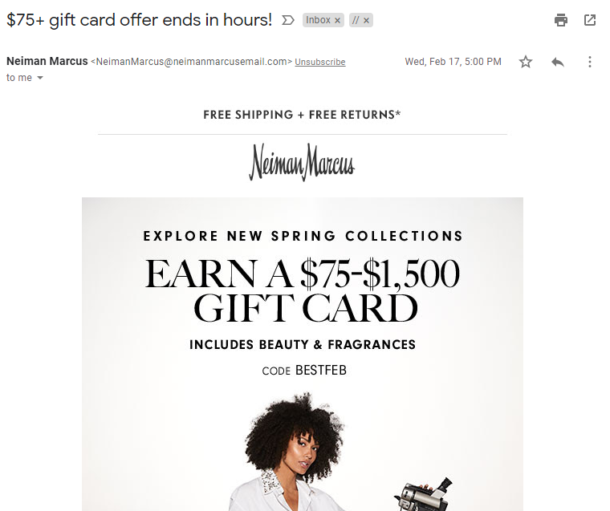

Slide 37
#2 Thing That Drives Email Response Rates
Suspense
B2B Emails that convey Suspense in the SUBJECT LINE have a
32% higher ‘Open Rate’
B2C Emails that convey Suspense in the SUBJECT LINE have a
38% higher ‘Open Rate’

Slide 38
The 2021 Color of The Year Is…

Slide 39
Bronze. Yay!

Slide 40
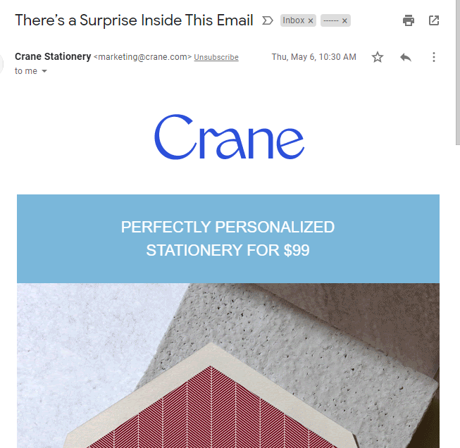
‘Suspense’ Subject Lines:
31% Higher Average Open Rate

Slide 41
‘Suspense’ Subject Lines:
31% Higher Average Open Rate
Suspense can be created in many ways…

Slide 42
3 Things Every Marketer Should Know…

Slide 43
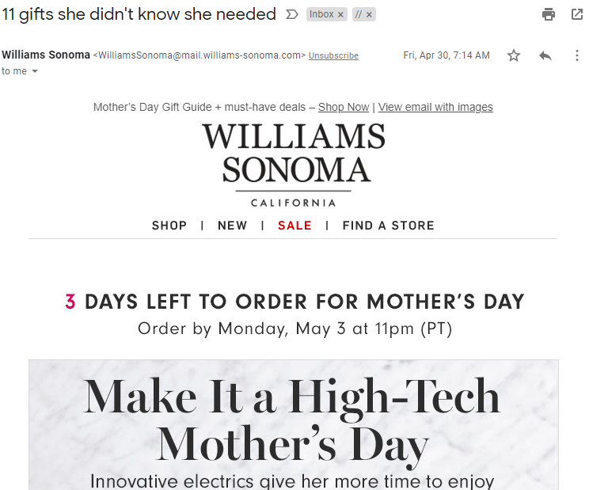
Lists are SUSPENSE:
‘List’ Subject Lines:
22% Higher Average Open Rate

Slide 44
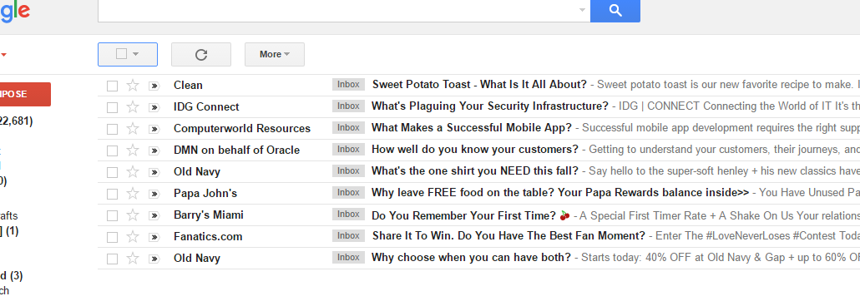
‘Question’ emails have an 27% higher overall open rate.
QUESTIONS are SUSPENSE:
27% Higher Average Open Rate

Slide 45
3 Things Every Marketer Should Know…

Slide 46
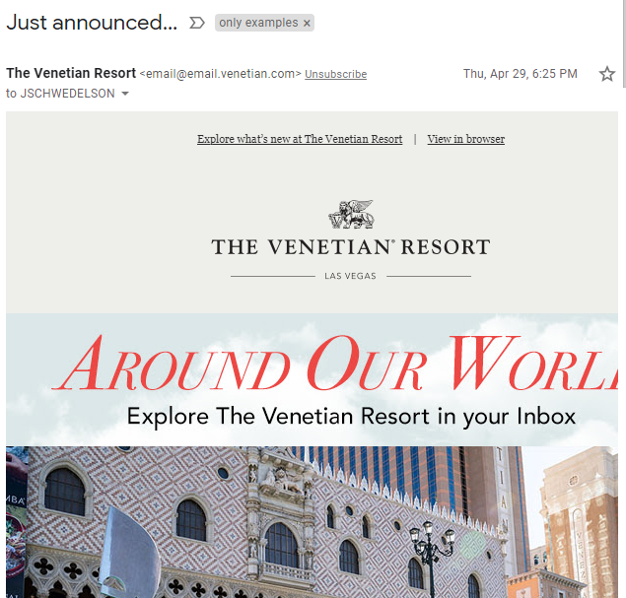
… = SUSPENSE:
‘…’ At End of Subject Lines:
19% Higher Average Open Rate

Slide 47
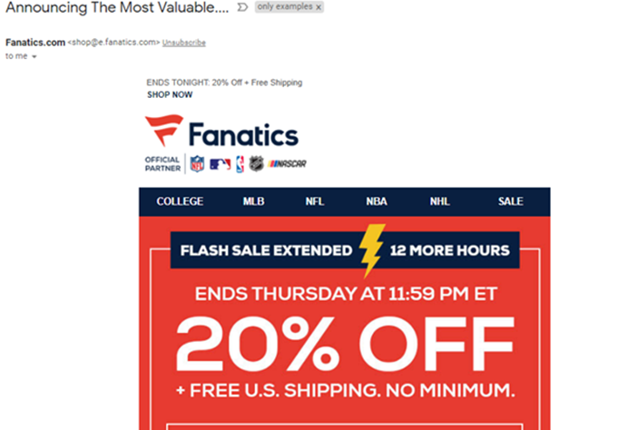
HALF Sentence: ‘Half Sentence’ Subject Lines

Slide 48
HALF Sentence: ‘Half Sentence’ Subject Lines 29% Higher Open Rate B2B 32% Higher Open Rate B2C
Have you seen…
Your Gift Is…
The Winner Is…

Slide 49
Little Things Make a HUGE Difference!

Slide 50
Is the LOGO in your email going to your homepage?
BtoC = 27% of ALL Clicks are on LOGO
BtoB = 31% of ALL Clicks are on LOGO

Slide 51
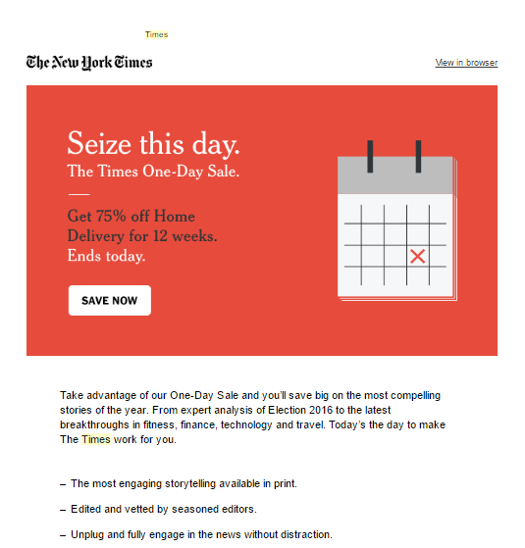
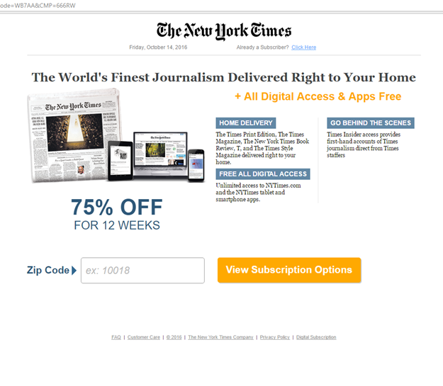
Emails that have all primary links going to ‘offer’ page have 57% higher overall conversion rate.

Slide 52
Little Things = Big Performance
[ ]
Just using these 2 characters in my subject line can increase my open rates by how much?

Slide 53
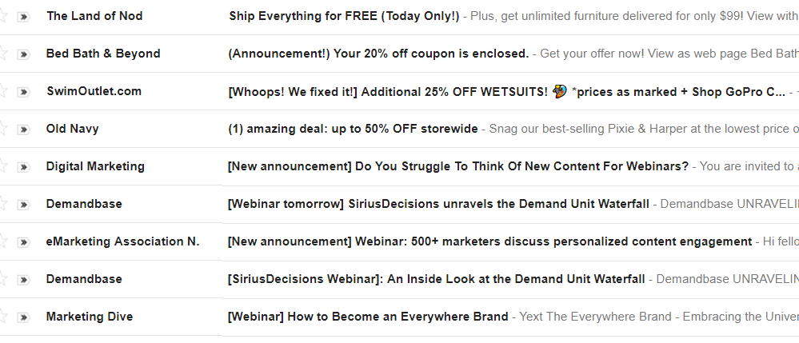
Top Performer: [Brackets] or (Parentheses) in Subject Line Boosting Open Rates by 31%

Slide 54
Title Casing in Subject Line: Title Casing Improves Open Rates By 14% vs. Standard Capitalization
This is NERDY stuff
Jay Is The Coolest Speaker Ever
Jay is the coolest speaker ever
jay is the coolest speaker ever

Slide 55
Paragraphs (blocks of text)
Over 50 Words in Single Paragraph Leads to 34% Lower Overall Click-Through Rate

Slide 56
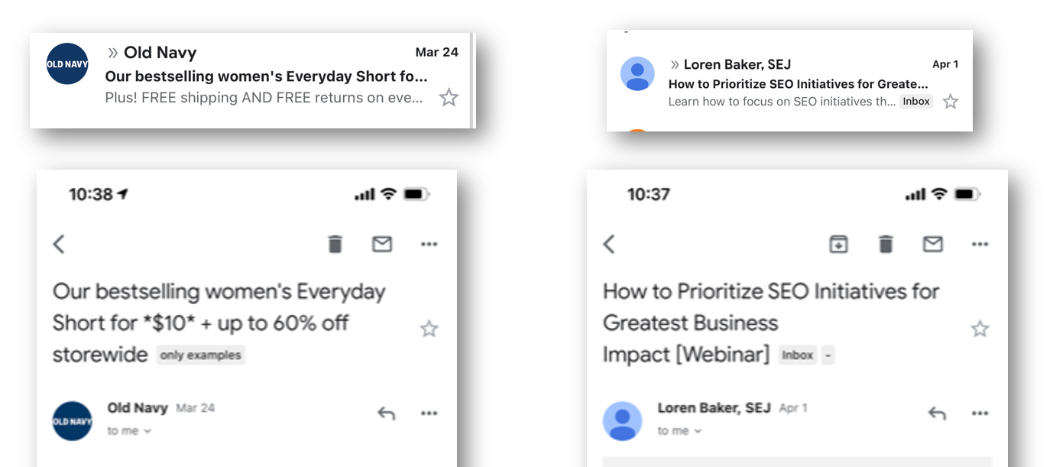
NOT ABOUT LENGTH OF SUBJECT LINE…

Slide 57
NOT ABOUT LENGTH OF SUBJECT LINE…
Subject Line:
‘Offer’ Mentioned in First 50% of Subject Line Has 37% Higher Open Rate Than Second 50%

Slide 58
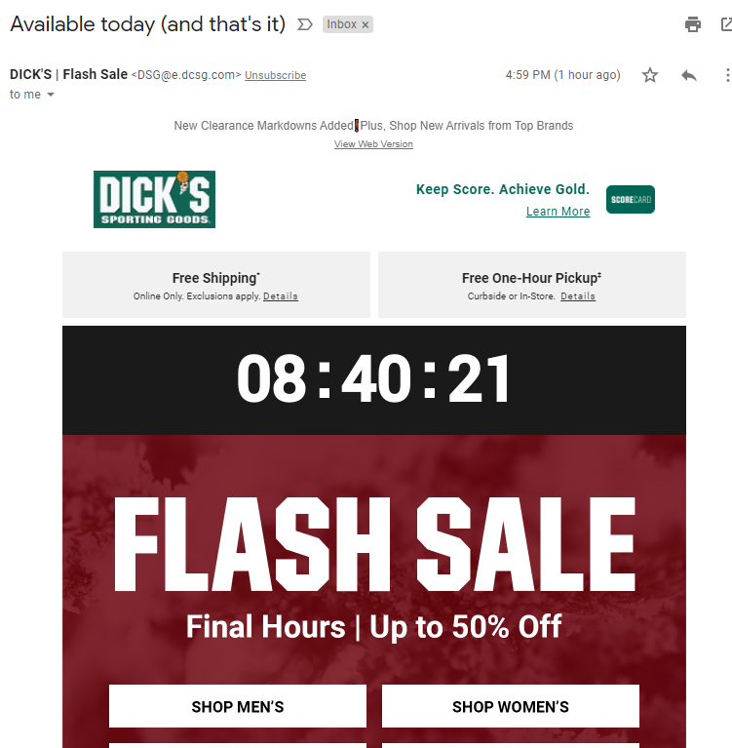
NEW TEST: Countdown Clock is a top performer
Expiring offer emails with ‘Clock’ had a 22% higher click rate vs. those messages without

Slide 59
C’MON!!!!

Slide 60
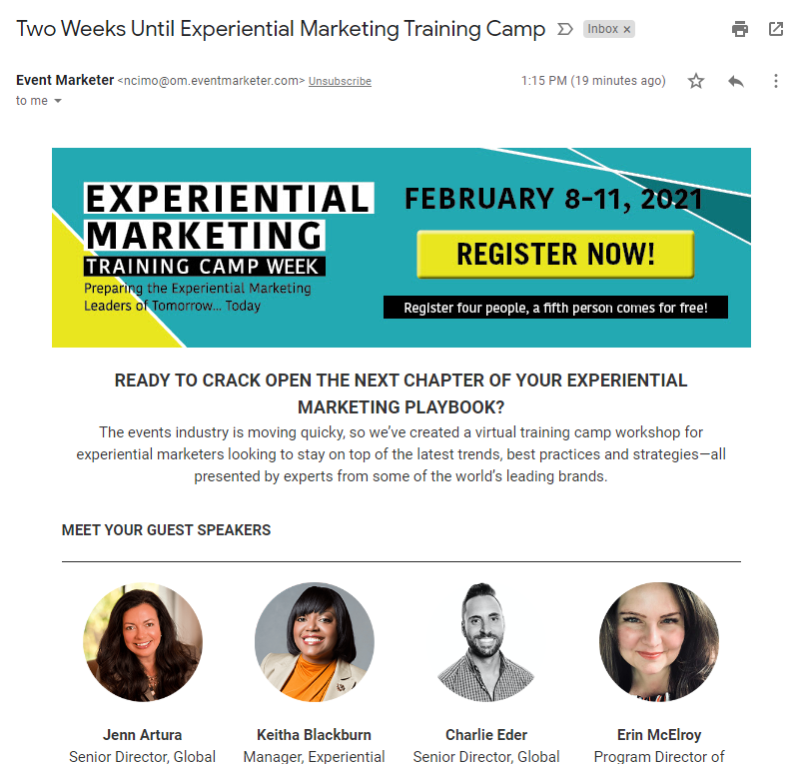

Slide 61
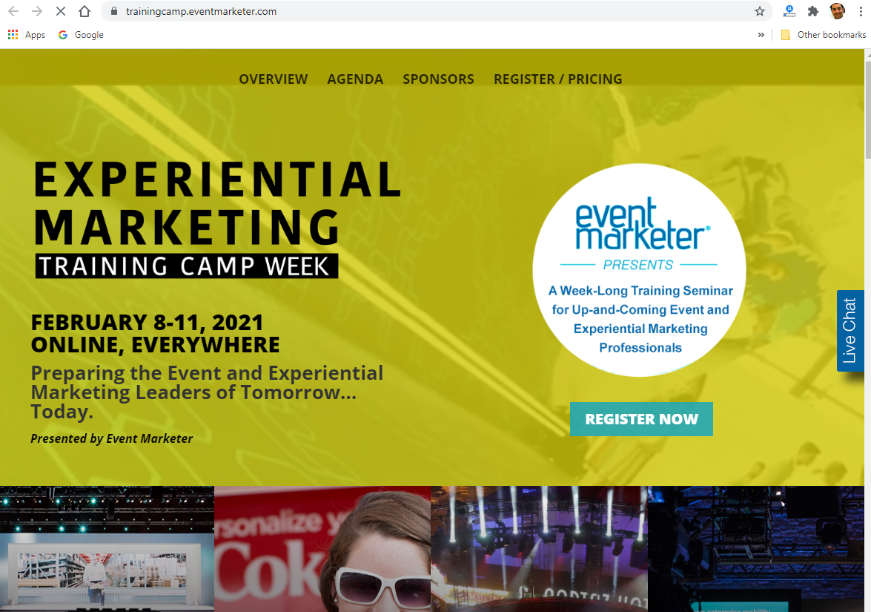
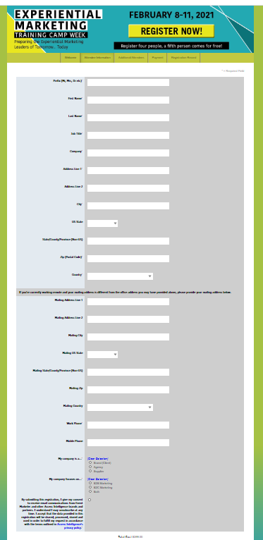
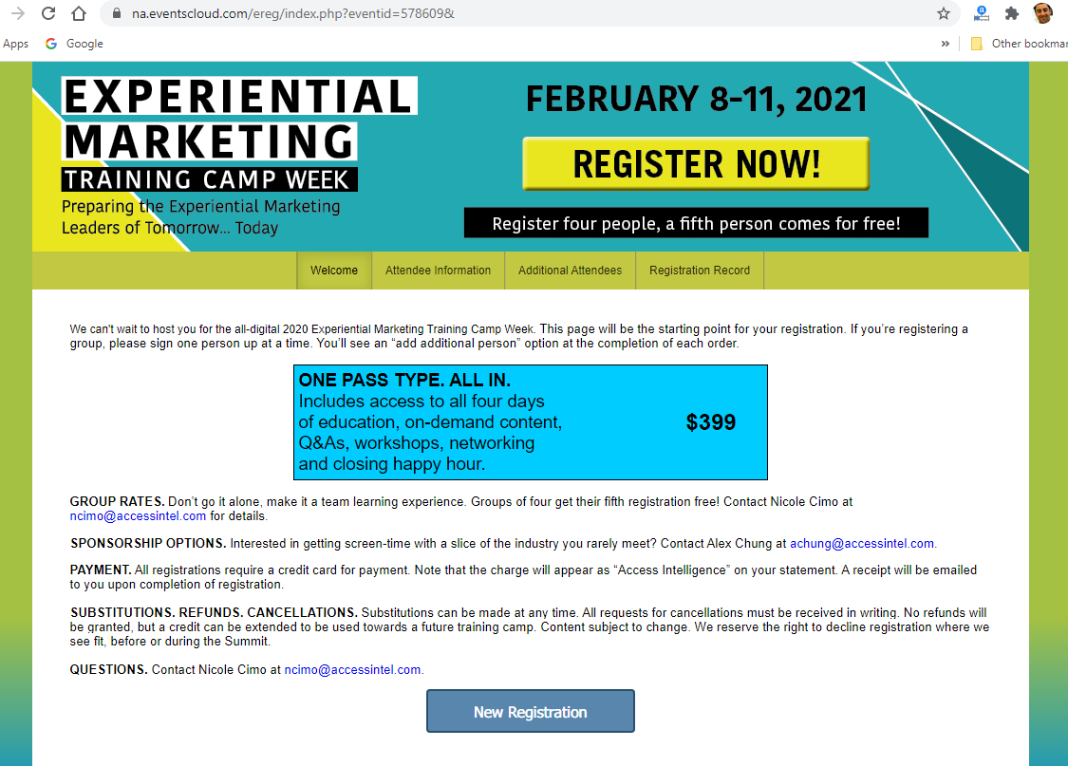
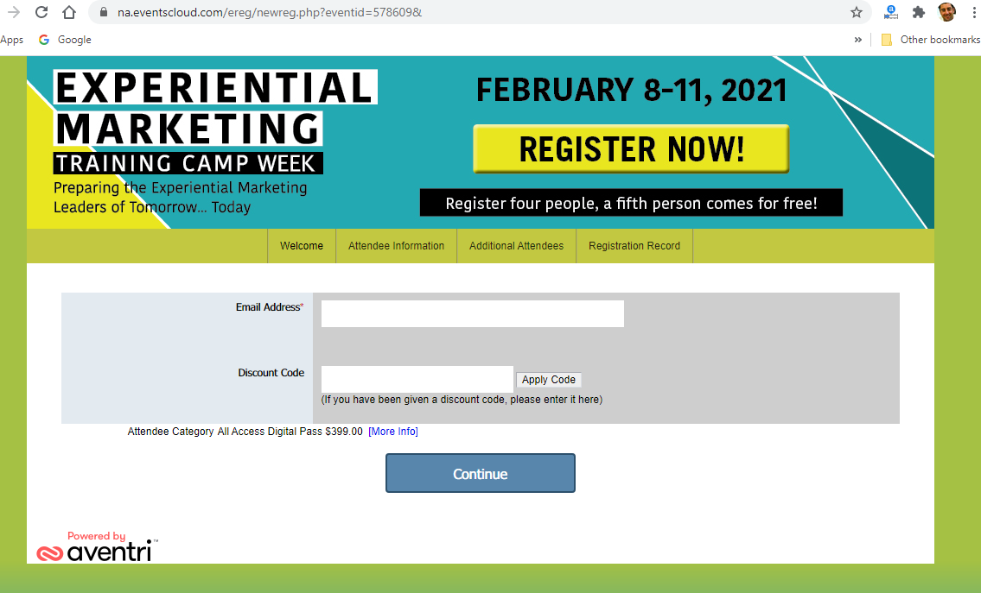
EMAIL
Landing Page
Page 4
Page 2
Page 3

Slide 62
EMAIL
Landing Page
Page 4
Cannot make this up.
‘EXPERIENTIAL MARKETING Training Camp’!!!!
Page 2
Page 3

Slide 63
EMAIL
Landing Page
Page 4
BtoB:
Every ‘Additional Click (page)’ You Will Lose Over 25% of Respondents
BtoC:
Every ‘Additional Click (page)’ You Will Lose Over 20% of Respondents
Page 2
Page 3

Slide 64
I always send out a
‘thank you’ email but its really not a big deal

Slide 65
I always send out a
‘thank you’ email but its really not a big deal

Slide 66
This Email That You Send Out is BY FAR The Most Important!

Slide 67
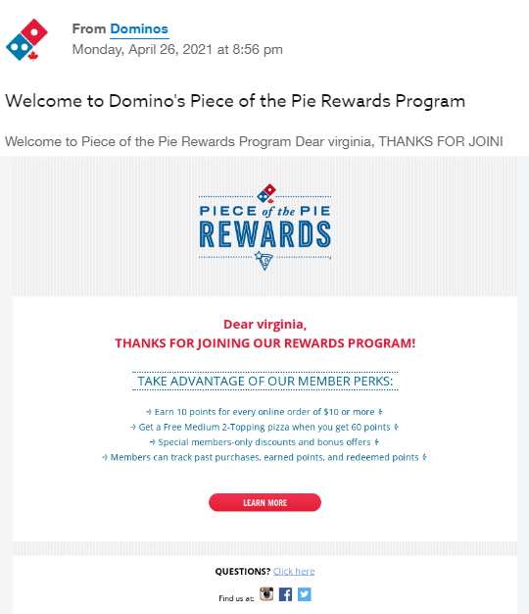
NOT ENOUGH!

Slide 68
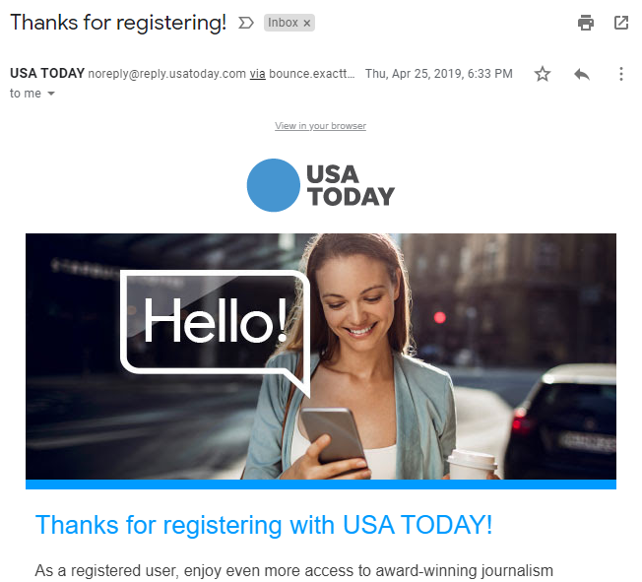
Who Cares? Of course you send out a post-registration email…
What is the big deal?

Slide 69
Future Delivery to Contacts Inbox Who Open Initial Post-Registration Email Increase by 87%
Future Emails to Contacts Who Don’t Open Post-Registration Emails Generate Open Rates that are LOWER by at least 60%

Slide 70
Future Delivery to Contacts Inbox Who Open Initial Post-Registration Email Increase by 87%
Future Emails to Contacts Who Don’t Open Post-Registration Emails Generate Open Rates that are 60% Lower
Push Aggressive/Fantastic Information In Post Registration Emails.
MAKE SURE ‘The Exciting Part’ IS MENTIONED IN SUBJECT LINE.

Slide 71
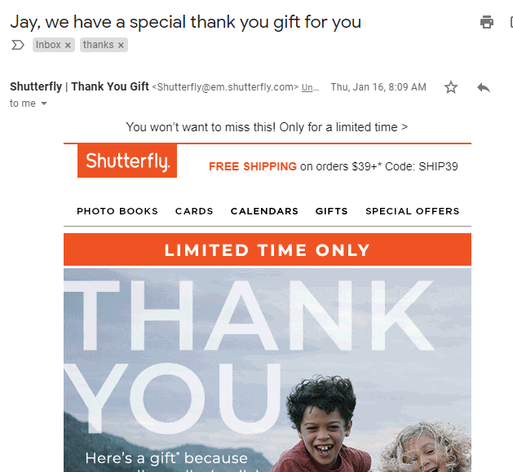
Push Aggressive/Fantastic Offer In Post Registration Emails.
MAKE SURE OFFER IS MENTIONED IN SUBJECT LINE.
Thank You, and…
Registered! Just For You…
Here is the next step…

Slide 72
NEW FREE STUFF!
JayS@CorpWD.com
@Worldata

Slide 73
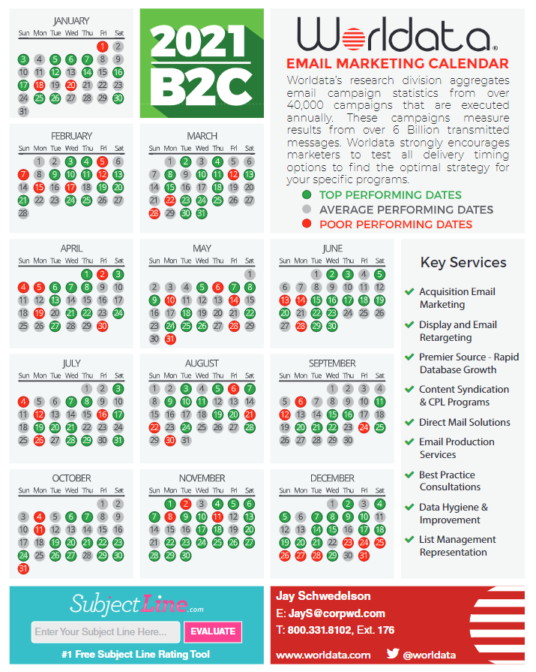
Email Marketing Calendar:
Best and Worst Days to Send
B2B and B2C Versions
UPDATED AGAIN!
NEW AS OF June 1st!!!!!
For SLIDES & Calendar: JayS@CorpWD.com
WAIT….There is more!!!!
(lots of resources at Worldata.com)

Slide 74
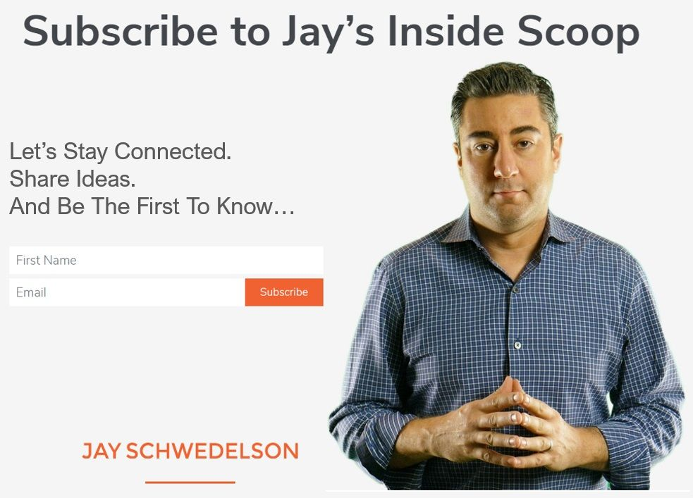
www.JaySchwedelson.com
If you email me you can also just say “add me to SCOOP”
For Slides, Calendar, Questions: JayS@CorpWD.com
@Worldata – Instagram and Twitter
WAIT….There is more!!!!

Slide 75
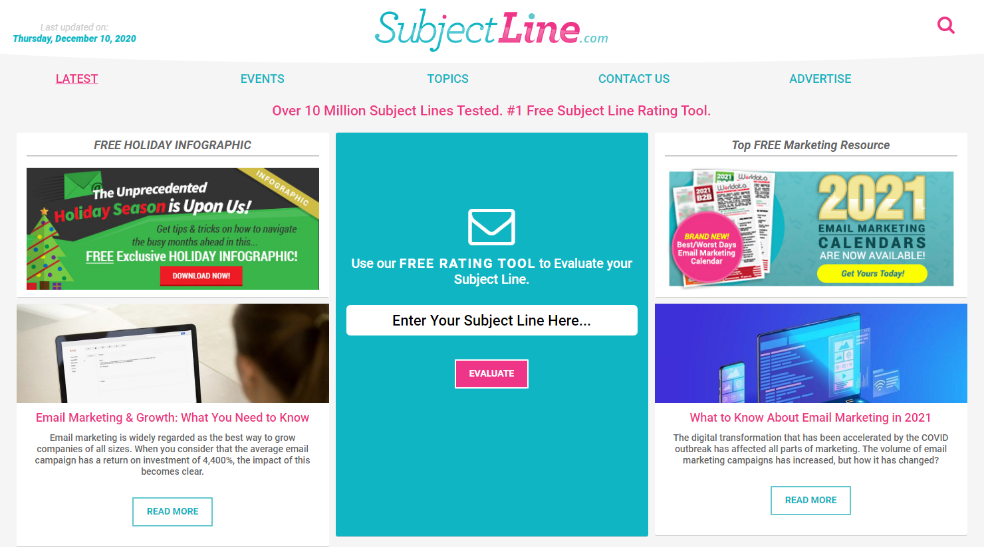
Over 10 million Subject Lines Checked And It’s FREE!
For SLIDES, Calendar, Scoop, Questions: JayS@CorpWD.com

Slide 76
Thank You!
For SLIDES, Calendar, Scoop, Questions: JayS@CorpWD.com
@Worldata – Instagram and Twitter

