Slide 1
Legislative Update for Direct Marketers

Slide 2
i
Current legislative landscape for merchants and direct marketers.
AGENDA
1
Privacy Laws, current and proposed
12
Remote Seller tax and related tax issues
2
Timely Postal Matters
34
KeepUSPosted
ii
Organization Roots
1
Objectives
2
Industry Engagement: Fighting Back
iii
How to fight
1
What to expect
2

Slide 3
Guest Speaker Biography
Hamilton Davison
Mr. Davison has been the President & Executive Director of the American Catalog Mailers Association (ACMA) since its founding in April 2007. Prior to this, he consulted for an educational services start-up, created a specialty card and gift retail chain and grew it to more than 150 stores, was CEO of the oldest and third-largest greeting card publisher and manufacturer, and started an oil and gas exploration business.
Mr. Davison’s involvement in postal affairs started in 1992 with his service on the Greeting Card Association’s postal affairs committee. He became chair and directed the litigation and witness team charged with protecting the GCA subclass against virtually every other mailer, helping bring his association from its nadir (losing a rate case appeal at the Supreme Court) to an established force in postal policy that was routinely consulted on all important postal policy issues. He championed and sold the Forever Stamp to many including proposing it to the Chairman of the Board of Governors.
Mr. Davison has testified before the House, Senate and a Presidential commission on the USPS. Both during and prior to founding ACMA, Davison has made numerous lobbying visits to both sides of the aisle in both Houses of Congress. He was a founding member of the Mailing Industry CEO Council and served as its Secretary & Treasurer from 2002-2006. He serves on the board of the Assn for Postal Commerce (PostCom) and the USPS’s MTAC as well as the executive committee of several industry coalitions.

Slide 4
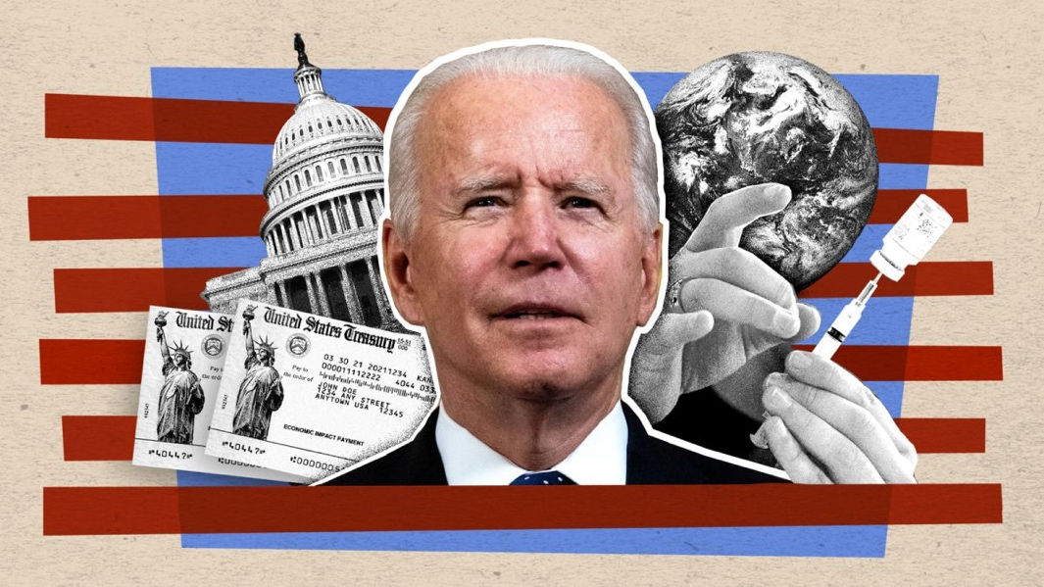
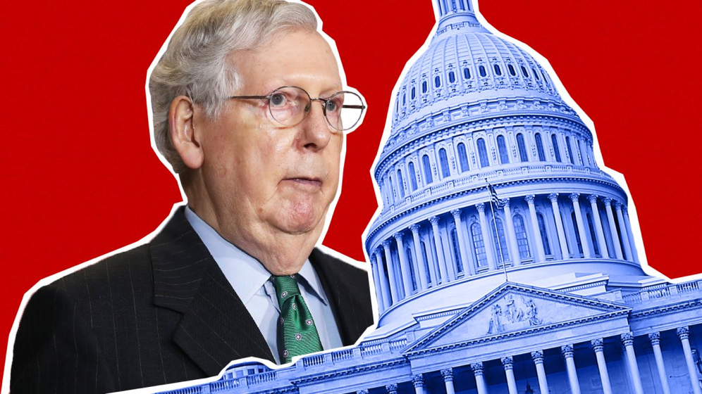
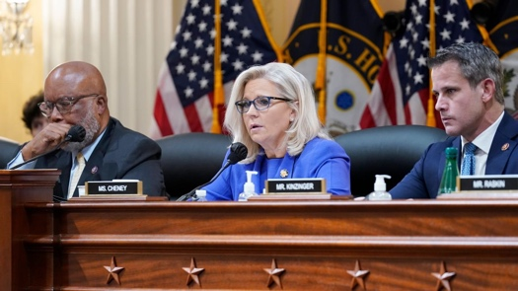
UPDATE FROM CONGRESS & NEAR-TERM EXPECTATIONS
Following passage of the Inflation Reduction Act, the Senate is in recess and will reconvene on September 6th.
The House will be in session this Friday to vote on the Inflation Reduction Act; Returns from recess September 13th.
Following August recess, lawmakers will be solidly in midterm mode and will be focused on their campaigns.
Congress has a busy agenda with must pass legislation and there is a strong likelihood that several bills will be punted to after the midterm elections. (NDAA, Appropriations, government funding etc).
September - December
Days Left in Session (September – December Work Period)
September
Senate: 18
House: 11
October
November
Senate: 9
House: 0
Senate: 10
House: 7
December
Senate: 15
House: 10

Slide 5
PRIVACY LAWS, CURRENT AND PROPOSED
Several legislative proposals had been introduced in Congress to address the patchwork of state privacy laws:
United States Consumer Data Privacy Act (Sen. Wicker)
Consumer Data Privacy and Security Act of 2020 (Sen. Moran)
Data Protection Act of 2020 (Sen. Gillibrand)
Consumer Online Privacy Rights Act (Sen. Cantwell)
In May, Representatives Pallone, McMorris Rodgers, and Senator Wicker, released a draft discussion federal privacy bill -The American Data Privacy and Protection Act.
In July, the House E&C Committee voted to pass the legislation by a strong 53-2 vote.
Notes:
Prior to COVID consuming all political oxygen,

Slide 6
PRIVACY LAWS, CURRENT AND PROPOSED
The American Data Privacy and Protection Act would:
Establish a national framework to protect consumer data privacy and security;
Grant broad protections for Americans against the discriminatory use of their data;
Require covered entities to minimize on the front end, individuals’ data they need to collect, process, and transfer so that the use of consumer data is limited to what is reasonably necessary, proportionate, and limited for specific products and services;
Require covered entities to comply with loyalty duties with respect to specific practices while ensuring consumers don’t have to pay for privacy;
Require covered entities to allow consumers to turn off targeted advertisements.
Notes:
Prior to COVID consuming all political oxygen,

Slide 7
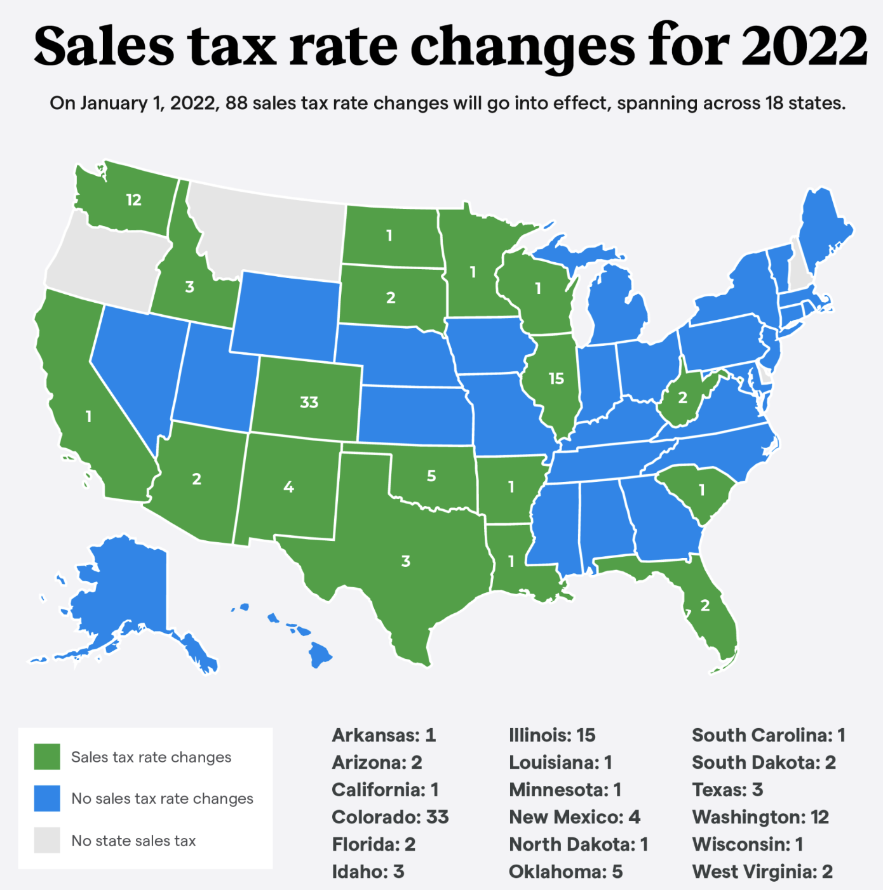
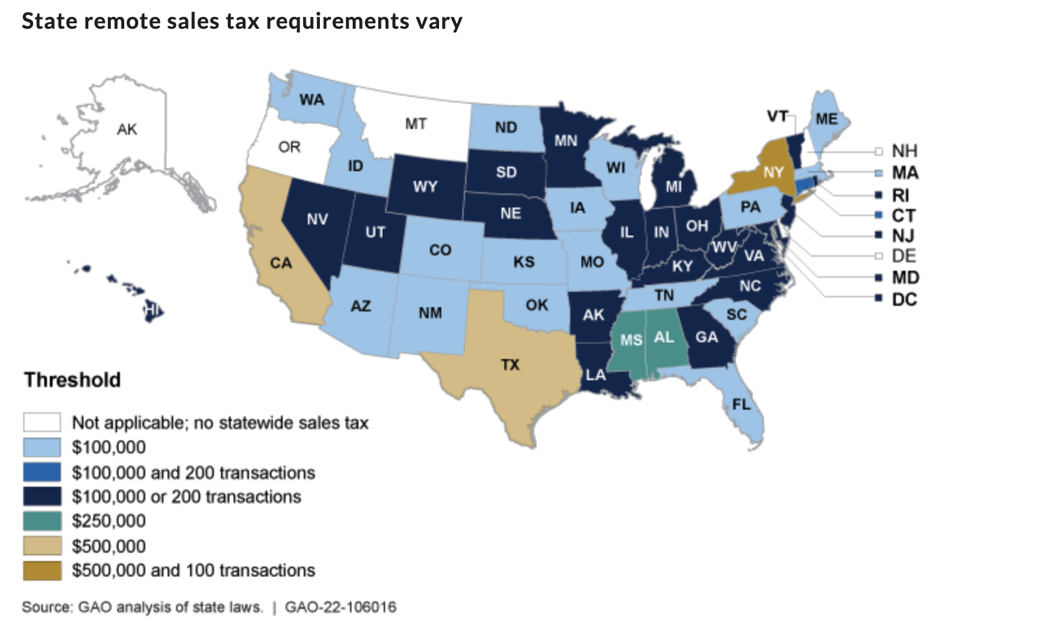
REMOTE SELLER TAX LAW ISSUES
After the Supreme Court’s decision in South Dakota v. Wayfair, states now require sellers that do not have a physical presence in their state to collect and remit their taxes on sales of products delivered into their state.
Shifting Sands: On January 1, 2022, 88 sales tax rate changes went into effect, spanning across 18 states.
ACMA has continued to actively engage and advocate for federal legislation that would create a unified remote sales tax framework.
Our efforts continue to be recognized by Members of Congress and in June, The Senate Finance Committee held a full committee hearing on Examining the Impact of South Dakota v. WayFair on Small Businesses and Remote Sales.
An ACMA Member Company was a witness at the hearing and ACMA and other member companies submitted written testimony.

Slide 8
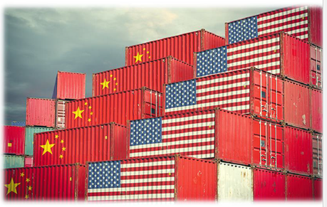
ACMA regularly updates its members with timely updates on other topics such as trade issues, new extra-jurisdictional regulations and other material developments…
TRADE & TARIFFS
On May 3, USTR announced its statutory four-year review of the Section 301 tariffs imposed on $370 billion in imports from China under the Trade Act of 1974.
Under statute, these tariffs are required to expire on the four-year anniversary of their imposition (July 6, 2022 and August 23, 2022) unless domestic beneficiaries of the tariffs request their extension.
This review is an opportunity for industry and other tariff-effected stakeholders to make the best possible case for the modification or elimination of the Section 301 tariffs on certain products and rebut protectionist organizations from extending these tariffs.
The review will cover the products on Lists 1, 2, 3, and 4.
USTR Katherine Tai has mentioned in the past that she does not want to weaken her negotiating position with China by lifting 301 tariffs, especially considering China’s failure to hit the Phase One agreement trade targets.
According to conversations with senior staff at USTR - The second phase (soliciting comments from those who dislike the tariffs) of the Section 301 tariff review is coming very soon and should be released by USTR shortly.

Slide 9
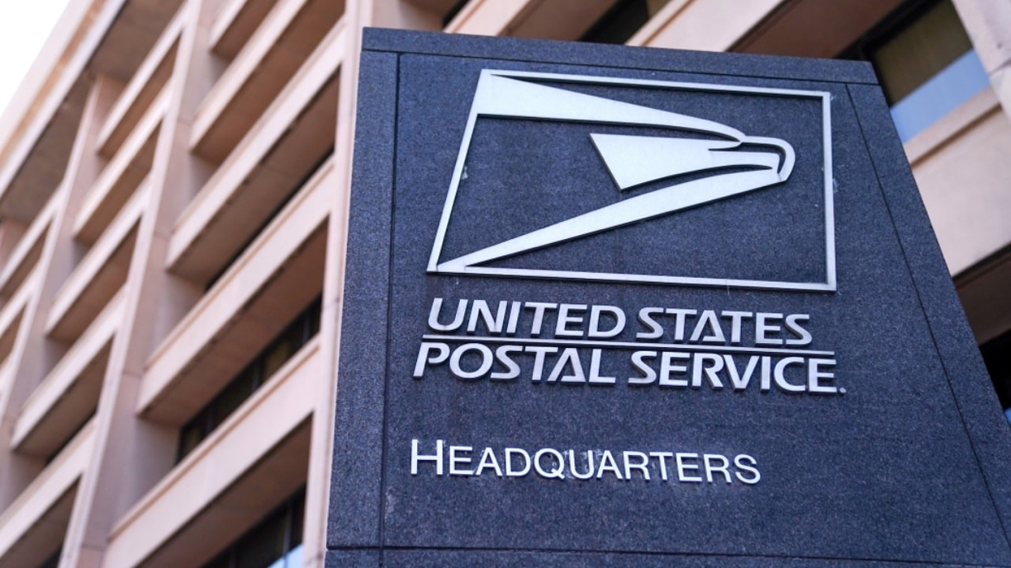
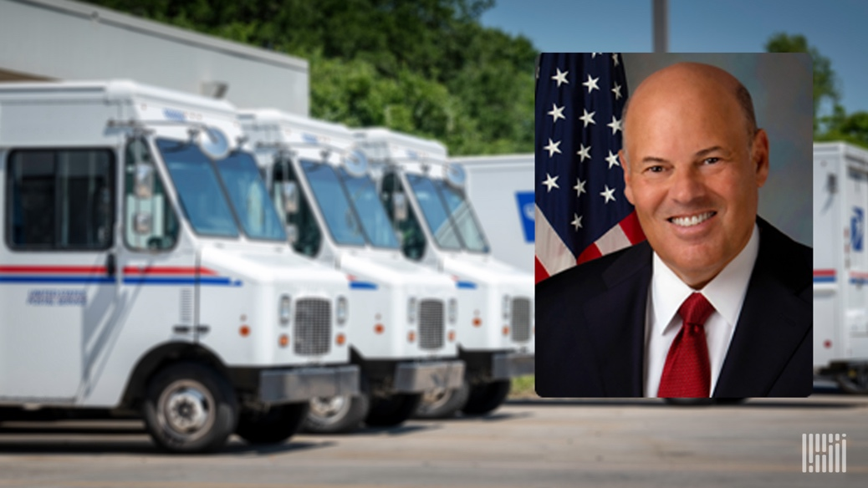
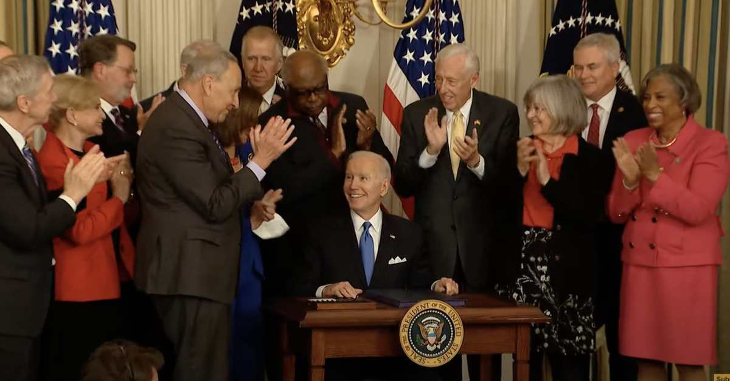
POSTAL SERVICE REFORM ACT (PSRA)
In April, after massive bipartisan support in House and Senate, Biden signed the PSRA into law, which provides $107 billion in direct and indirect support for the USPS.
The PSRA would:
Eliminate the retiree health prefunding requirement for the USPS.
Requires the USPS to establish and provide reasonable service performance targets for “market dominant products” – annually, and create a portal for public to display publically.
Requires that the USPS maintain an integrated network of delivery of market dominant products and competitive products – six days a week.
Requires the PRC to assess whether regulatory revisions are needed to ensure all direct and indirect costs attributable to mail and package delivery are properly attributed to these products.
Requires the PRC, in cooperation with the USPS inspector general, to submit a report to Congress and the postmaster general identifying the causes of inefficiencies in handling flats mail – such as catalogs and magazines – and quantifying the effects of volume trends, investment decisions, excess capacity, and operational inefficiencies on flats costs.

Slide 10
POSTAL SERVICE REFORM ACT (PSRA)
What The PSRA didn’t include:
Reverse any of the PRC final rule #5763 providing additional rate authority.
Limit the number of times a year the USPS can increase postage rates.
Mandate that the USPS move its retirement assets into higher interest earning thrift savings plans.
<2% return from Treasuries
Restore Civil Service Retirement System (CSRS) overpayments to USPS.
Estimated as much as $111 billion

Slide 11
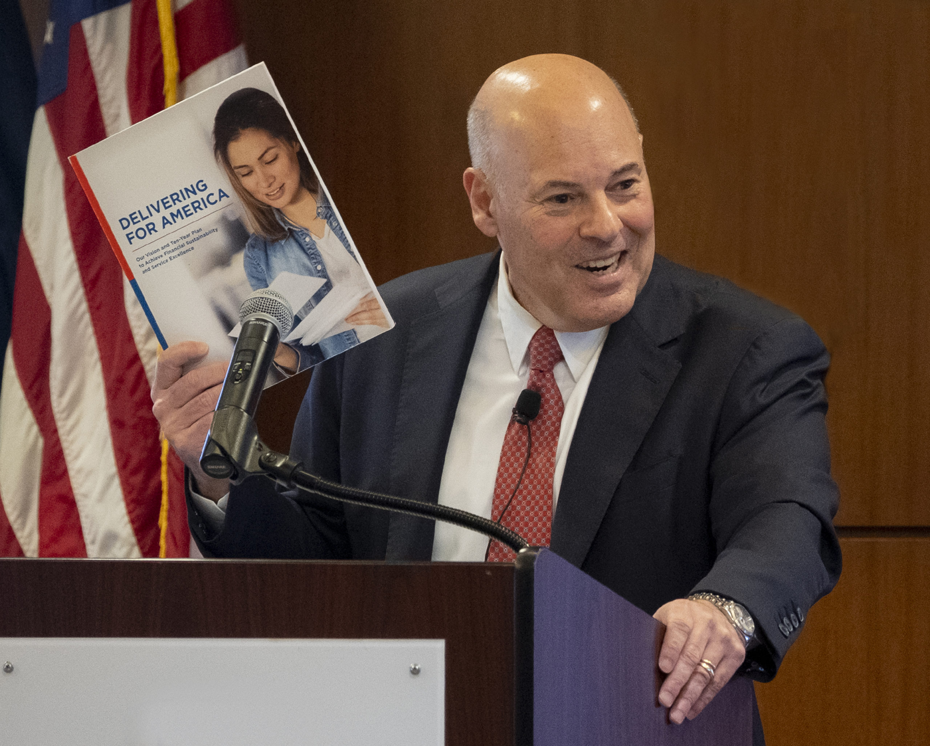
POSTAL CONCERNS ON THE HORIZON
Efforts to have PRC do a second 10-year review
Appropriations bill language urging a study
Comments on RM2205-5
COVID relief
$3B for EVS
Future rate increases, frequency and size
January 22nd, 2023 Release
Forecasted at 4.1% - 4.3%, Flats + 2%
Impending structural changes
2023 Promotions

Slide 12
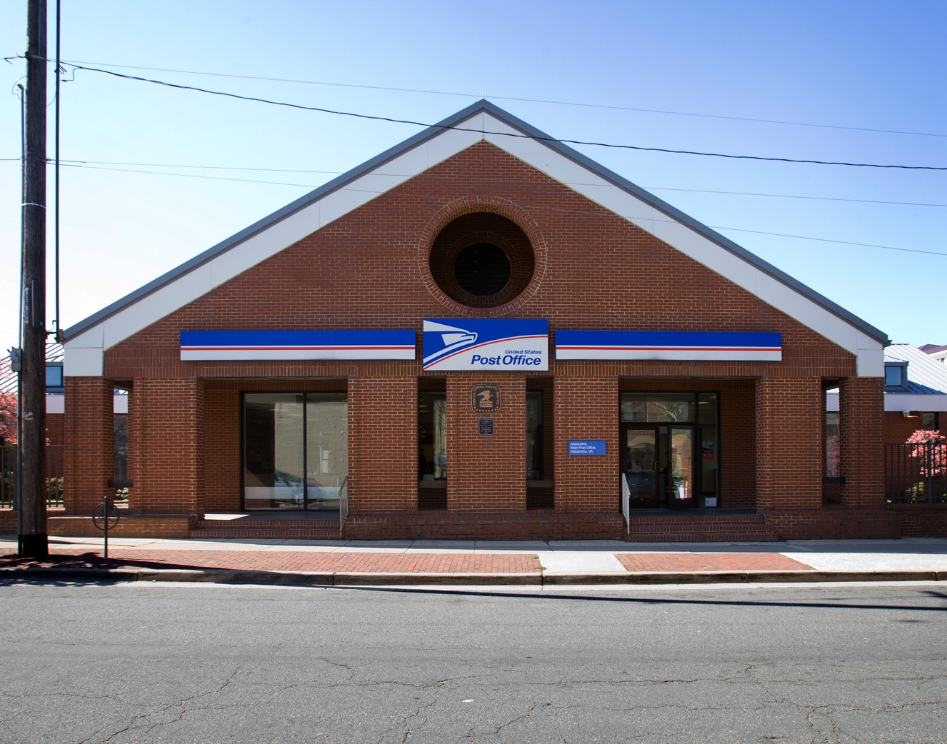
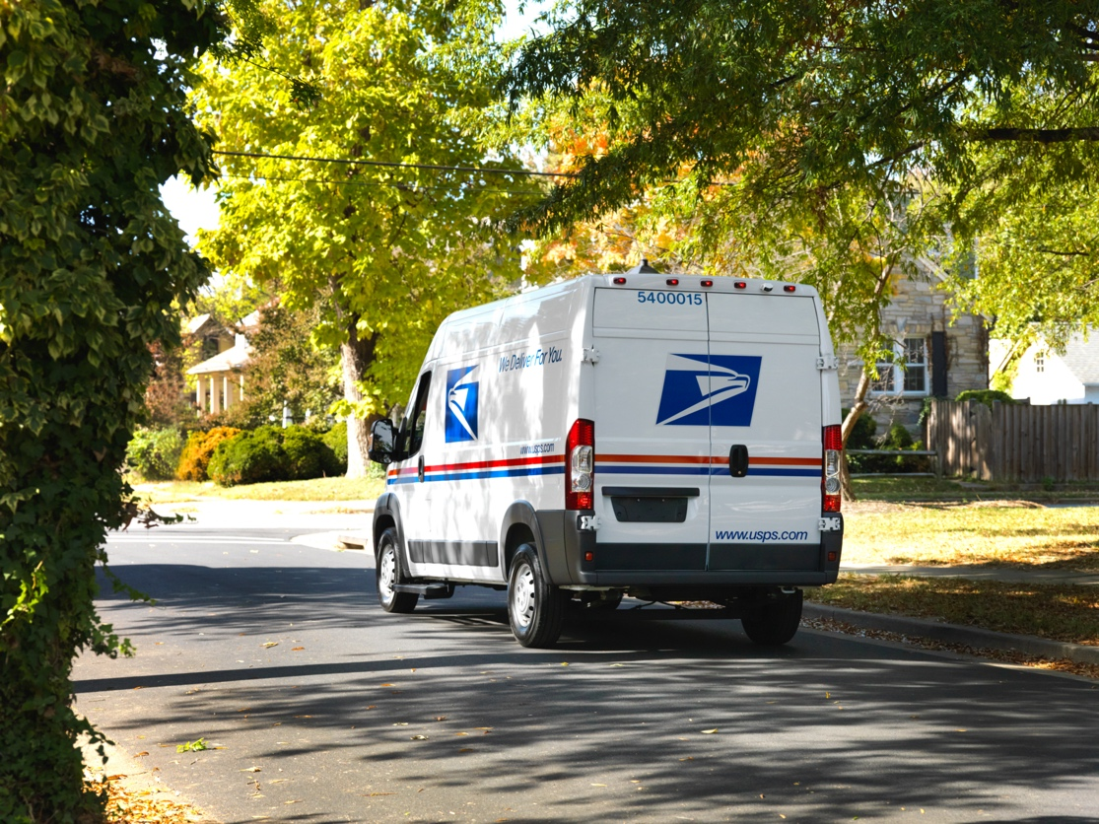
POSTAL CONCERNS ON THE HORIZON
Network Redesign
NDC, ASF, SCF, ADC
Vision –– RPDC, LPC, SDC/DDU
Timeline – over the next three to four years.
Elimination of FSS
Peak Season Preparedness
Equipment - 46 Package sorting machines added, 53M total daily package capacity, up from 50m
Employees – 10,000 conversions throughout 2022 & 19,000 peak season hires starting in October.
Facilities – 58 long term and parcel sort annexes, & 24 temporary peak processing annexes for 2022

Slide 13
Keep US Posted
Send Mail. Save Mail.

Slide 14
Who is Keep US Posted?
It is a community of individual Americans and allied organizations
united in the belief that a reliable, affordable U.S. Postal Service is essential to our way of life. We are grounded in the reality that we must act now to protect it.

Slide 15
Supporting
Partners

Slide 16
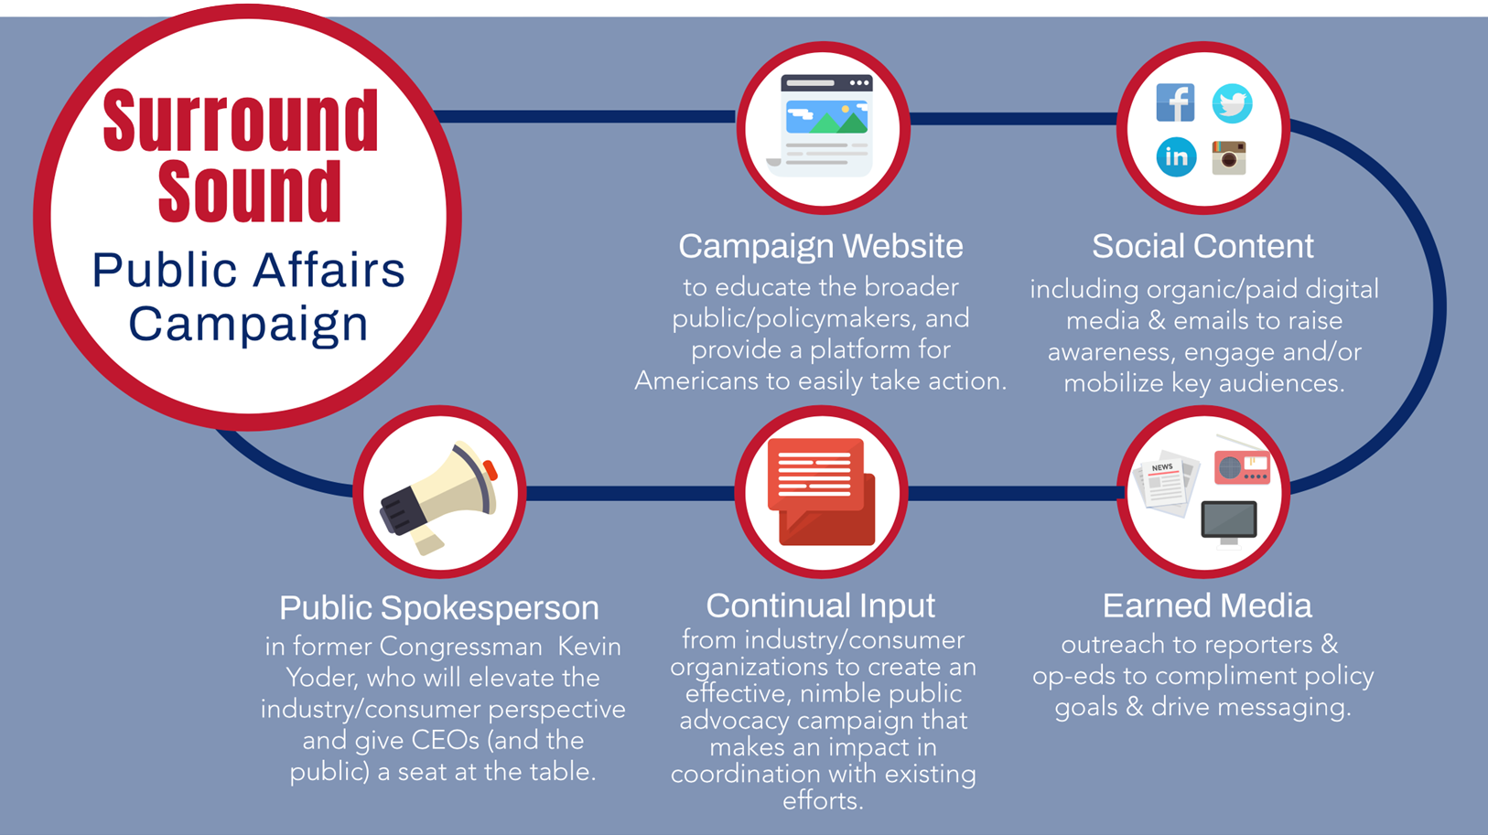

Slide 17
Generated tremendous advocacy for the Postal Service Reform Act in just one month.
17,650
2,488
Emails to Congress
Tweets to Congress

Slide 18
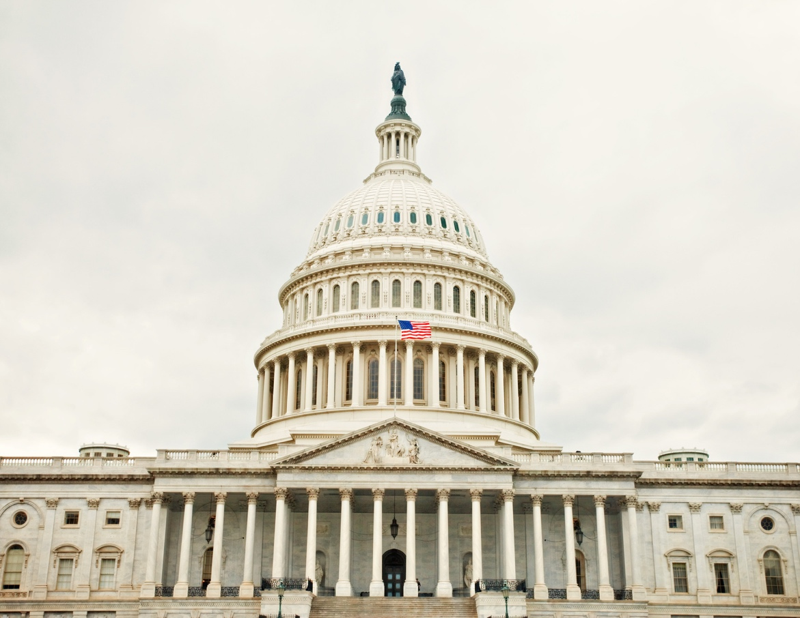
Building Congressional Champions
CONNECTING INDUSTRY & CONSUMER CONSTITUENTS
CAPITOL HILL EVENTS
PRESS IN-DISTRICT & LOCAL RECOGNITION

Slide 19
We must turn our attention to making sure the American people and businesses benefit from postal reform.
We will continue working to keep rates down and improve service.
This is a multi-year effort.

Slide 20
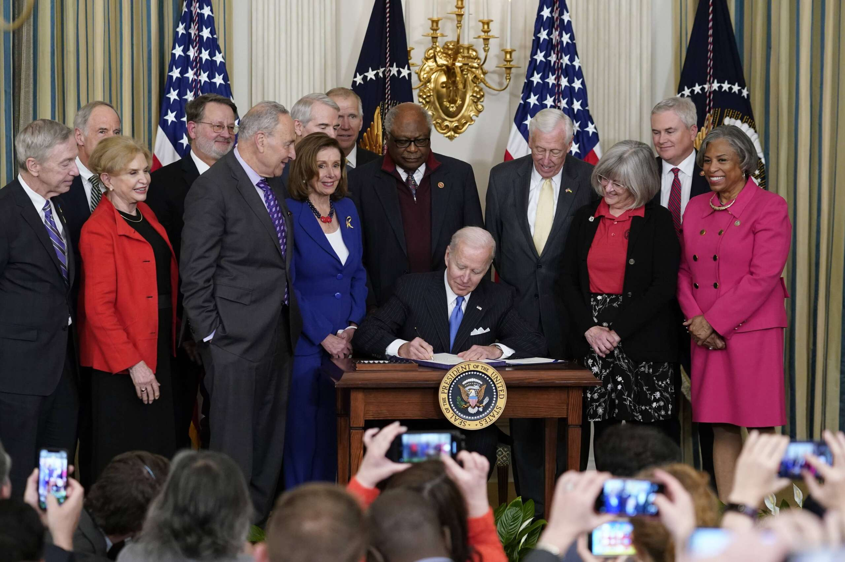
The same day Biden signed the PSRA, DeJoy announced historic rate hikes.
The announcement was made for rate increases in spite of the landmark legislation’s passage, ignoring the hard work of Congress.

Slide 21
“Therefore, from my perspective, the mailing industry needs to be prepared for continued use of our authority to raise prices on market dominant products at an uncomfortable rate until such time as we have accomplished our objective of projecting a trajectory that shows us becoming self-sustaining—as required by law. While our pricing decisions are ultimately made under the authority of the Board of Governors, in the near term, I will most likely be advocating for these increases.”

Slide 22
A crisis is brewing in the mailing industry.
Each of us has something at stake. If we do not DO something now, the actions being taken today will lead to a loss of almost half the customer base (42%) over the next decade.

Slide 23
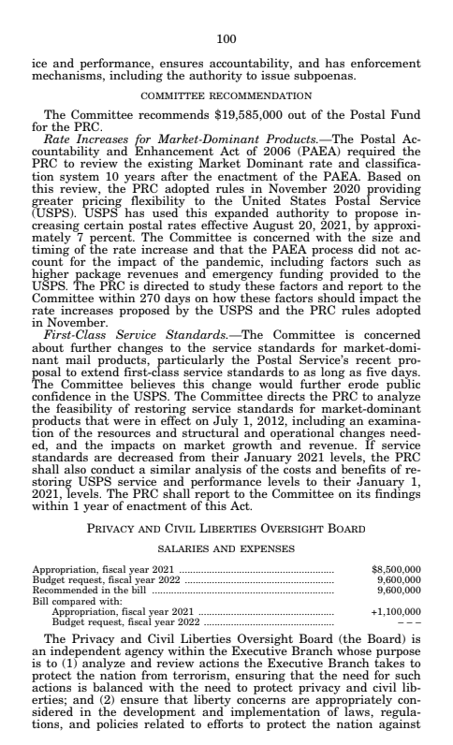
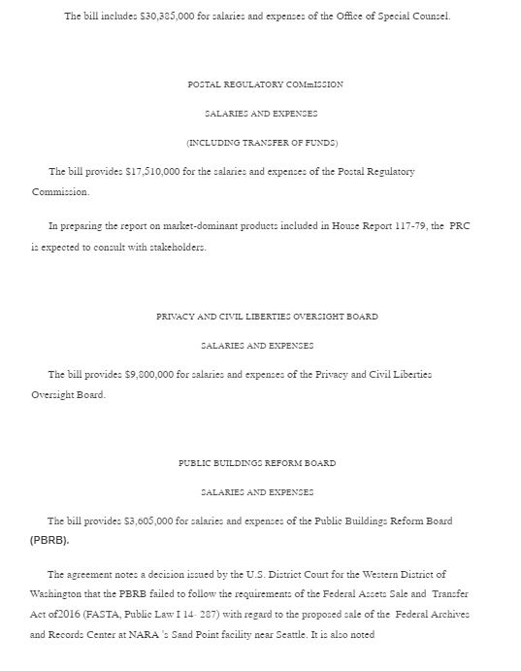
Congressional leadership is needed to force a change in the rate plan.
Keep US Posted has been working with Congress to push the PRC to reconsider the rate caps. Progress has been made but this effort requires a steady drumbeat.
hello@keepusposted.org
www.keepusposted.org

Slide 24
The Power & Importance of Trade Association Advocacy in Washington
Irrespective of industry, the value of advocacy in Washington can’t be understated. Trade associations play an integral role in shaping public policy outcomes in Washington.
Members of Congress continuously look for input and support from trade associations given their diverse supply chains, distribution networks, and collective market strength.
Without a voice in Washington, companies lack an effective mechanism to influence public policy narratives in Washington and ultimately are at risk of significant policy headwinds on their businesses.
As importantly, a voice in Washington also provides companies with actionable intelligence on evolving policy discussions.
Irrespective of political dynamics, Congress will ultimately legislate and Members of Congress on both sides will continue to try to score legislative wins. Therefore, continued advocacy and engagement is critical.

Slide 25
ACMA’s Recent Impact on behalf of Members
Postal Costs: Material support to get PSRA passed in 2022. Successfully got “non-starter” issues removed and buried. Significant constituent mobilization. Fought for items that benefit mailers and deep education of Congress as to why this is all so important.
Sales Tax – National level: Went from no congressional interest in 2018 to a 2022 hearing on Sales Tax Issues including getting an ACMA member company CEO to testify and submitting written testimony while encouraging others to do likewise. Significant post-hearing follow up to identify champions and drive legislation.
Sales Tax – State level: Continued litigation to check bad behavior on the part of state’s Departments of Revenue including filing this month in California to prevent direct sellers who only gather orders from having to file corporate income taxes.

Slide 26
ACMA’s Recent Impact on behalf of Members
(continued)
Privacy – National level: Broad congressional outreach to educate legislators on direct marketing specific privacy issues. Legislators most active on privacy seeking ACMA input.
Privacy – State level: Continuing lobbying in states that with moving privacy legislation to ensure direct marker concerns are considered.
ACMA Members are well informed, actively driving outcomes that are material to their business, and are building relationships with those that control their future.

Slide 27
CONTACT US
For more information on the ACMA:
Info@catalogmailers.org
.
https://catalogmailers.org/

