Slide 1
Navigating the Post-Cookie Internet
How Privacy is Redefining Digital Identity and Marketing Strategy
James Purtle, Sr. Director Digital Strategy

Slide 2
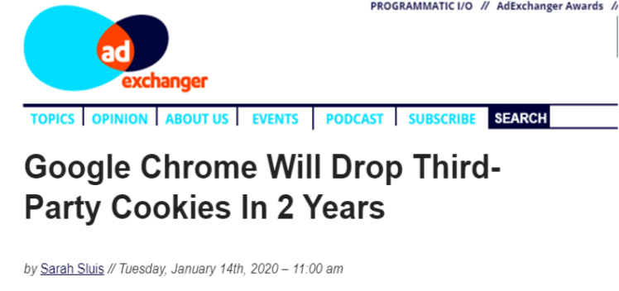
“Cookie Apocalypse”

Slide 3
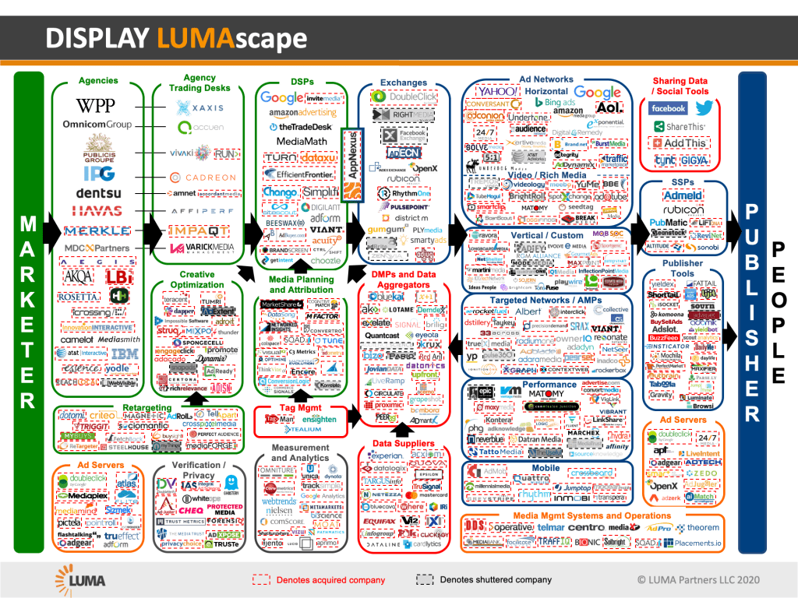
-50%
$250B

Slide 4
Don’t Panic
Demand drives the ecosystem
AdTech has anticipated this change
3rd Party Cookies will be phased out responsibly
This is good for consumers AND good for marketers

Slide 5
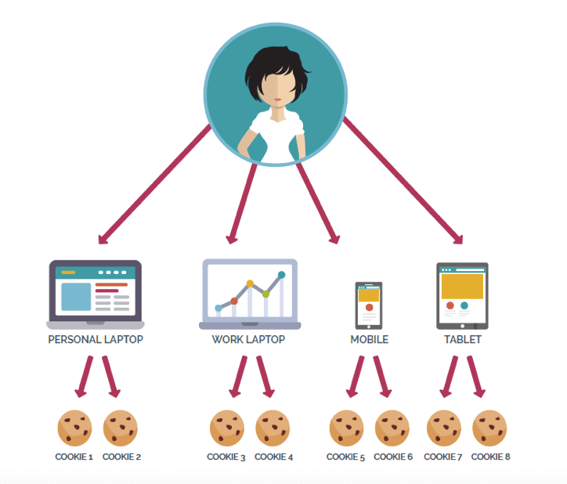
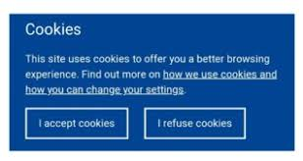
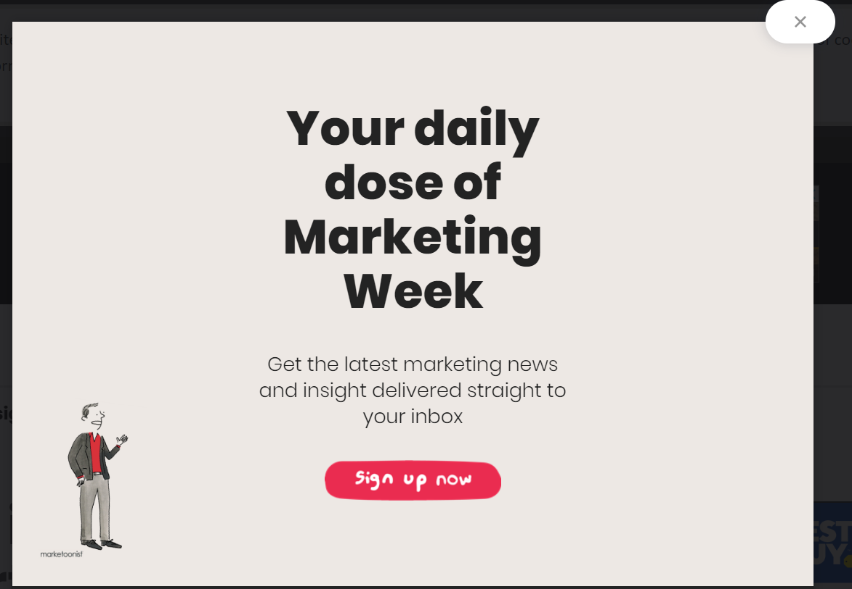
Privacy by design

Slide 6
Pros and Cons for Marketers
Pros
Cons
1:1 customer interaction
Transparency
Trust
Collaboration
Behavioral targeting/segmentation
Web retargeting
Direct response (customer acquisition)
Exclusion
Frequency
Measurement/Attribution
Partnerships

Slide 7
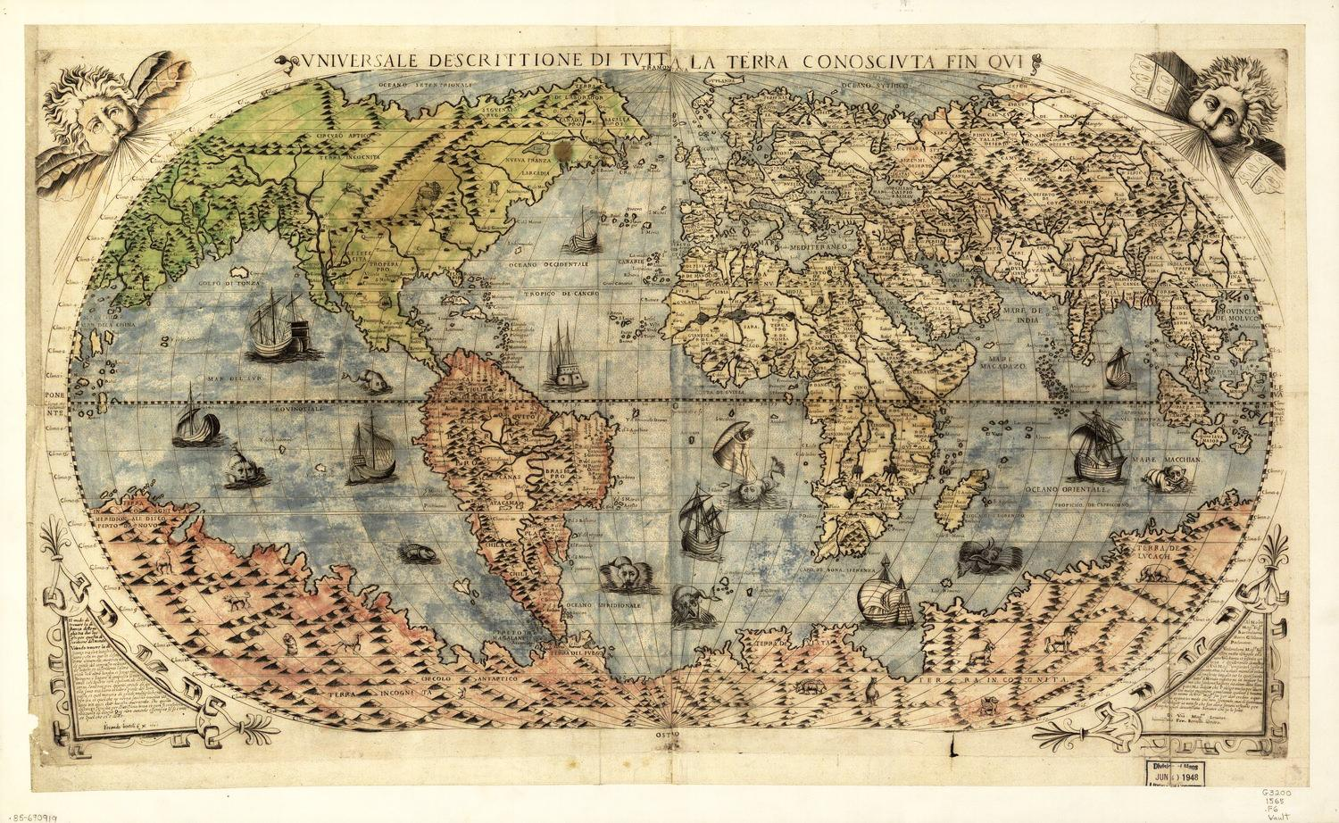
Notes:
Paolo Forlani (1565) (Forlani 3) re-interpretation of Giacomo Gastaldi’s world map 1546
Title: Universale Descrittione Di Tutta la Terra Conosciuta Fin Qui Date: 1565 Author: Paolo Forlani Description: Between 1560 and 1570, Paolo Forlani issued four world maps, with his 1565 map (known as Forlani 3) being the largest and the most decorative of the sequence. As with Forlani’s earlier world maps, Forlani 3 is a re-interpretation of Giacomo Gastaldi’s world map of 1546 (#376), however a significant addition has been made: a large and extensive southern continent is shown and labeled Terra Incognita. Forlani has populated the unknown southern land mass with imaginary topographical features as well as unlikely animals - among them a camel, an elephant, a lion, a rhinoceros and most outlandish, a griffin and a unicorn. Giacomo Gastaldi was one of the greatest cartographers of the 16th century and the leading figure of the Lafreri School of cartography. Many of the maps published by this school were compiled by Gastaldi, and issued under the imprint of the various publishers of the period, with or without due credit. The Lafreri School of mapmakers is the umbrella term frequently applied, for want of a more accurate term, to the loose group of Italian cartographers, mapmakers, engravers and publishers working in Venice and Rome from about 1540 to about 1580 (with some of their printing plates being used well into the 17th century). Each of Paolo Forlani’s four world maps were issued in collaboration with other Italian mapmakers. Today, these maps typically survive only in very rare composite atlases known as Lafreri Atlases (named for Antonio Lafreri of Rome, who added a title page to some of these atlases, although no two known examples have an identical set of maps).

Slide 8
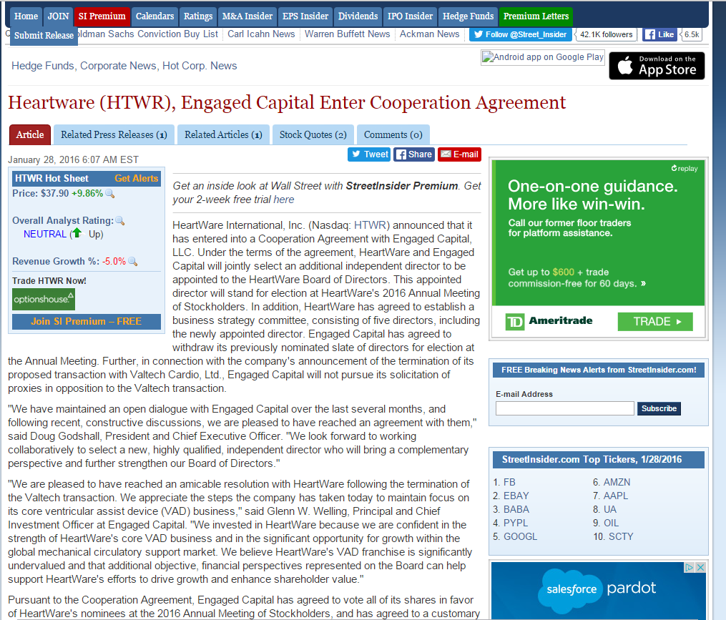
Contextual Targeting
Notes:
Contextual targeting: tried and true
Will continue to have a place in the marketing plan.
Better for branding than for direct response/personalization

Slide 9
A better cookie?
Existing Alternatives – IP Address, Device IDs
Alternative ID solutions
Anonymous behavioral targeting work-arounds
FLoC
TURTLEDOV
Notes:
“Federated Learning of Cohorts” (FLoC) – Modal observations to create randomized segments
“Two Uncorrelated Requests, Then Locally-Executed Decision On Victory” (TURTLEDOVE) – separate context from behavior

Slide 10
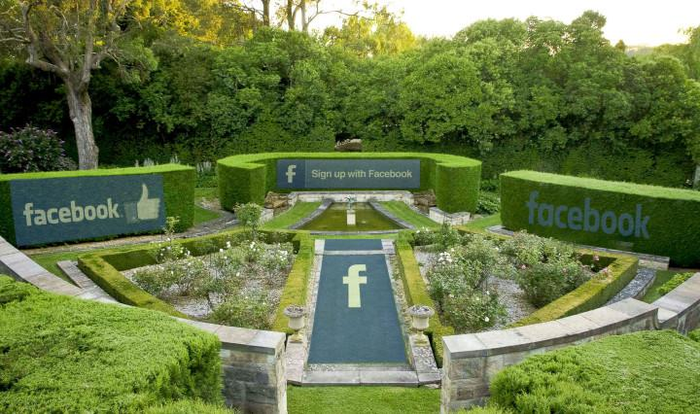
First-Party Data
Notes:
More and more publishers will start behaving like platforms – logged in, personalized environments.

Slide 11
Terra Incognita
Device IDs
IP Address
A patch-work of solutions will compete for market share
Marketers should demand transparency, measurement
No one-size fits all
Contextual Targeting
email
Anonymous Behavioral Segments
3rd party cookies
First Party Data
Alternative IDs

Slide 12
Thank You!
James Purtle, Sr. Director Digital Strategy
James.purtle@infogroup.com

