Slide 1
Notes:
Good afternoon, and thank you all for attending today’s HVDMA webinar on Broadcast Radio: The Timeless Power of Connection. I would like to extend a special thanks to Braden and the HVDMA team for organizing this event, as well as to Lorrie and the team at Dataline for their generous sponsorship. As mentioned, my name is Ava Savosh, and I serve as Vice President of Sales at iHeart Media. I am excited to share insights on one of my favorite topics—radio and its significant impact on both consumers and advertisers.

Slide 2
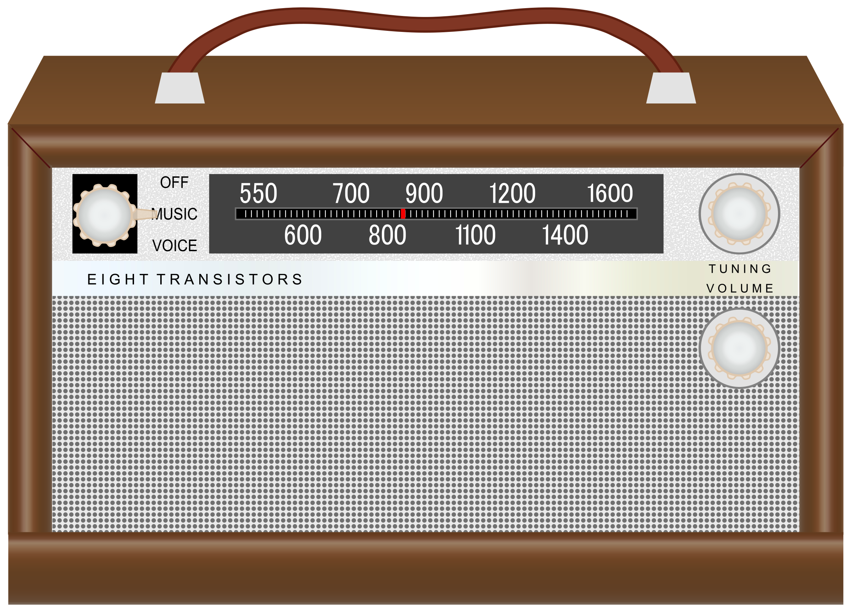
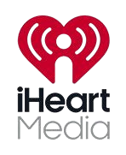
Notes:
WHAT IS RADIO? - Broadcast radio is the original mass communicator, bringing music, news, and entertainment to the world through the magic of radio waves. Whether it’s a local DJ spinning hits on a morning drive or a talk show diving into the day’s hot topics, radio connects us all—no Wi-Fi needed. There are two main ways radio reaches listeners: terrestrial stations, which transmit signals over the air, and satellites, offering even broader coverage. Formats like AM, FM, and digital radio each bring something unique to the table. AM’s long-range signals are perfect for news and talk shows, FM’s crystal-clear quality makes music shine, and digital radio takes it up a notch with features like song info and extra channels. In the U.S., radio remains a powerhouse, reaching about 82% of adults every week—proof that even in a world of streaming and podcasts, radio is still king. With over 15,445 stations nationwide, it delivers content everywhere, from bustling cities to the quietest rural towns. Trusted, accessible, and endlessly reliable, radio broadcast continues to be a go-to for millions looking for connection, entertainment, and information.

Slide 3
POWER OF RADIO
Economic Contribution
Hyper-Local Content and Real-Time Connections
Diverse Programming
Accessibility
Trust and Community
Notes:
POWER OF RADIO - Radio and audio have a unique ability to connect people through storytelling, music, and news, creating a shared experience even across vast distances. They offer an intimate and immediate way to convey emotions and information, making them powerful tools for communication and entertainment. Whether it's a podcast, a live broadcast, or a favorite song, audio can evoke memories and feelings in a way that visual media often cannot. Radio is a powerful resource that continues to play a vital role in modern society by offering significant economic contributions, hyperlocal content tailored to specific communities, real-time connections that keep listeners informed as events unfold, and a wide range of diverse programming to suit all interests. Its accessibility ensures that it reaches people from all walks of life, regardless of location or income, while its longstanding reputation fosters trust and strengthens community bonds. As one of the oldest and most reliable forms of communication, radio remains a cornerstone of information, entertainment, and connection in an ever-evolving media landscape.
• ECONOMIC CONTRIBUTION – A January 2024 study by the National Association of Broadcasters (NAB) examined broadcasting’s impact on the economy through direct employment, its ripple effect on other industries and as an advertising medium for messaging consumers. Local broadcasting's largest impact on the American economy stems from its role as a forum for advertising of goods and services that stimulates economic activity, Woods & Poole found. The study estimated local broadcast TV and radio advertising generated $1.03 billion in GDP and supports 1.42 million jobs. More than $630 billion in GDP and 875,000 jobs are attributed to the stimulative effect of broadcast television, and nearly $400 billion in GDP and over 540,000 jobs are attributed to radio.The study highlighted that the main role of broadcasting is to make product information more accessible through advertising. By doing this, these platforms play a big role in driving economic growth. Since they reach households across the U.S., local TV and radio stations give consumers valuable info about the marketplace while also helping businesses stay competitive and informed.
• HYPERLOCAL CONTENT/REAL-TIME CONNECTION – Radio stations have focused on providing hyper-local content, including community news, events, and live interactions. Radioinfo.com reports “While music discovery had once been radio’s bread and butter, the rise of platforms like YouTube and TikTok shifted that role to the internet. In response, radio pivoted toward storytelling, talk, and live community events.” Music discovery used to be radio’s strength, but platforms like YouTube and TikTok have taken over. In response, radio shifted to storytelling, talk shows, and live events. Niche stations thrived, focusing on retro gaming music, local sports, true crime, and audio dramas. News and talk radio also saw a resurgence. In an era of misinformation, many turned to trusted local voices for reliable updates. AM stations, once outdated, became hubs for real-time, fact-checked news and community debates. TikTok’s future in America remains uncertain due to privacy concerns, as platforms like it rely heavily on personal data.
• DIVERSE PROGRAMMING - Radio has diversified its programming to include niche content such as talk shows, true crime, sports, and audio dramas, appealing to a wide range of interests. Talk shows offer engaging discussions on current events and personal stories, while true crime delves into intriguing mysteries and real-life investigations. Sports programming keeps fans updated on games and scores, and audio dramas bring captivating storytelling to life through sound. This variety ensures there’s something for everyone, keeping listeners entertained and engaged.
• ACCESSIBILITY - Radio’s charm is in its simplicity and accessibility. Unlike streaming services, radio doesn’t need an internet connection or fancy gadgets. All you need is a radio and the ability to tune in. This makes it perfect for everyone—whether you’re in a remote area or don’t own a smartphone. No high-speed data? No problem. Radio waves don’t rely on expensive tech, which is why it’s such a reliable source of info and entertainment for people everywhere. It’s also completely free! No subscriptions, no monthly fees. You can tune in with anything from an old-school transistor to the radio in your car. And let’s not forget, radio reaches everyone—teenagers, seniors, city folks, or those living in rural areas. It’s one of the best ways to spread news and keep people connected. Plus, it’s live! While podcasts and streaming services are great, radio keeps you in the moment with up-to-date news, events, and discussions. The best part? Radio is always there when you need it most. In emergencies or power outages, you can still count on it for crucial information. No internet? No worries. Radio proves time and again that it’s a trusted, timeless medium for everyone.
• TRUST AND COMMUNITY - What makes radio so special is the emotional connection it creates. Radio hosts and DJs have a way of making listeners feel like they’re part of a community. Unlike streaming platforms, which can feel pretty impersonal, radio is often live, with presenters chatting and interacting with their audience. It’s that personal touch that makes radio stand out—it feels like you’re having a conversation with a friend. Listening to the radio is such a unique experience. Call-in segments let listeners share their thoughts and feel truly heard. The live aspect is exciting too—news and music happen in real-time, and you can react right along with it. And let’s not forget the nostalgia. For so many of us, radio brings back memories of simpler times, whether it’s a favorite DJ’s voice or a talk show you grew up listening to. At its core, radio offers comfort and community. It’s no wonder that even in the digital age, it’s still going strong.

Slide 4
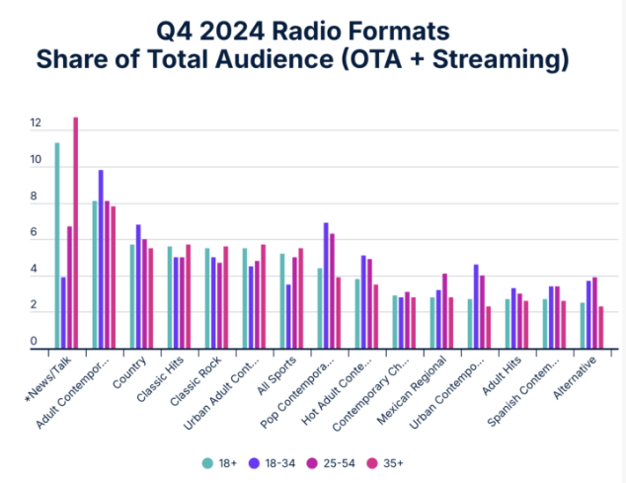
Notes:
Relevance - Even with the explosion of streaming platforms, podcasts, and on-demand content, radio has refused to fade into the background. By embracing innovations like online streaming, personalized playlists, and smart device integration, it’s managed to keep a firm foothold in the ever-changing media landscape. Fast forward to 2025, and radio is still going strong adapting to new technologies and evolving alongside listener preferences.
Did you know that two-thirds of U.S. listeners tuned into the radio daily in Q4 2024? According to Radio World, during October to December, 67% of daily audio time was spent with ad-supported radio, compared to 18% for podcasts, 12% for streaming audio, and just 3% for satellite radio. Not much has changed from the previous quarter, with only streaming audio seeing a tiny 1% increase. This just shows how much people still love their daily dose of audio!
And there’s even more proof that radio is still a big deal. Radio Ink shared results from the 2025 FMR Associates/Eastlan Ratings National Radio Listening Survey, which found that 85% of adults aged 25-64 still tune in to radio every week. That’s some serious staying power! The survey, based on 1,500 adults, highlights how Americans engage with audio. AM/FM radio is still leading the charge, even though it dipped slightly by 1% compared to 2024. Streaming audio follows with a 65% weekly reach, personal music collections come in at 52%, and satellite radio trails at 16%.
Interestingly, in larger markets (top 30), streaming edges ahead with 67% reach. But in smaller markets, traditional radio reigns supreme, making up 71% of all audio listening. No matter where you live, one thing’s clear—radio continues to play a huge role in how we stay informed and entertained.

Slide 5
Notes:
RADIO VS. SPOTIFY – Edison Research’s Share of Ear report for Q4 2024 proves one thing loud and clear: AM/FM radio is still the top choice for in-car listening. With an impressive 86% share, AM/FM remains the go-to way to reach people on the move. As Pierre Bouvard, Chief Insights Officer at Cumulus Media/Westwood One, points out, AM/FM radio listening in cars has even bounced back to pre-pandemic levels. The study, which surveys 4,000 people annually, also highlights some interesting trends in ad-supported audio. While ad-supported digital platforms like Spotify and Pandora only reach less than a third of the U.S., AM/FM radio connects with two-thirds of the nation—and together, they reach nearly 74% of Americans every day. But here’s the kicker: AM/FM radio dominates when it comes to ad-supported audio, making up almost 90% of all listening time in that space. Pretty impressive, right? Let’s break it down further. On a typical day, only 5% of people listen exclusively to ad-supported Spotify, another 5% listen to both Spotify and AM/FM radio, but a huge 90% stick to just AM/FM radio. As Bouvard puts it, “If you’re only advertising on Spotify, you’re missing 95% of Americans.” And get this—AM/FM radio ads actually reach two-thirds of Spotify’s audience! It’s a similar story with Pandora. Just 4% of people listen only to Pandora, another 5% listen to both Pandora and AM/FM radio, but a whopping 91% are loyal to AM/FM radio. So if you’re only advertising on Pandora, you’re missing 96% of Americans. Meanwhile, AM/FM radio still manages to reach over half of Pandora’s audience.

Slide 6
Notes:
In May 2024, Forbes reported that Americans still listen to way more radio than podcasts—even younger audiences! According to a study by Nielsen and Edison Research, adults in the U.S. spend over four hours a day listening to audio. Of that, 67% goes to good old-fashioned radio, while podcasts come in at 20%, music streaming at 10%, and satellite radio at just 3%. (The study didn’t include ad-free listening like some satellite radio options). Moreover, in April 2024, Edison revealed some fascinating insights, highlighting how radio and cars continue to go hand-in-hand, especially when it comes to young adult listeners in the U.S. Surprisingly, radio remains a key way to reach today’s 13-34-year-olds. According to the latest data from Edison Research’s Share of Ear®, a significant 53% of this age group tunes into at least some radio every single day. This statistic showcases radio’s enduring presence and its ability to connect with younger audiences, even in a world dominated by streaming platforms and digital audio services. While many assume that younger listeners stick exclusively to apps like Spotify or Apple Music, this research proves that traditional radio is still very much part of their daily lives, particularly during commutes and car rides. It’s a testament to the ongoing relevance of radio in an ever-evolving media landscape.

Slide 7
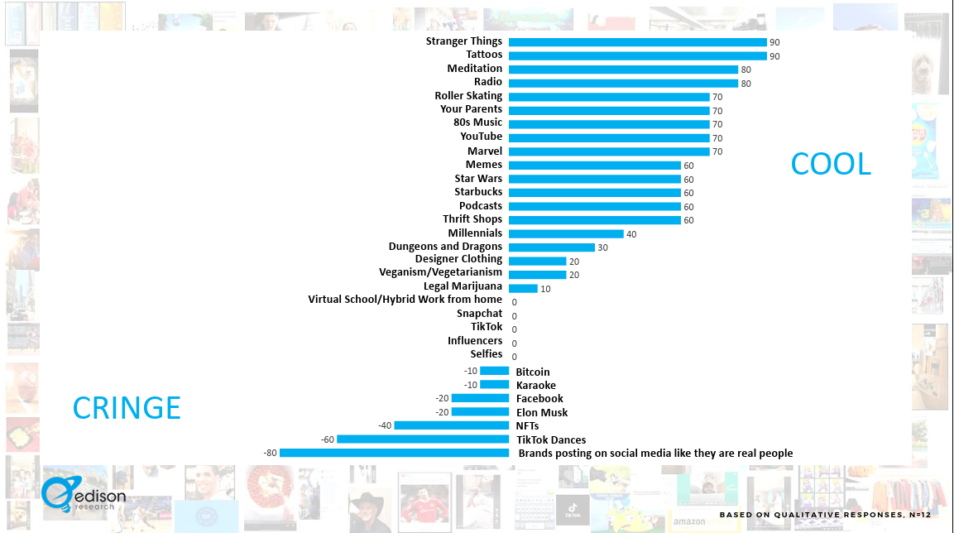
Notes:
GEN Z IMPACT - When are young Americans tuning into the radio the most? You guessed it—while driving! Morning commutes (6am–10am) and late afternoon drives (3pm–7pm) are prime times to catch listeners, especially those aged 13-34. According to Share of Ear, younger audiences are vibing with genres like Hip-Hop and R&B, Top 40s, and Alternative Rock. Meanwhile, older listeners (25+) lean towards Classic Rock, Country, Hip-Hop and R\&B, and Top 40s. It’s clear—each generation has its go-to playlists. Here’s something cool: Wondery, Art19 (an Amazon company), and Edison Research found that 37% of 12-24-year-olds in the U.S. listened to AM/FM radio last week. For those 25 and older, that number jumps to 60%. And Gen Z? They’re actually giving radio some major love, ranking it as "cool" on their Cool vs. Cringe scale. Despite the rise of streaming platforms, radio still holds its own. These insights reveal a fascinating look at how different age groups connect with music and media today!

Slide 8
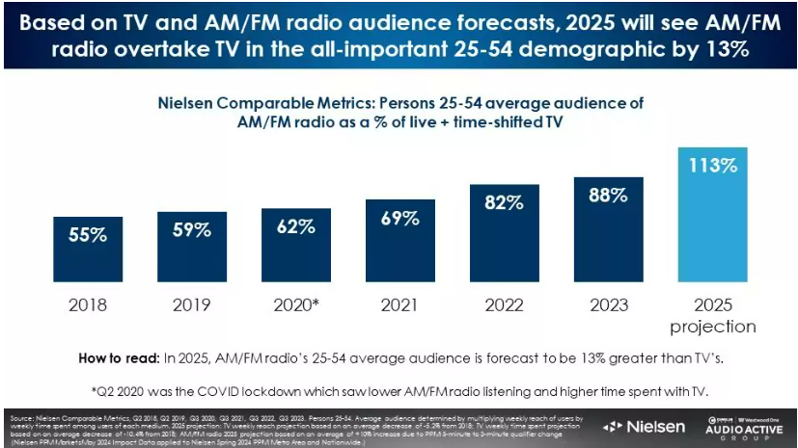
Notes:
RADIO ADVERTISING IMPACT - The rise of AM/FM radio over TV is picking up speed. Over the past five years, AM/FM radio has steadily overtaken linear TV in ratings. By 2023, AM/FM radio’s ratings among 18-49-year-olds were already 12% higher than TV. For the 25-54 demographic, the gap has been closing fast. By 2025, projections show AM/FM radio will surpass TV by 13% in the key 25-54 group and expand its lead among 18-49s by a whopping 47%. Already America’s top mass-reach media, AM/FM radio is set to grow even more in advertising reach. Daily reach is expected to jump by 7%, and weekly reach by 4%. Since reach is crucial for effective advertising, this growth is great news for marketers looking to boost sales. Radio ads are also about to get a lot more effective. Most stations currently run two ad breaks an hour, usually at :15 and :45, designed to fit typical 5-minute listening habits. But there’s a shift happening stations are experimenting with shorter, more frequent breaks. Why? Because shorter breaks keep more listeners tuned in. A huge Portable People Meter study of nearly 18 million ad breaks and over 61 million minutes of advertising found that shorter breaks lead to better audience retention. More listeners sticking around means better results for advertisers. It’s a win-win for radio and marketers alike!

Slide 9
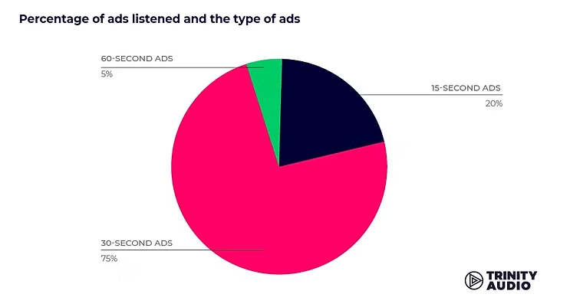
Notes:
WHY RADIO SHOULD BE CENTRAL TO YOUR MARKETING STRATEGY – McGuinness Media and Marketing shared, “Some might think streaming services and social media would make radio a thing of the past, but it’s actually doing better than ever. In 2025, radio isn’t just surviving—it’s thriving as a key tool for marketing, advertising, and content creation.” Unlike ads you see on social media or websites, radio makes you imagine what you’re hearing. That not only helps people remember the message but also creates a stronger emotional connection. Think about iconic jingles like McDonald’s “I’m Lovin’ It” or Nike’s “Just Do It.” Pair those with the right radio spot, and you’ve got a winning formula for boosting brand recall. Audio advertising just sticks with you! Audio is intrusive. Trinity Audio found that audio really sticks with us. When it comes to ad lengths, 30-second ads made up the majority at 75%, followed by 15-second ads at 20%, and the rest were 60 seconds long. Interestingly, there wasn’t much difference in how well the ads performed—15-second ads had a 91.7% completion rate, while 30-second ones were close behind at 90.5%. This shows how simple and personal audio ads feel, making them a fresh yet familiar way to advertise. No wonder listeners don’t seem to mind them!

Slide 10
WHAT MAKES RADIO EFFECTIVE?
Increased Brand Awareness
Enhanced Cross Channel Campaigns
Improved Targeting and Personalization
Strengthened Trust and Credibility
Amplified Reach
Cost-Effective Integration
Data and Analytics
Notes:
WHAT MAKES RADIO EFFECTIVE - Radio is a great way to boost your digital marketing efforts by working together to expand your brand’s reach and engagement. Here’s how radio can make an impact:
• Increased Brand Awareness - Radio ads are a great way to get more people checking you out online. Just mention your website, social media, or any special promotions, and you’ll encourage listeners to look you up and engage with your content. People hear an ad, get curious, and head to Google to search for what they heard. Radio drives search. Radio ads can get people to take action right away—like visiting a website or using a promo code. This real-time response often means more interaction online as listeners jump on those calls to action. Over time, this can naturally boost your SEO and kickstart other digital marketing strategies like PPC, retargeting ads, and more.
• Enhanced Cross Channel Campaigns - Pairing radio with digital marketing is a smart way to create connected campaigns. Think about it—you can run a radio ad to promote a social media contest or a special online deal, making it easy for people to engage across platforms. Plus, brands that combine radio with other channels see better results. With just 11% of your budget, radio could double the impact of your multi-channel campaign.
• Improved Targeting and Personalization - Radio is an awesome way to connect with specific groups of people, making it easier for brands to reach their ideal audience. It’s a super targeted approach that works perfectly alongside digital marketing to get the right message to the right people. With so many different stations catering to all kinds of audiences and interests, advertisers can pick the ones that match their target market. Connecting with sports fans? A sports talk radio show is the way to go. Trying to reach a local crowd? Regional stations have you covered. Radio advertising gives you plenty of options to target your audience with precision!
• Strengthened Trust and Credibility - Radio is one of those trusted mediums where hearing an ad or endorsement on your favorite station can really boost a brand's credibility. That trust often spills over to digital channels, making people more likely to engage with a brand they’ve already heard about on the radio. Plus, radio is unique—your friend might hear a commercial that you didn’t. Later, when you’re chatting about a product or service, your friend remembers the radio ad and mentions it to you. Suddenly, you’re looking it up because a trusted friend recommended it. And where did that recommendation come from? Yep, radio.
• Amplified Reach – According to U.S. News and Business, “One of the key strengths of radio advertising is its wide reach and audience engagement.” Pairing radio with digital marketing is a great way to expand your brand’s reach. Radio grabs listeners during commutes or at work, while digital channels keep them engaged during their downtime. Together, they ensure your brand stays front and center all day long.
• Cost -Effective Integration – Radio advertising is a budget-friendly option compared to other traditional media, which means brands can save money and put more into their digital marketing efforts. It’s a smart way to get the best of both worlds and boost ROI. Plus, as U.S. News and Business points out, radio ads usually cost less to produce and airtime is cheaper than TV or print ads, making it a great choice for businesses of all sizes.
• Data and Analytics - When it comes to tracking results and performance, radio advertising has come a long way. Many stations and agencies now offer advanced tools that let you see how your campaigns are performing in real-time. You can track things like reach, frequency, listener demographics, and response rates to really understand how ads are impacting brand awareness, customer engagement, and sales. By using this data, you can tweak and optimize your campaigns to get the best bang for your buck. For example, take a look at a client’s Google Analytics. Since audio ads drive searches, you’ll likely notice a year-over-year increase in users during the times you’re running a radio campaign compared to when you’re not.
By leveraging the unique strengths of both radio and digital marketing, brands can create comprehensive and impactful campaigns that effectively drive engagement, build trust with their audience, and achieve a significantly greater reach. Radio offers a personal and trusted connection with listeners, while digital marketing provides precise targeting, real-time analytics, and interactive opportunities. Together, these channels create a cohesive strategy that maximizes brand visibility and fosters stronger relationships with consumers.

Slide 11
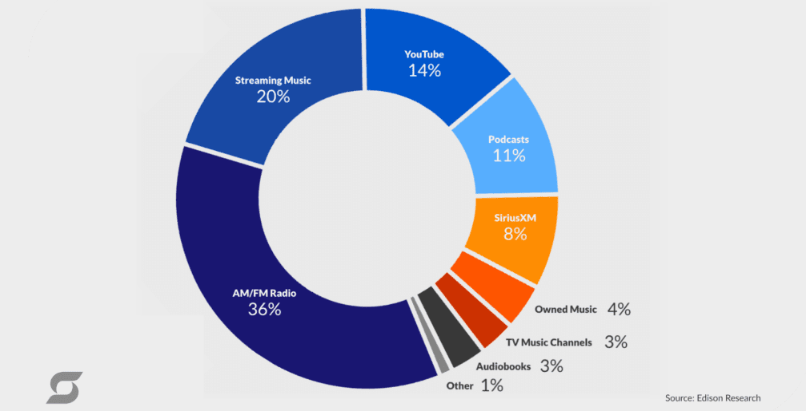
Notes:
FUTURE OF RADIO – The future of radio is looking bright, according to McGuinness Media and Marketing. With its local vibe and ability to adapt to digital and on-demand platforms, radio is here to stay as a powerful tool for storytelling and connection. By 2030, Radioinfo.com predicts AM and FM radio will still hold its own—not as the biggest player in the audio world, but as a reliable and important one. Radio is that perfect bridge between our analog past and digital future. It offers something special: real human connection, local stories, and the thrill of spontaneity in a world that's all about on-demand everything. Whether you're listening in your car, on a smart speaker, or through an app, radio proves time and again that it’s here for the long haul. Some classics just never go out of style.

Slide 12
Thank you!
Ava Savosh
Ava@iheartmedia.com

