Slide 1
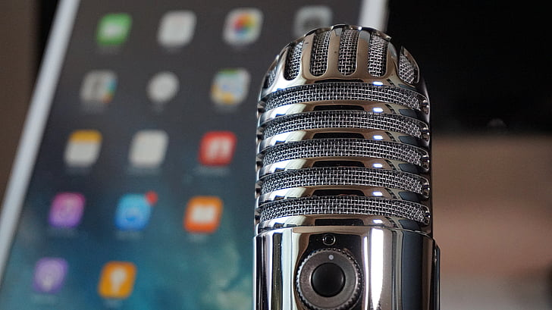
Exploring the Essential Business Value Of Radio vs. the Emergence of Podcasting in the Digital Age
March 14, 2023

Slide 2
Notes:
MMMM, I’m lovin’ it”
McDonalds
Ever wondered why the McDonald’s slogan– “I’m Lovin’ It” – can suddenly make your mouth water and bring you back to your happy meal days?
The McDonald’s sound is just one example of audio marketing.
When we hear the sound of a strong, familiar audio, our brains respond with recognition and association without consciousness. As Sonic minds describes it, “The iconic McDonald’s sound is just one example of modern marketing, called audio or sonic branding… The use of audio is growing. Mostly all brand touchpoints and all digital platforms use audio; hence, your brand will always make sound, one way or another. This creates both an opportunity and a challenge for brands. No matter your service or product, you need to invest in the development of your audio brand.”
Today, we will review the power of audio and its history from 1900s broadcast to modern podcasting.
We'll cover how audio has been used to tell stories and create effective marketing strategies for businesses over time.
I would like to start by setting the scene with an overview of the history of radio.

Slide 3
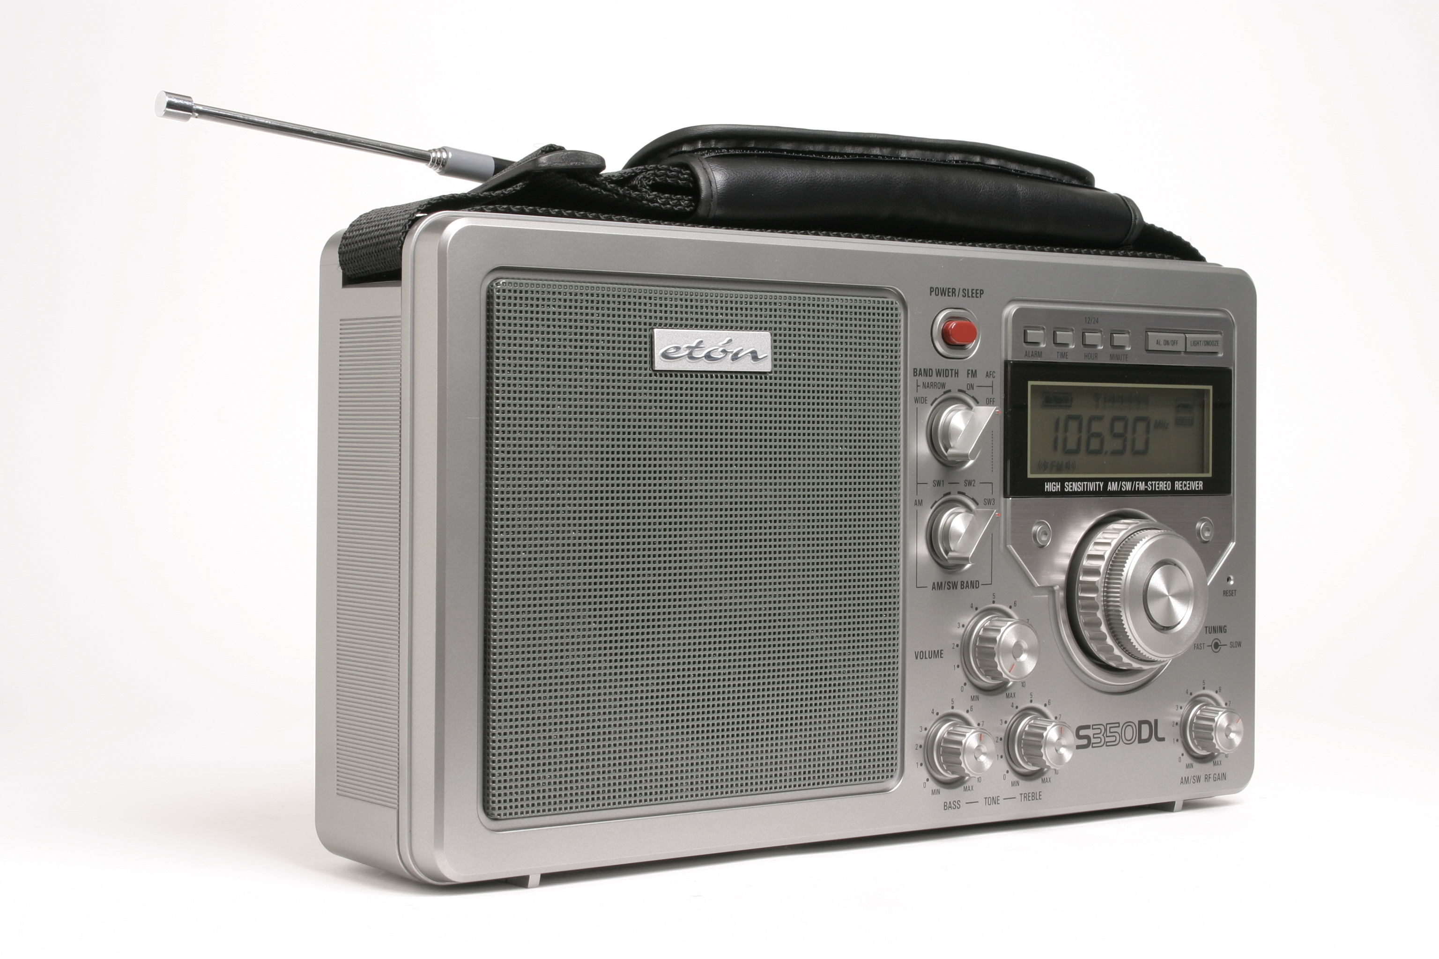
“Radio’s identity and importance within the media mix do not seem to have diminished since radio listening is either stable in the developed markets or increased in developing and recently deregulated markets”
Priestman, 2012
Notes:
Over the course of the last century, radio has been a predominant resource in terms of communication, entertainment, and information. The first real social medium, radio has connected consumers through the power of audio since the early 1900’s with soundwaves across large platforms. Radio goes where people go and fits into people’s lives as needed.
In other words, radio refers to both the device in which people listen to the audio, as well as the communication and reception of electromagnetic waves carrying sound.
Since its inception, radio has been an essential element for communication and entertainment.

Slide 4
Guglielmo Marconi succeeded in sending the first signal through the skies from the British Marconi Corporation in Cornwall, England to Canadian Marconi Corporation Newfoundland, Canada.
Inventor Alexander Graham Bell, discovered the first analog transmission of the human voice over wire
Lee De Forest develop the Audion tube. A three-electrode vacuum tube to be used for voice transmission. De Forest tested the Audion tube between France and New York with one of his most famous experiments coming from the Eiffel Tower in 1908
Telegraph was
patented by Samuel Morse
1840
1874
1901
1908
1871
1886
1906
Electromagnetism was discovered by Scottish physicist James Clerk Maxwell
German physicist, Heinrich Hertz, developed the first method to construct and accept artificial waves
Reginald A. Fessenden came to America from Canada to pursue audio communication. On December 24, 1906, from Brant Rock, Massachusetts, Fessenden was successful at becoming the first person to transmit voice and music through airwaves.
Notes:
Broadcast radio that we know today is a bi-product of the telegraph.
.
Patented in 1840 by Samuel Morse, the telegraph became “the world’s first instantaneous information service” (Godfrey, 2005). It functioned through Morse code.
.
These signals carried message signals to growing cities and suburbs. The innovation and success of the telegraph, grew a vested interest in communication systems with a focus on using audio.
.
In the 1870s, radio technology advanced further when electromagnetism was discovered by James Clerk Maxwell. Electromagetism was a stepping stone for Heinrich Hertz to develop the first method to construct and accept artificial waves.
.
Alexander Graham Bell became interested in this new communication system and began tinkering, discovering the first analog transmission of the human voice over wire in 1874. With the discoveries made by Bell, the telegraph’s abilities grew to include the transmission of human voices and the decline of the use of Morse code.
.
From the mid-1800’s to 1904, many inventors contributed to the development of radio. Though Marconi is credited as the “most well-known experimenter in the industrial history of radio” (Godfrey, 2005).
.
An inventor and an entrepreneur, in 1901 Marconi succeeded in sending the first signal through the skies from the British Marconi Corporation in England to Canadian Marconi Corporation in Canada. Ergo, being the first person to use radio as a device to both send and receive information.
.
In transmitting his transcontinental radio message, Marconi proved the concept of wireless communication” (Radio, 2019). “Rather than inventing radio from scratch, however, Marconi essentially combined the ideas and experiments of other people to make them into a useful communications tool” (Chapter 7: Radio, 2016).
.
Interested in audio as well, Fessenden came to America from Canada to pursue audio communication. On December 24, 1906 from Brant Rock, Massachusetts, Fessenden was successful at becoming the first person to transmit voice and music through airwaves.
.
At the same time, Lee De Forest, the self-proclaimed “Father of Radio,” was working between the United States and France to develop the Audion tube. A three-electrode vacuum tube to be used for voice transmission. Throughout the process, De Forest tested the Audion tube between France and New York with one of his most famous experiments coming from the Eiffel Tower in 1908. The Eiffel Tower transmission was documented to have been received as far as 500 miles away (Godfrey, 2005). Marconi, Fessenden and De Forest’s innovation allowed for the first time, one human being “the ability to speak directly and over great distances to many dispersed individuals in their homes, simultaneously and instantaneously” (Priestman, 2012).
.
The invention and development of radio communication was different from the telephone. The telephone allowed for communication from the masses to an individual, meanwhile radio allowed for communication from one individual to the masses.

Slide 5
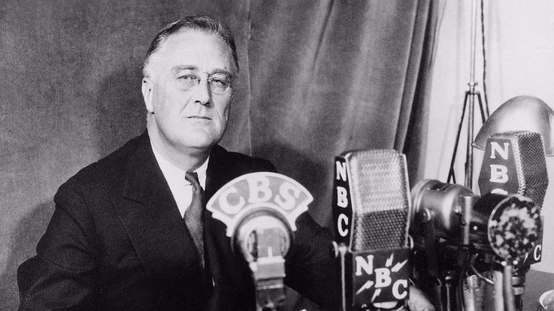
MY FRIENDS: Radio’s Golden Age
Notes:
Radio’s importance as an essential element to the community was heightened during the late 1920’s as America entered the Great Depression.
.
As the 32nd President of the United States, Franklin D. Roosevelt came into office with America still facing it’s “greatest American crisis since the Civil War. As a way to mitigate any criticism towards The New Deal, FDR looked towards radio. “While governor of New York, Roosevelt had used radio as a political tool, so he quickly adopted it to explain the unprecedented actions that his administration was taking to deal with the economic fallout of the Great Depression''
.
In the 1930’s over 80 percent of all households owned at least one radio, with poor and working-class listeners tuning in, on average, four hours a day” (Rabinowitz, 2009).
.
FDR was honest with the American people, acknowledging that the government may make mistakes along the way but to be patient and to support his programs (Radio, 2019). Nonetheless, FDR’s fireside chats brough comfort into the homes of his constituents. “His message was to give hope and confidence and don't be afraid. He defined the challenge and invited listeners to share in resolving it. It wasn’t ‘us against the government.’” (Ambrose, 2008).
.
FDR was successful in reducing anxious, tense feelings across the nation by being instructive and a friend, without being too political through the application of radio. “The success of his efforts lay in the medium and its effectiveness in helping Roosevelt establish a perceptively personal connection with listeners, increasing the sense of trust between the public and the presidency” (Radio, 2019).

Slide 6
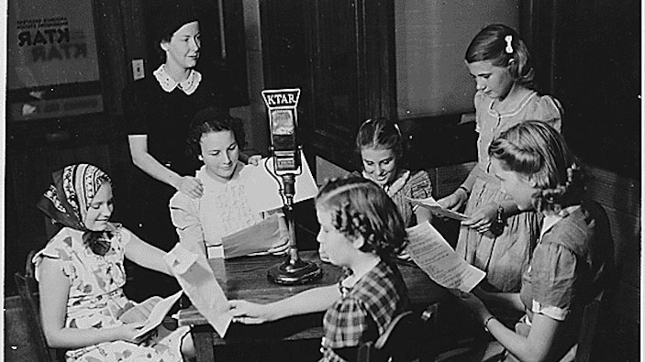
Notes:
During radio’s Golden Age, the medium was respected as the most influential media outlet; “use of the radio shaped public attitudes about America's involvement in both World War I and World War II
.
FDR’s radio influence lasted throughout the Great Depression and into World War II, though the language and tone of the President shifted as the United States entered the war. Radio turned from a tool for comfort, to ease tension from the Great Depression into a wartime mechanism to generate propaganda; “an effort to convince people to accept certain ideas of beliefs, where the public’s acceptance of those ideas benefits a certain person or group but does not necessarily benefit itself” (Godfrey, 2005).
.
Some historians and media researchers have defined the use of radio for propaganda as a way to “convince people to accept certain ideas of beliefs, where the public's acceptance of those ideas benefits a certain person or group but does not necessarily benefit the public itself” (Propaganda, 2019).
. Essentially sparking advertising across airwaves

Slide 7
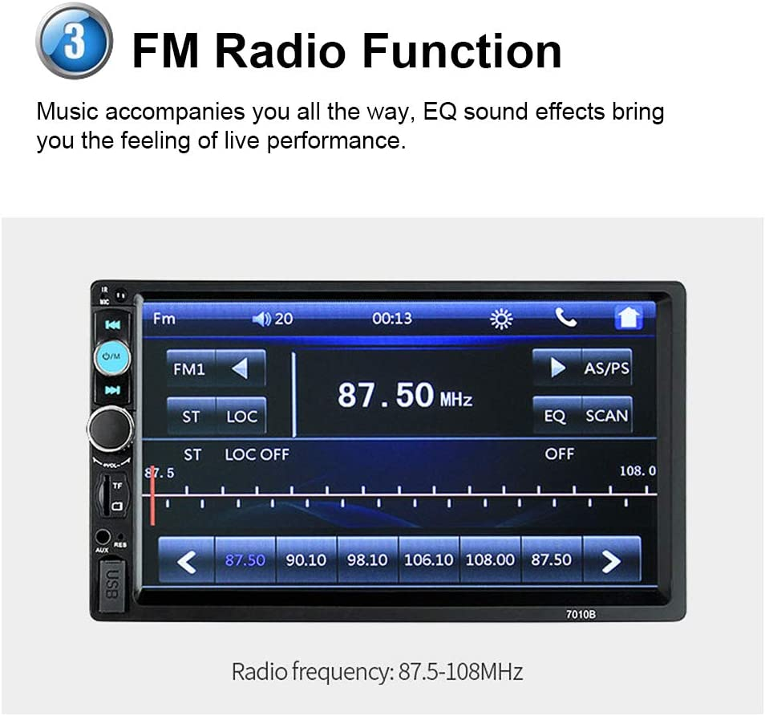
Digital radio is the transmission and reception of sound processed into patterns of numbers, or "digits" – hence the term "digital radio."
Notes:
“With the introduction and swift public take-up of television, radio lost dominance and for a time looked as if it would be displaced as a major player on the stage of mass communication” (Radio Broadcasting, 2015).
.
In the 1990s, though, commercial radio responded to the challenge and diversified. Radio started to look into the preferences of listeners and introduced new channels for broadcasting. Thus, digital radio was introduced.
.
Digital radio is the transmission and reception of sound processed into patterns of numbers, or "digits" – hence the term "digital radio."
.
Digital radio offers CD-Quality sound to the car, home and office allowing for AM/FM Broadcasts to go where audiences go.

Slide 8
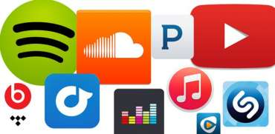
Notes:
two competing US companies, XM Radio and Sirius, launched their services in 2001 and 2002 respectively to go after the lucrative North American market.
.
Radio acquired a dynamic new profile, not only for music but also for talk programs, sport, the arts, drama and comedy” (Radio Broadcasting, 2015). “XM Satellite Radio began to offer its subscription based 100-channel service in late 2001 while competitor Sirius planned to begin advertising free transmissions by early 2002” (Sterling, 2005).
.
Today, consumers have access to AM Broadcasts, FM Broadcasts, as well as Satellite Broadcasts through Sirius XM, Pandora and Spotify and streaming platforms such as iHeart Radio and YouTube.

Slide 9
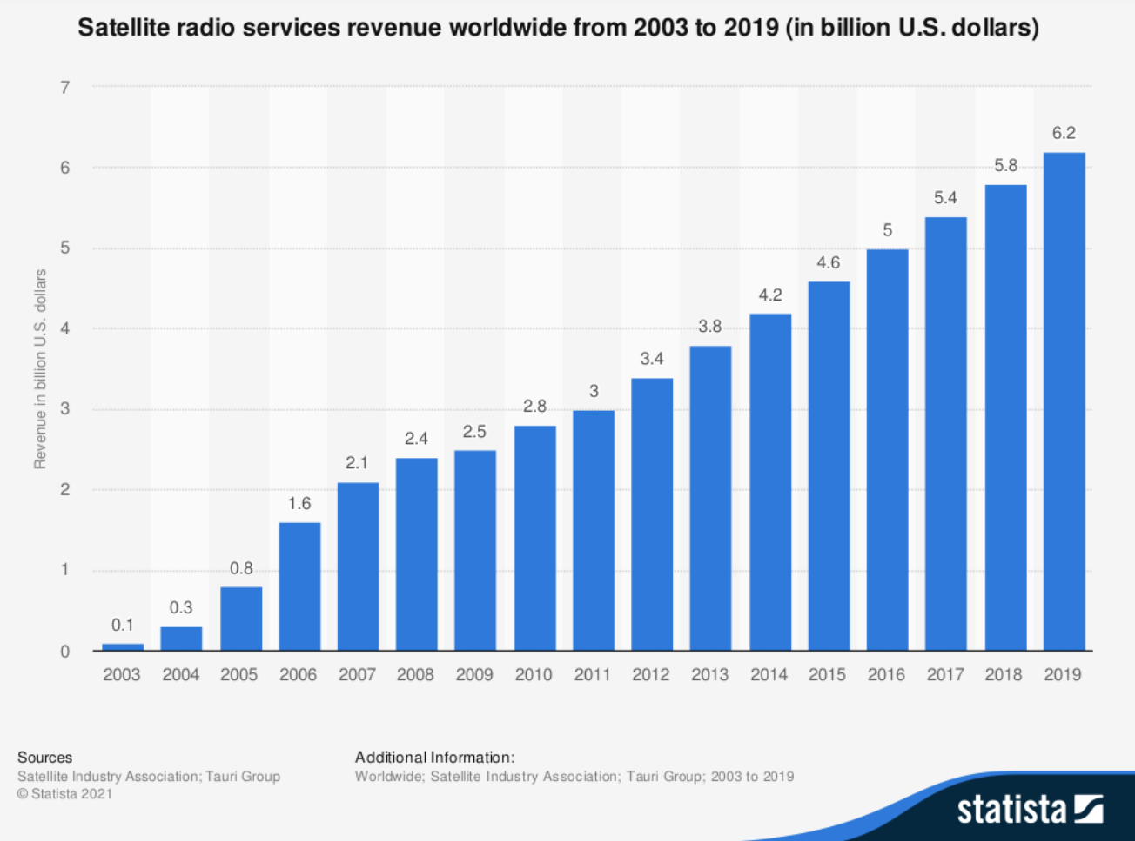
“Data on satellite radio services revenue worldwide from 2003 to 2019 shows a consistent increase in revenue each year, and the 2019 figure of 6.2 billion U.S. dollars was more than double the amount recorded in 2011. Meanwhile, TV revenue has been gradually declining each year, though still makes up the vast majority of satellite services revenue worldwide at 92 billion U.S. dollars”
Satellite Radio, 2020
Notes:
“Data on satellite radio services revenue worldwide from 2003 to 2019 shows a consistent increase in revenue each year, and the 2019 figure of 6.2 billion U.S. dollars was more than double the amount recorded in 2011. Meanwhile, TV revenue has been gradually declining each year, though still makes up the vast majority of satellite services revenue worldwide at 92 billion U.S. dollars”

Slide 10
Radio reaches a Huge Audience
Radio is Targeted
Radio Cuts Through
Radio is the Anywhere, Anytime Medium
Radio is the Pulse of the Community
Radio is Influential
Radio Reaches Your Target Customers with Frequency
Notes:
How does this all relate to successful advertising?
.
1.Radio Reaches a Huge Audience
A 2019 survey results showed the number of people listening to radio is continuing to increase. In Australia, over 10 million people listen to a commercial radio station for at least one hour every week of the year.
.
2. Radio is Targeted
Radio allows messages to be tailored and localized to each audience. Advertisers can target their message to specific demographics and communities, geographic areas, and around events and genres in a market. Each radio station is operated with specific market segments in mind, so after a careful selection process, your product or service will be advertised to your exact target market.
.
3. Radio Cuts Through
Radio is the medium that people spend the most time with throughout the day, providing ample opportunity for a message to reach its audience. People carry out a wide range of activities while simultaneously listening to the radio.
.
4. Radio is the Anywhere, Anytime Medium
Given the radio’s portability, advertisers have the opportunity to reach people on the go, giving them an edge over competitors. The accessibility of radio enables listening to occur in places that other media may have difficulty reaching, for example, your target customers don’t read a newspaper or magazine whilst driving, nor do they watch tv whilst working in the garden Today, radio even overlaps with the phenomenon of digital media via downloadable radio station apps.
.
5. Radio Is the Pulse of the Community
Radio is live and local so it reflects the community. People listen to the radio to find out what is happening now in their community such as special events, news, traffic updates, weather reports, sport and entertainment. It’s more local than global….the traffic is jammed or the bridge is closed. In fact, it's very interesting to note that radio has many of the characteristics that the new digital world has in the way it acts as your constant companion, with you wherever you are.
.
6. Radio Reaches Your Target Customers with Frequency
Advertising works by repetition. Your target customer may well need to hear your commercial three or four times before they respond to your call to action. To reach this level of frequency, radio advertising is usually more cost-effective than other media. People choose to listen to the radio - they want to listen and be engaged, and they listen on average to almost 15 hours of commercial radio each week.
.
And finally,
.
7.Radio is Influential
Radio is the medium to build top-of-mind awareness - careful time placement of ads can have a real impact on your call to action. Studies show that radio content influences people because they feel they are hearing it from a "friend" and referrals are always the best type of sales opportunity.

Slide 11
Types of Radio Advertising
Radio Sponsorships: You can sponsor the news, contests, sports, traffic, or any of the other regular shows on that radio station.
Radio Jingles: People are more likely to remember a brand if it has a memorable jingle or song associated with it.
Personified Commercials: In a personified commercial, also known as a pre-recorded ad, the listener follows a character within the advertisement, creating empathy with the listener.
Radio Live Reads: When a radio personality or DJ reads your advertisement while being broadcast live, it is known as a “live read.”
Notes:
Radio ads run within multiple lengths, but the industry standard are :15s, :30s, or :60s. The way you determine the length of the ad is not by the client’s budget, rather is it by determining how much time is needed to effectively tell a client’s message.

Slide 12
The Buying Funnel
Awareness
Interest
Desire
Action
Notes:
Radio is an intrusive medium and the only medium that can meet you at any point.
.
Let’s take a look at the buying funnel using the A-I-D-A theory. The elements in this theory are Awareness, Interest, Desire and Action.
.
For the purpose of this exercise, we are going to use one of the quickest sales funnels – buying something to eat.
.
The stars on the left of the screen represent everyday people out in the world. When a triggering action happens, someone enters the buying funnel. The triggering action here is represented by the dashed line. In terms of our example, consumers are living their lives and suddenly become hungry. They enter the buying funnel with the awareness that they are hungry.
.
As they are driving, they are served a radio ad for McDonalds. They are aware that they are hungry and now they are interested in the offer McDonalds is promoting.
.
The longer they drive, the more they think about McDonalds Big Mac special creating a desire to find the nearest McDonalds.
.
The consumer finds a McDonalds and takes action to complete the purchase.
.
As you can see, some consumers will drop off throughout the course of the buying process, however others will follow all the way through. As marketers, it is our task to hit consumers during all aspects of this process.
.
Due to radio being intrusive, it can hit people during all aspects of the cycle as it can work subconsciously to deliver a message.

Slide 13
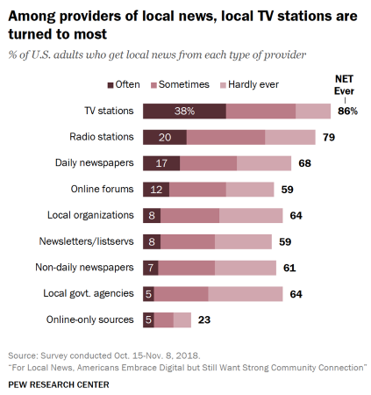
Notes:
Ad results media reports, 40% of all audio time spent goes to AM/FM radio and AM/FM radio represents 76% of ad-supported audio.
.
A Pew Research study conducted in the summer of 2022 concluded that nearly half of adults in the United States reported that they get often get news from the radio. 47% of U.S. adults said they get news from radio at least sometimes, a figure that has remained relatively constant in recent years. White and Black Americans are equally likely to get news at least sometimes from radio (48% each). Meanwhile, 42% of Hispanic adults and 37% of Asian adults say they get news from radio at least sometimes.
.
While many may say that radio is a dying medium, marketers see things differently. Radio is an essential form of communication being the most reliable news source available. If power were to go out, radio stations would still operate and be able to deliver in-real-time news reports. Take into account 9/11. When the towers fell, radio served as a public service for those not at Ground Zero. Radio stations that were known for music and that would traditionally never play newscasts were broadcasting live information from the site of the towers with breaking news being featured as it was happening and a recap of what was known being offered at the top of the hour.
.

Slide 14
Notes:
In March 2023, Edison Research’s Share of Ear dataset reported that AM/FM broadcast listeners ages 13+ in the United States spend 59% of their day with broadcast audio and Americans aged 25-54 spend over half of their daily audio time (55%) with AM/FM radio (including over-the-air and streams), and Americans 55+ spend most of their ad-supported audio time (78%) with AM/FM radio.
.
Further breaking down how broadcast audio is an intrusive medium, those who spend less time with broadcast during the day compared to others are still impacted by the messaging. Take for example, you are talking with a friend. They are an active Elvis Duran in the Morning Z100 listener while you prefer to listen to Spotify. Everyday for the last week, Danielle Monaro does an endorsement for “Fresh Direct” following her Danielle Report. You mention that you are interested in eating healthier with the warmer months approaching. Your friend offers a suggestion of trying “Fresh Direct.” an online grocery store that will send you fresh produce. You immediately are interested and want to look into how you can order your first cart. You ask your friend how they heard of such a great idea, and they can’t recall, saying they heard it from a friend. That friend was radio. Your friend heard a radio commercial while listening to the Elvis Duran show and with enough frequency, they remembered the messaging and shared it with you.

Slide 15
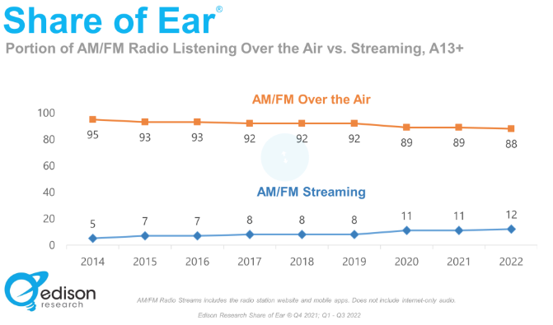
Notes:
Further, in it’s Share of Eat report, Edison Research concludes that listeners age 25-54 are the most likely to consume AM/FM radio via a station stream. As shown in the graph, 12% of the AM/FM listening by those age 13+ is to the radio station streams.”
.
Most convos we’ve had has been on the music side but there is an entire world of spoken world audio. You will know it as podcasting

Slide 16
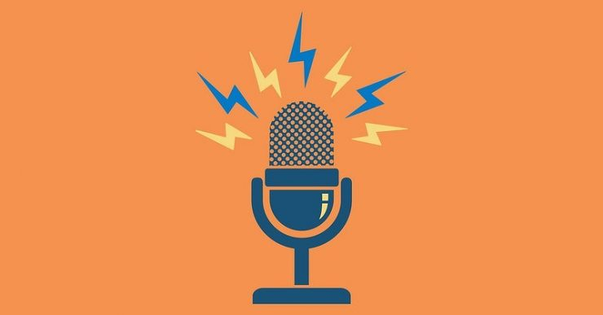
WHAT IS A PODCAST?
Notes:
Ask the group to send a heart emoji if they’ve ever listened to a podcast.
Then ask the group to type in the chat the last podcast they listened too. Have Braden read the first few responses.
At its core, podcasts are on-demand radio shows. Going back to the inception of radio, to inform and entertain podcasts are spoken word radio shows that listeners can consumer on the go when they want to. Listeners pull content to themselves instead of being pushed content.
ACCORDING TO THE PEW RESEARCH CENTER, there has been an increase in podcast listeners over the last decade as Americans over twelve have listened to at least one podcast in their lifetime. It is reported that on average, Americans consumes 8 episodes per week

Slide 17
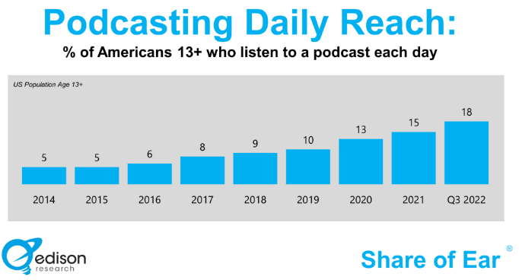
Notes:
Edison research concluded in 2014, podcasts reached 5% of those in the U.S. age 13+. However in recent data, podcasts now reach 18% of those age 13+ in the U.S. — a 20% increase in the past year and over three times the reach of 2014.
.
Likewise, Statista reports, “Data from a study conducted in early 2022 showed that 38 percent of the U.S. population reported to have listened to a podcast in the past month, more than three times the share recorded a decade earlier. While older generations also tune in, the main group consuming podcasts is the age group of 12- to 34-year-olds.”
.
Edison says that as of Q3 2022, Podcasts account for 24% of all spoken word audio consumption among those age 13+ according to the latest Share of Ear data, and we know that time spent with podcasts has grown”
.
Forbes reports Comedy, News, and Culture respectively are the top genres for podcasting. Followed by True Crime, Sports (#5) and Business.
.
As podcasting reaches people of all ages and the audio medium offers a diverse array of topics leveraging this medium is very powerful and can have massive impact with the right messaging to fit the right audience.

Slide 18
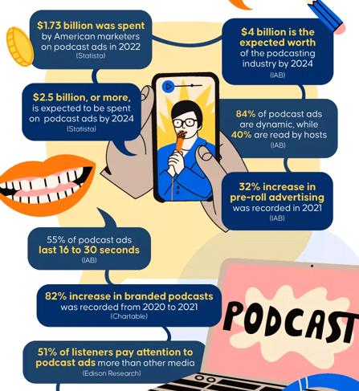
As podcasts continue to rise through the ranks of audio content, you can expect more businesses to use the format for their marketing operations. The growing number of listeners paves the way for podcasting to become one of the most effective marketing tools.
Notes:
As of February 2023, Forbes reported podcast revenue topped $1 billion for the first time in 2021, rising by more than 70% that year to final tally of nearly $1.5 billion. IAB expects the industry to hit $2 billion this year and double that in 2024.
As podcasts continue to rise through the ranks of audio content, you can expect more businesses to use the format for their marketing operations. The growing number of listeners paves the way for podcasting to become one of the most effective marketing tools.

Slide 19
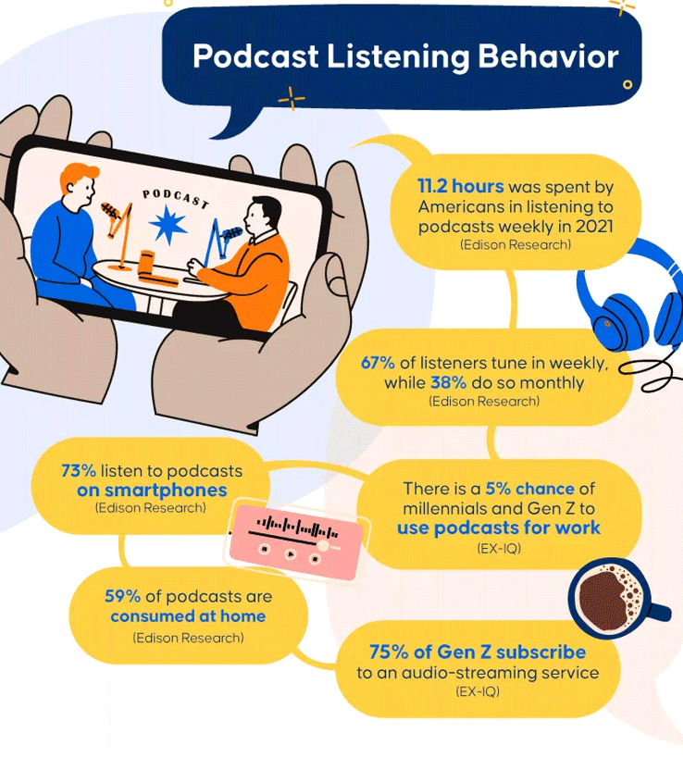
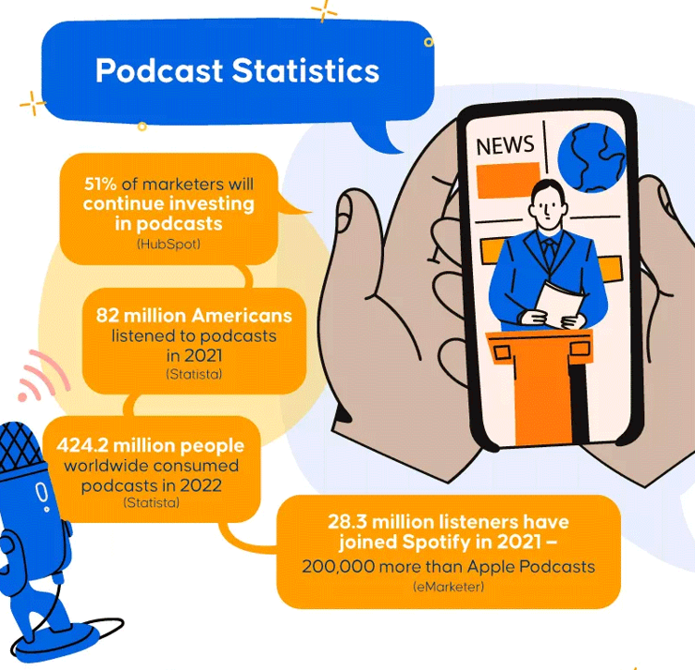
Notes:
Spiralytics reported that…
.
51% of listeners pay more attention to the format’s ads than any other media and 51% of marketers are already incorporating podcasts into their marketing strategies are planning to support more, with 53% claiming it’s the most effective format.
.
While listening to a podcast is familiar, its popularity among streaming services and traditional radio has transformed the platform into a valuable marketing tool for enterprises worldwide.

Slide 20
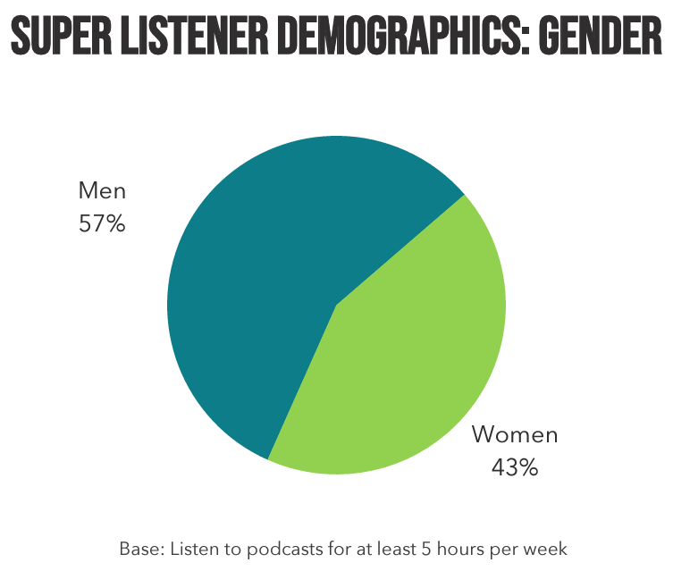
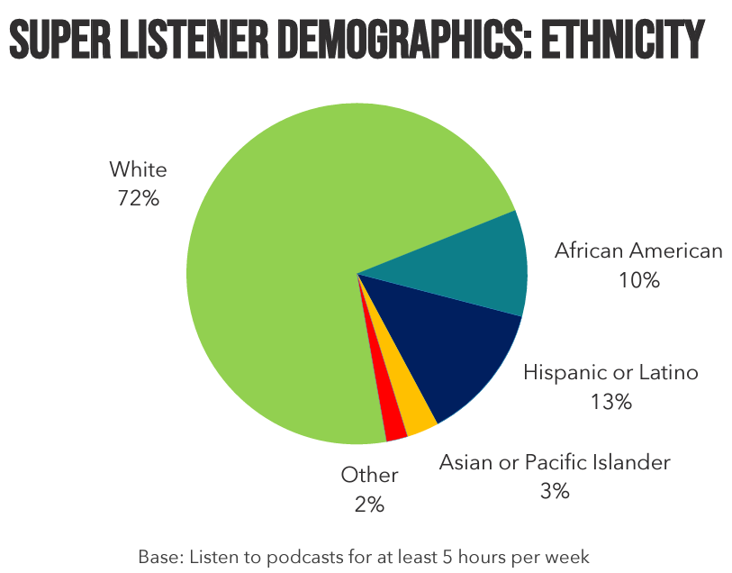
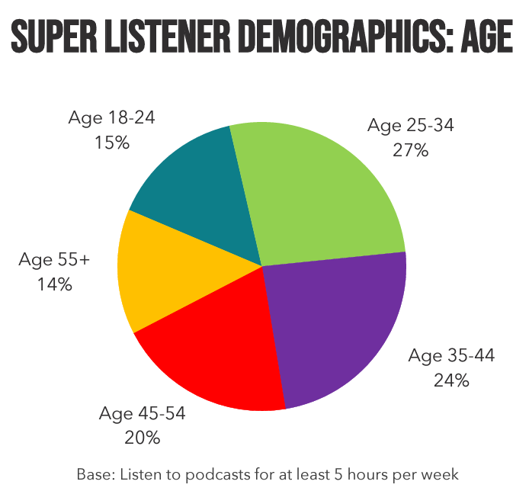
“SUPER LISTENERS” STUDY SHOWS HEAVY PODCAST USERS ARE LISTENING MORE AND REMAIN ENGAGED WITH ADS
Notes:
Edison Research and Ad Results Media partnered to hold a study on podcast super listeners. For the study, 1,000 online interviews were conducted and results were broken out by age, sex, and race to reflect the demographics of weekly podcast listeners.
The survey concluded the following…
• Men listen to an average of 5 hours of podcasts per week on average 57% of time, while females listen to an average of 5 hours of podcasts per week 43%
• Adults ages 25-34 represent the largest age grouping of podcast listening while adults 55+ represent the least with 14% share.
• Ethnic groups represented 28% of consumers who listen to podcasts at least 5 hours per week.
Podcasting and the power of audio allow for further targeting. It opens the door to break down demographics in terms of ethnic background, beliefs and hobbies allowing for everyone to find something that they can relate too.
.
The study concluded that in 2021 50% of listeners agreed that Advertising on a podcast is the best way for a brand to reach them and that if a listener’s favorite podcast became exclusive to a specific service they would be willing to use that service.

Slide 21
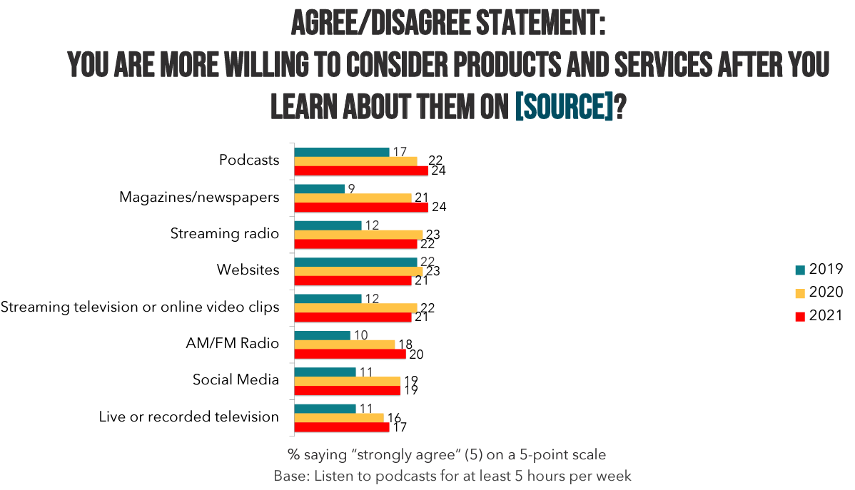
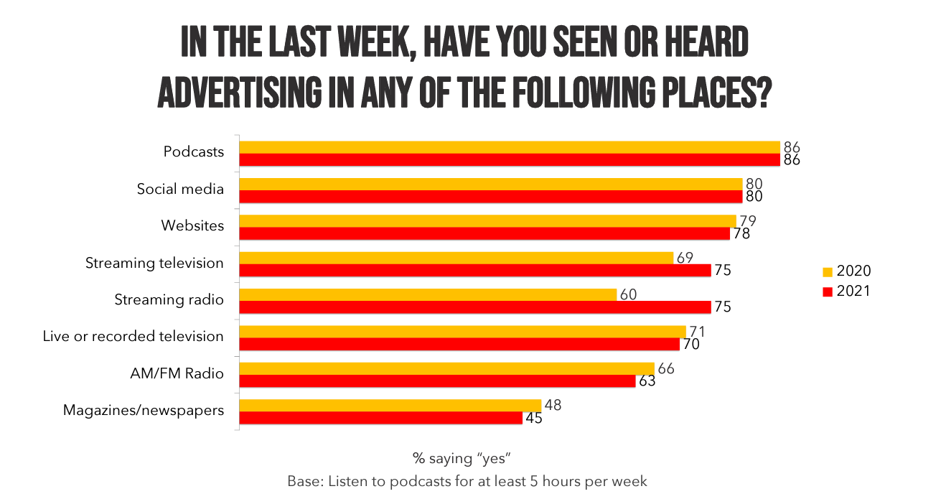
“SUPER LISTENERS” STUDY SHOWS HEAVY PODCAST USERS ARE LISTENING MORE AND REMAIN ENGAGED WITH ADS
Notes:
In 2020 86% of listeners in the study recall hearing an ad in a podcast. In 2021, the number is flat – again 86% of listeners in the study reported learning an ad in a podcast. This is the highest percentage of listeners recognizing they were listening to an ad when compared to social media, websites, and streaming television to name a few.
Additionally, in 2021 24% of people in the study reported that they strongly agree that they are more willing to consider products and services after they learn about them through a podcast and when compared to other advertising platforms, podcasts were rated as the lowest medium in terms of too many advertisements. The highest rated medium for advertisements was live or recorded television and followed by social media.

Slide 22
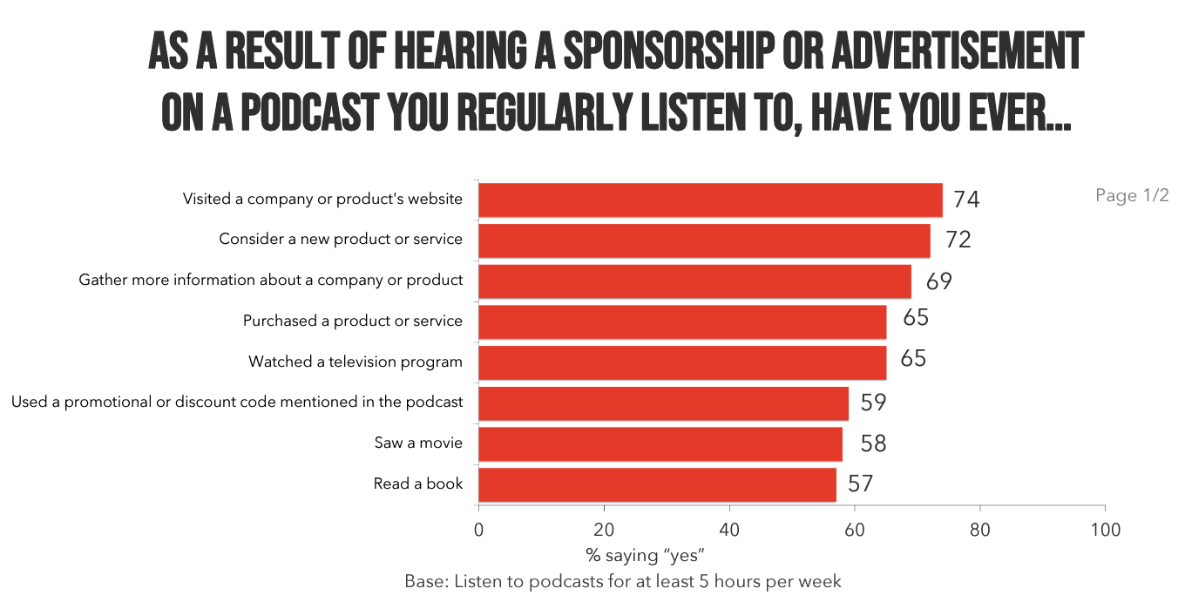
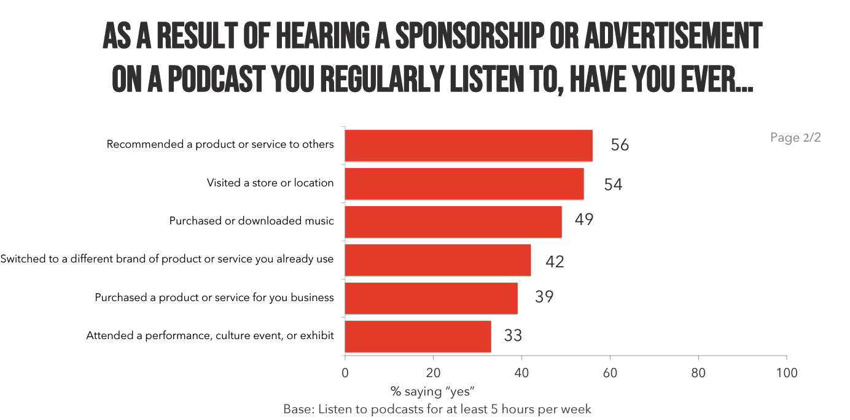
“SUPER LISTENERS” STUDY SHOWS HEAVY PODCAST USERS ARE LISTENING MORE AND REMAIN ENGAGED WITH ADS
Notes:
Finally, the study concluded that as a result of hearing a sponsorship or advertisement on a podcast the participants regularly listen to, consumer were very likely to act such as visiting the business’s website, considering using the product and/or gathering more information on the product. Noting that 42% of the sample size said they would switch from a brand or product they already use.
With the right messaging, podcast marketing is very powerful and can alter or change buying habits.

Slide 23
Notes:
A survey conducted by Advertiser Perceptions in November 2021 among 300 media agencies and marketers concluded in March 2022 that “71% of ad buyers had already discussed buying podcast ads and 44% said it was likely they would buy podcast ads in the coming six months.
At the same time, Advertiser Perceptions found that broadcast radio is still being embraced with 21% of the survey group saying they would look to increase spending in AM/FM radio and the majority reporting they would remain budget neutral in their broadcast spend.
While podcasting is an emerging medium, radio continues to hold it’s share with more than half of media spends. The combination of both audio tactics, offer immersive penetration and pick-up where the other leaves off throughout listener’s day.

Slide 24
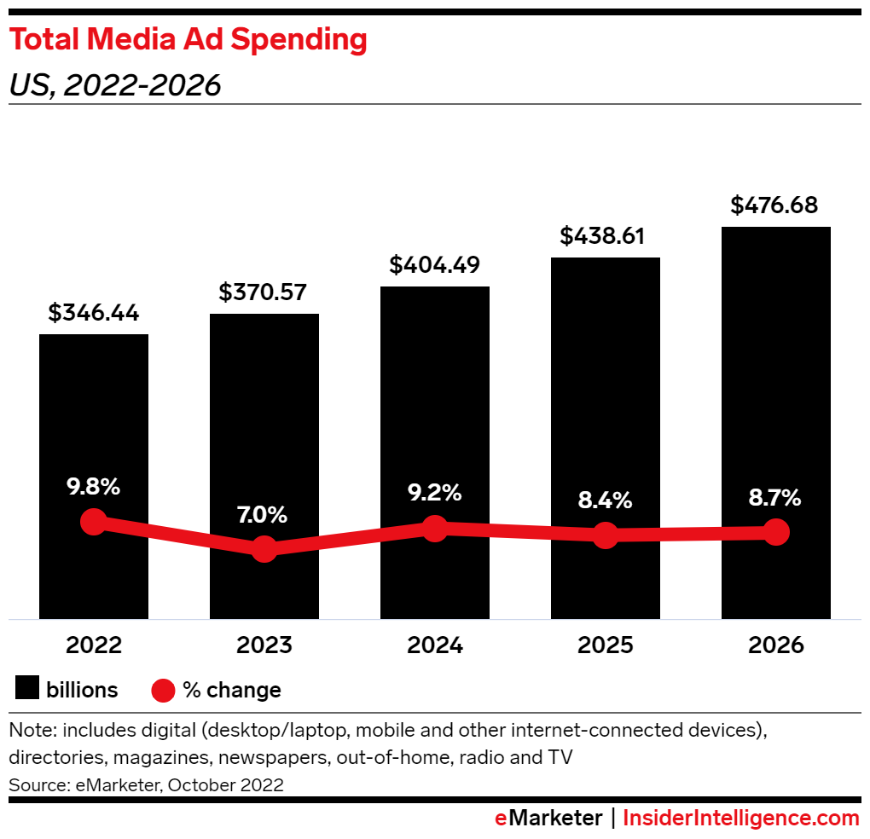
$370.6B in Total US Ad Spending Predicted.
Data is from a February 2023 Advertiser Perceptions survey as cited by MediaPost. Over 300 US advertisers and media agency executives were surveyed during December 2022.
Notes:
In the next three years, organizations are planning to remain budget neutral, but how do they gain their unfair share against competitors?
.
With the power of audio.

Slide 25
Ava Yurchison
AvaYurchison@iheartmedia.com l (631) 617-3546
Notes:
Thank you all for tuning in and thank you to the Hudson Valley Direct Marketing Association for the time to present today. For the remaining time, I’d love to open the floor for any questions. If anyone has any questions or would like to continue the conversation, I am available to connect and discuss how radio and/or podcasting may work for you or your clients via email or phone.

