Slide 1
for those who think
and hope things will basically go back
to the way they were:
stop. they won’t.
McKinsey & Company
© 2022 Market Insights | 1

Slide 2
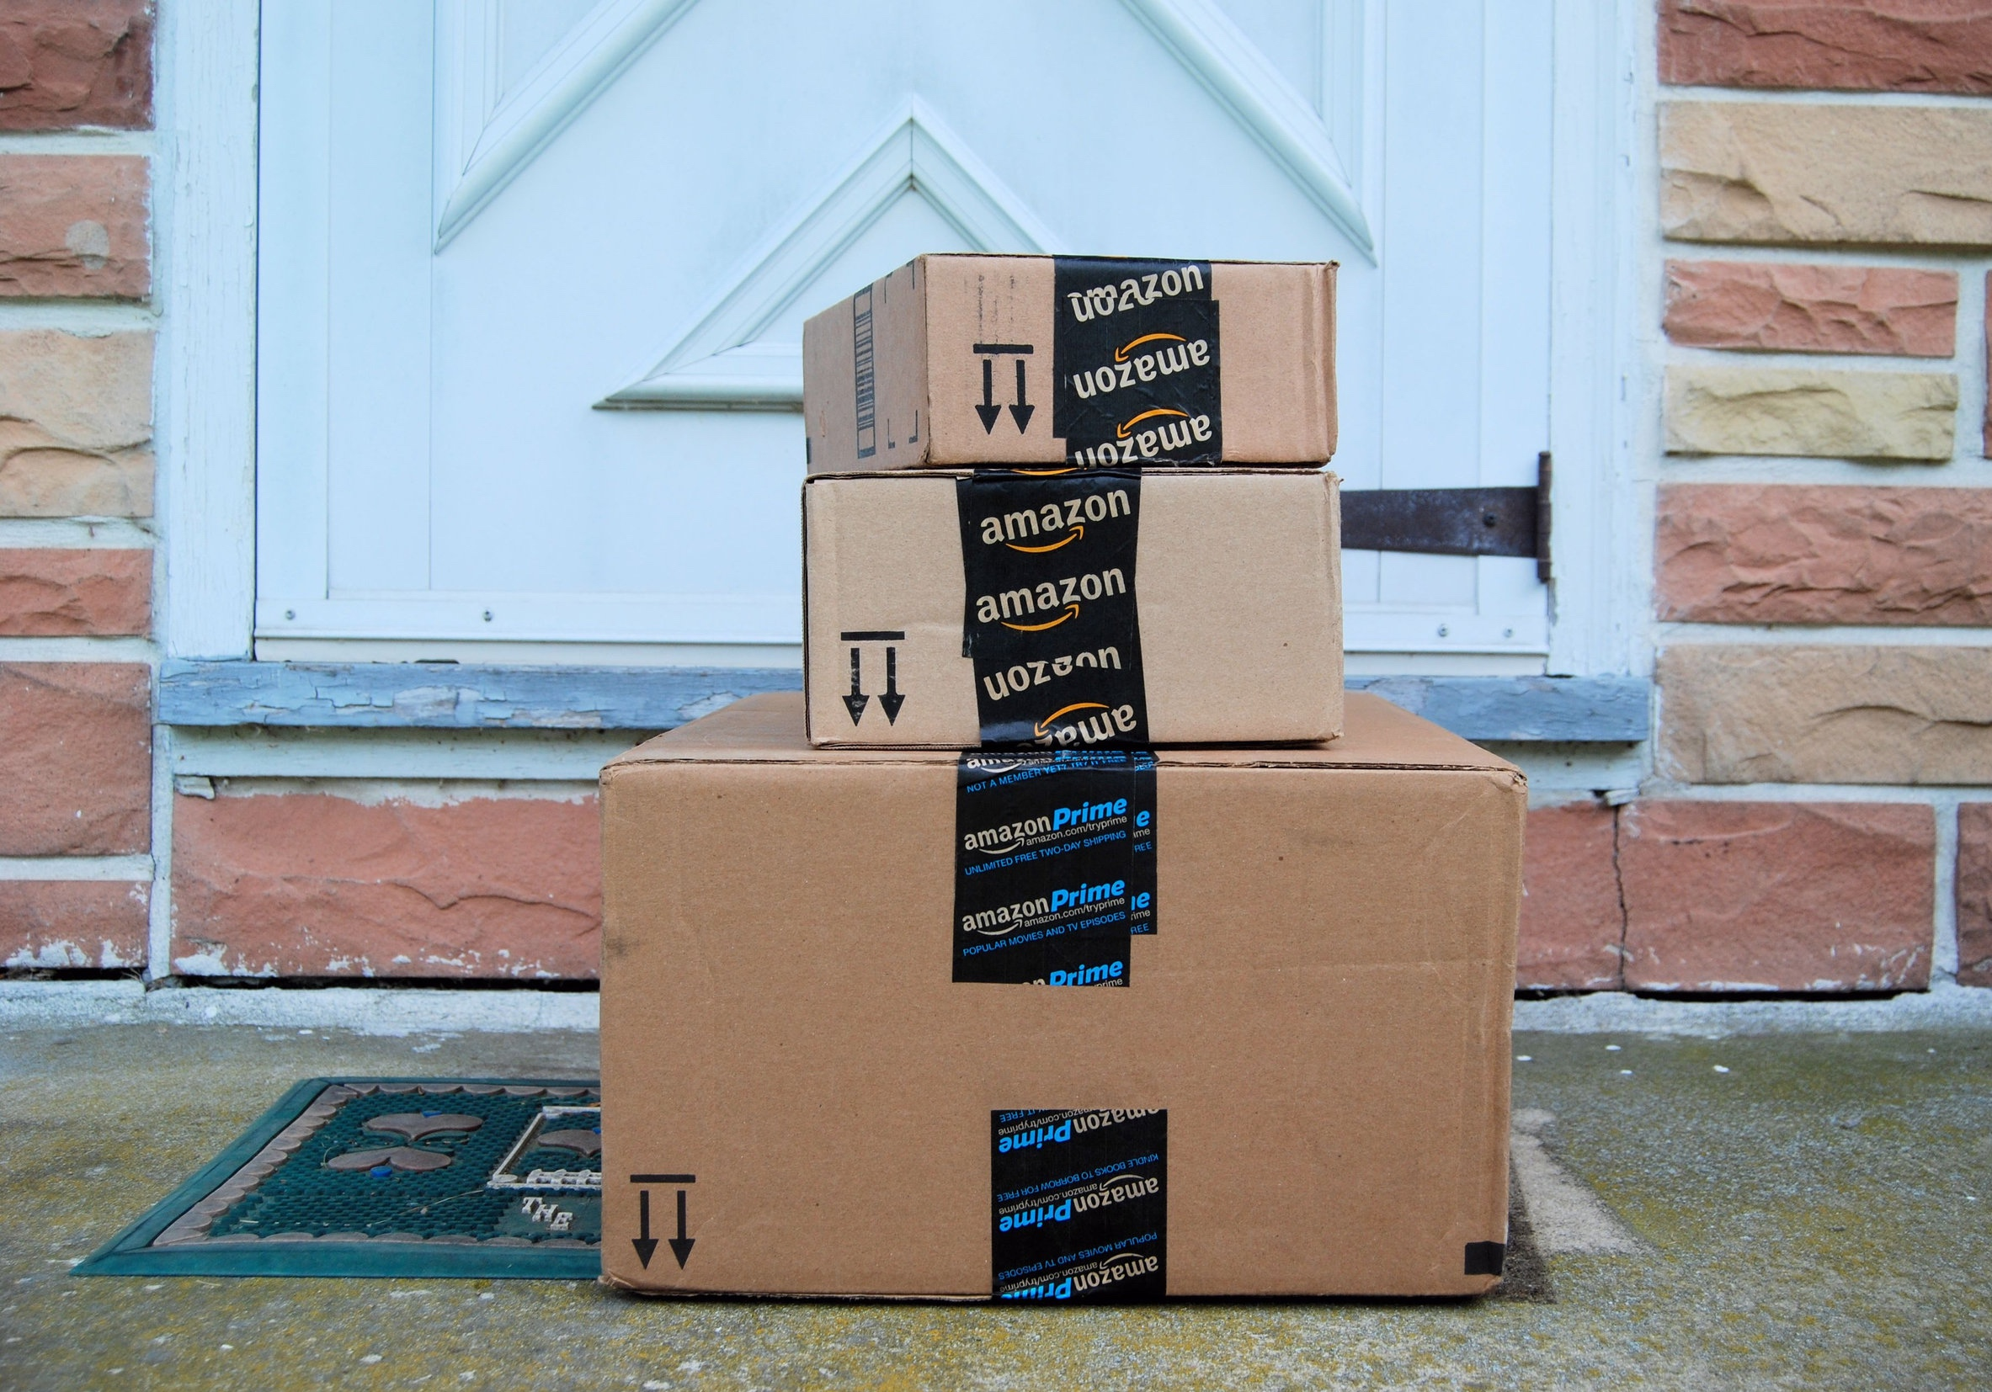
changed consumer expectations of the experience
© 2022 Market Insights | 2

Slide 3
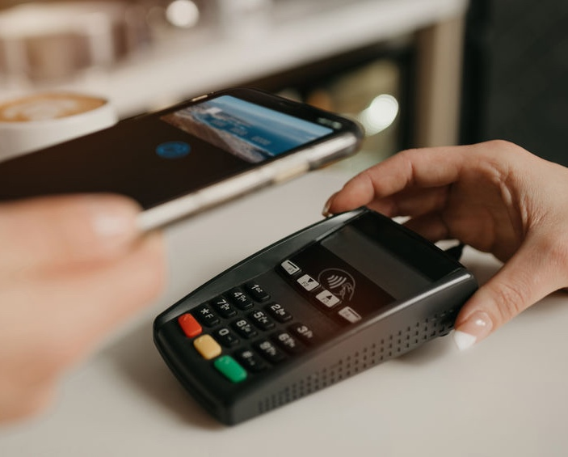
changed our relationship to cash and credit
© 2022 Market Insights | 3

Slide 4
changed the geography of competition
© 2022 Market Insights | 4

Slide 5
changed the relevance of brick and mortar
© 2022 Market Insights | 5

Slide 6
changed the workforce and the workplace
© 2022 Market Insights | 6

Slide 7
recalibrate strategies
reimagine CX
reshape culture
© 2022 Market Insights | 7

Slide 8
© 2022 Market Insights | 8

